Slide 1

Stocksbridge Nursery Infants
Phonics Screening Check 2026
Janine Hutchinson
Your name

Slide 2

What is Phonics?
Children begin to learn phonics (sounds) in the Early Years; both Nursery and Reception. They then continue to learn phonics in Year 1 and Year 2
We use Monster Phonics as our validated phonics scheme.
Once children begin to blend sounds together, they use this knowledge to read words.
Once a child’s reading has progressed, they develop segmenting for writing skills; breaking a word up into sounds to spell.

Slide 3
What is the Phonics Screening Check?
Eleven or so years ago, the DfE announced that all children in Year 1, in England, would be taking part in a statutory Phonics Screening Check. This has continued each year.
The Phonics Screening Check is designed to confirm whether individual children have learnt sufficient phonic decoding and blending skills to an appropriate standard.

Slide 4
What happens during the check?
The check contains 40 words.
Each child will sit one to one and read each word aloud to their teacher.
The check will take approximately 4-10 minutes per child although all children are different and will complete the check at their own pace.
The list of words the children read is a combination of 20 real words and 20 pseudo words (nonsense words).

Slide 5
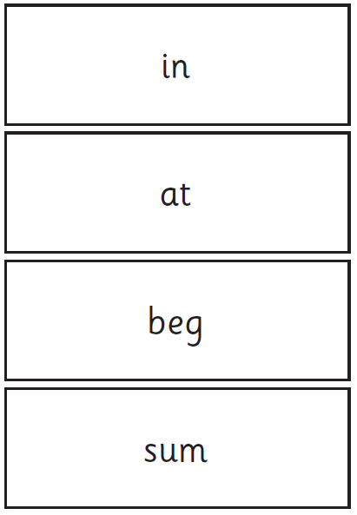
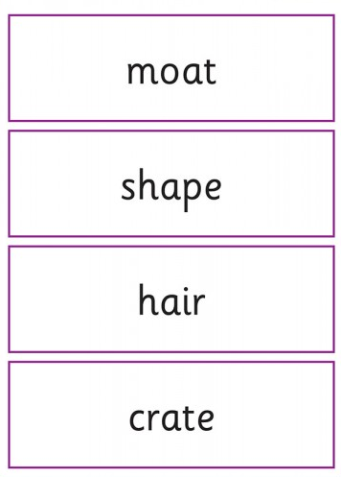
Example of the Real Words:

Slide 6
Pseudo Words (Nonsense/Alien Words)
The pseudo words will be shown to your child with a picture of an alien. This provides the children with a context for the pseudo word which is independent from any existing vocabulary they may have.
Pseudo words are included because they will be new to all pupils. They do not favour children with a good vocabulary knowledge or visual memory of words. It is purely to assess their ability to phonetically decode.

Slide 7
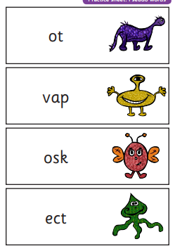
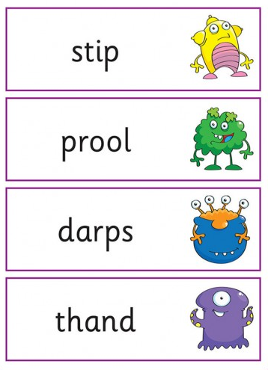
Example of the Alien (Pseudo) Words:

Slide 8
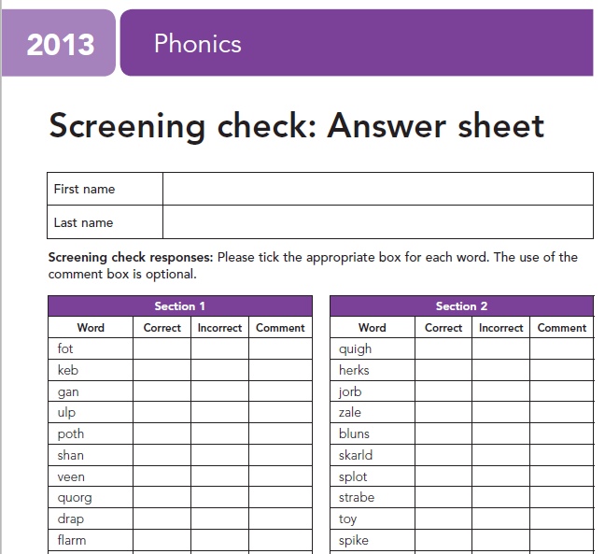
Example of the teachers scoring sheet:
We put a tick in the correct column if the child reads the word accurately.
We also tick the incorrect column if the child does not get the word correct because we do not want them to feel anxious if they see a cross or a dot which could then impact negatively on the rest of the phonics check.

Slide 9
Reporting the results
By the end of the Summer term, all schools must report the results to the Local Authority.
Data from the Summer check will be used by DfE to determine which pupils have not met the expected standard in phonics.
Y1 Children not meeting the standard in June will be able to re take the check the following year (when they are in Year 2).
You will be notified of the results after they have been submitted and collated by DfE. Schools must report pupils’ results to parents in their annual reports.

Slide 10
Threshold
Schools are not made aware of the threshold until the phonics checks have been administered to avoid maladministration (cheating).
Historically, the pass rate has been 32 out of 40. This means that your child will need to read 32 out of 40 words correctly in order to pass the phonics screening test. It is important to note that the threshold can change from year to year and we will not know what the pass mark is for 2026 until the test has been administered.

Slide 11
Any questions?

