Slide 1

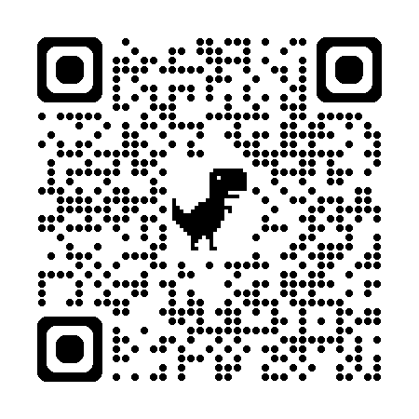
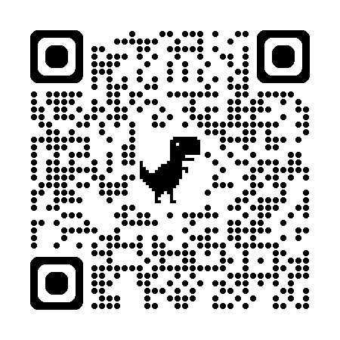
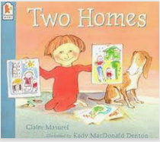
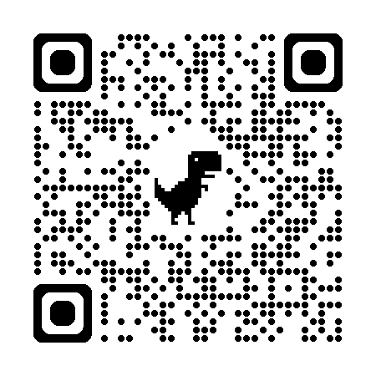
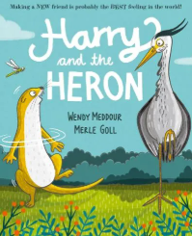
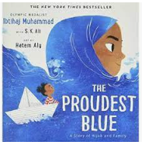

Autumn 1 Reception/Y1 : Me and my school in Stocksbridge
Key books this term:
You can access our key books either at the library or listen to the story being read via Youtube using the QR code.
This is a new book, so we have no QR code. However, we have ordered it and we will put it into a PowerPoint for you to enjoy.
Perfectly Norman
The Proudest Blue
Two Homes
The Friendship Bench
Harry and the Heron
Key Vocabulary:
Imagined – Form a mental image or concept of something.
Extraordinary – To be very unusual or remarkable.
Problematic – A thing that constitutes a problem.
Unbearable – Not able to be endured or tolerated.
Key Questions?
How do you think Norman feels when he grows his wings?
Why does Norman want to hide his wings?
Why did the picture become black and white?
Why did the colour return?
Key Vocabulary:
Curtsy – A formal greeting made by bending the knees with one foot in front of the other.
Whispered – Speak very softly using one's breath rather than one's throat, especially for the sake of secrecy.
Hijab – A head covering worn in public by some Muslim women.
Pounding – Walk or run with heavy steps.
Key Questions?
-How do you think Asiya feels throughout the story?
-Why do you think some children were mean to Asiya?
-How does Faizah feel when she see’s her sister?
Key Vocabulary:
Home – The place where one lives permanently, especially as a member of a family or household.
Favourite – Something or someone that is preferred to all others of the same kind.
Telephone – A very common device for communicating over a distance.
Ring – Contact someone using the telephone.
Key Questions?
-Why has Alex got two homes?
-Does he enjoy spending time at both?
Is Alex happy throughout the story?
How did Alex spend his time at his Mum’s house and his Dad’s house?
Key Vocabulary:
Friendship – The state of being friends.
Seagull – A type of bird that lives near the sea.
Beamed – Smile radiantly.
Key Questions?
-What does it mean ‘by the splash and curl of the sea?’
-Why wasn’t Shadow allowed to come into school?
-What might a friendship bench be?
-What does friendship mean to you?
-How did they fix the friendship bench?
Key Vocabulary:
Heron – A large fish-eating wading bird with long legs, a long S-shaped neck, and a long pointed bill.
Otter – A semiaquatic fish-eating mammal of the weasel family, with an elongated body, dense fur, and webbed feet.
River – A river is a large natural stream of water that flows over land.
Awful – very bad or unpleasant.
Key Questions?
Can an otter and a heron be friends?
What makes a kind friend?
How does it make you feel when someone is kind to you?

Slide 2

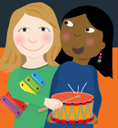
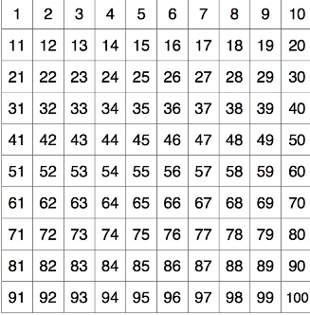
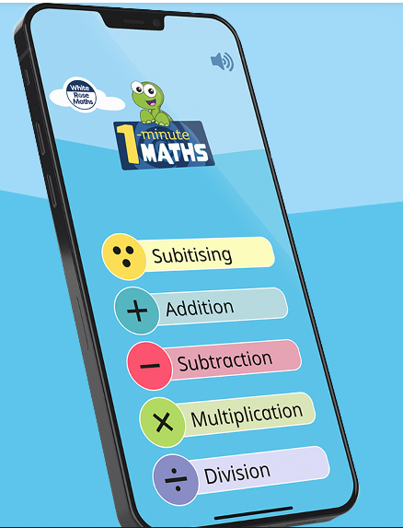





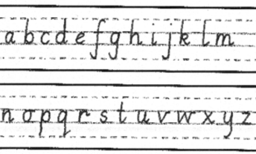
.
Understanding the World
History
Creative Development
Mathematics
Art
The children will be working on their counting skills with numbers up to 10. They will count out sets, sequence the digits, find out which sets of objects have more or less. The children will use their subitising skills to find out how many objects are within a group without counting and will then develop this skill into knowing number bonds by heart up to and including 10.
Please, download the White Rose 1 minute maths app.
The children will learn how to use line and tone in drawings. They will be working on drawing themselves and others by using observational skills.
Children will learn new information about their local area and how it came to be the way it is today. The children will learn about Samuel Fox and his significance to Stockbridge.
. Music
Geography
This term we will be exploring Pulse and Rhythm. For children to understand pulse, they need to feel it and the songs and activities suggested for this term will help them do just that! This term, the children will learn to recognise pulse, matching movements to music. They will explore percussion instruments and perform simple instrumental accompaniments to familiar songs.
The children will learn the differences between human and physical features of Stocksbridge including:
key physical features:: hill, mountain, sea, ocean, river, soil, valley, vegetation, season and weather
key human features: city, town, village, factory, farm, house, office and shop
We will also be studying our school grounds using aerial photographs and plans.
Personal, Social, Emotiona
l Development
PE
Indoor (Team Building) – This half term children will develop their teamwork skills. They will work individually, in pairs and small groups, learning to take turns and work collaboratively. They will develop key skills of communication and problem solving.
Outdoor (Ball Skills) – Children will explore and develop their fundamental ball skills such as throwing and catching, rolling and dribbling with both hands and feet. They will work on developing control and accuracy.
Please can you check that all clothing has your child’s name on it.
Thank you.
  AT HOME: Please read your school reading books and practise reading your tricky words regularly. Please log reading in your child’s reading diary.
English
Phonics and Reading
We continue to use the Monster Phonics scheme of work in school to teach phonics.
Our reception children will begin by learning single sounds in sets that can be blended together to read small words (for example- s a t p will be taught together as they can make simple words such as at, as, tap, sat
Year 1 is an important year for Phonics. In June the children will take part in a government assessment known as a ‘Phonics Screening check’ which checks how well children know and use their phonics skills to read.
We regularly assess how the children are progressing with their phonics and reading skills. You will be given a copy of any assessments we do and will also be given resources to help at home.
We encourage regular practise and engagement in reading through blending and practising new sounds using the resources that will be sent home. Regular reading practise using the books provided by school will also impact the progress your child makes.
Jigsaw – Being Me in My World
In this topic, the children are learning to understand what is fair and unfair, kind and unkind, right and wrong. Children will learn to feel happy and secure in their new class whilst celebrating the achievements of others.
Writing
Some children will be just starting out on their writing journey and others will be a little further along. Wherever your child is at, please do not worry as we will be helping and supporting them every step of the way.
For our reception children we will be developing pencil skills to form these pre-writing shapes,
before moving on to name writing.
For our Year 1 children, we will continue working on letter formation, word and independent sentence writing.
Science
This half term the children will learn to identify, name, draw and label the basic parts of the human body and say which part of the body is associated with each
sense.
RE-
The children will express creatively their own ideas about the questions:
Who am I? Where do I belong? How we all are connected?
Talk about the fact that people come from different religions. How can we tell? How can we live together when we are all so different? Find out what different religions do to celebrate the fruitfulness of the earth – focus on Christian Harvest Festival and Muslim Zakat (charitable giving).
.
Every Wednesday, your child will take part in different Forest School Activities. On a Wednesday, please send your child in their own clothes or clothes you don’t mind getting muddy.

Slide 3
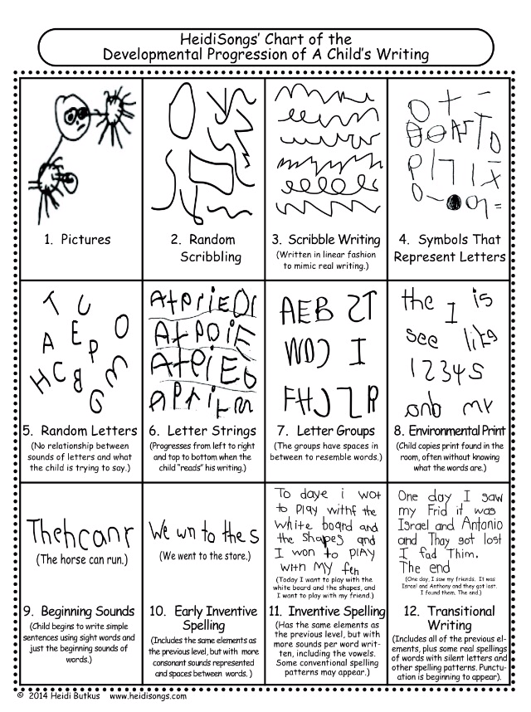
Writing progression- what writing might look like

Slide 4
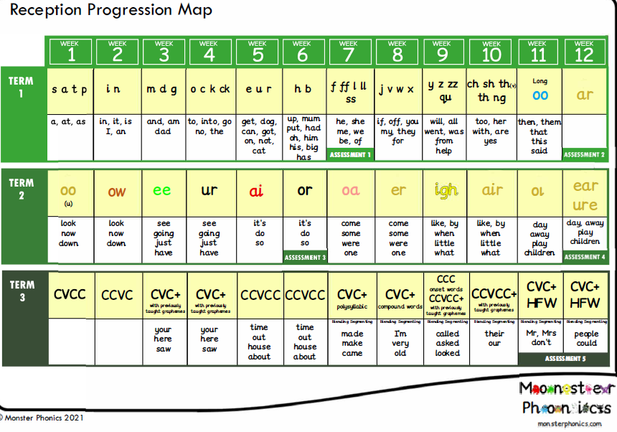
These are the sounds and words that your child should be able to read by the end of this half term..

Slide 5
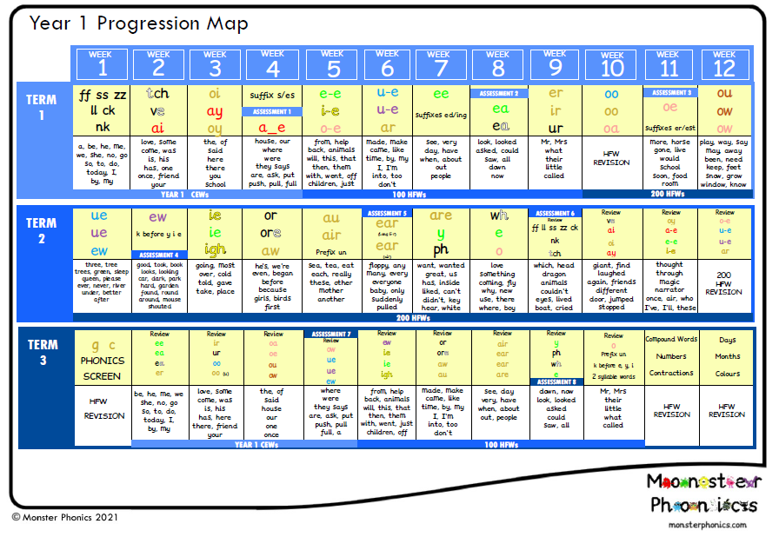
These are the sounds and words that your child should be able to read by the end of this half term..

Slide 6
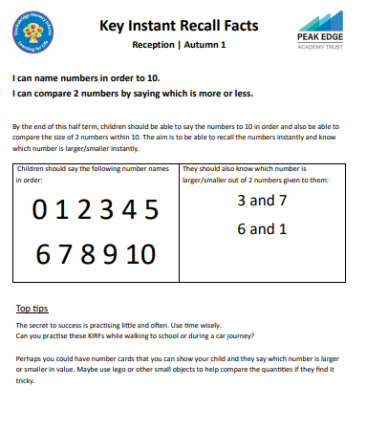
Reception Maths – Autumn 1
Please have a go at the following
maths activities and upload any work you do to Seesaw.

Slide 7
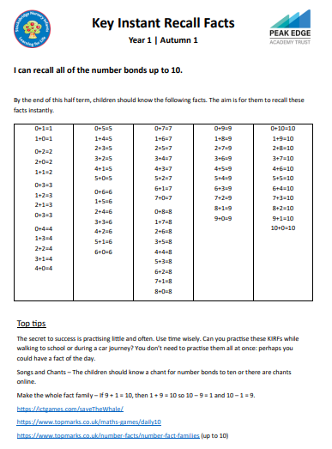
Y1 Maths – Autumn 1
Please have a go at the following
maths activities and upload any work you do to Seesaw.

