Slide 1
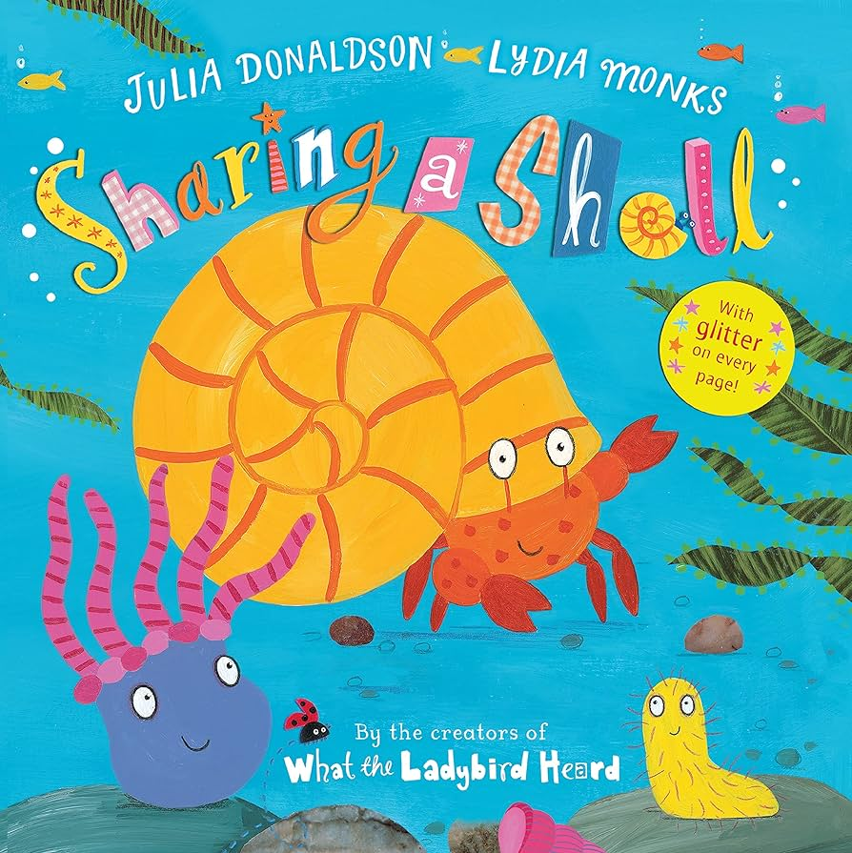
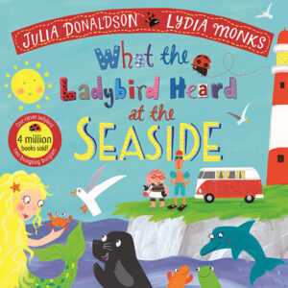
You can access our key books either at the library or listen to the story being read via Youtube.
Summer 2 Reception: What’s it like to be beside the seaside?
Key books this term
Key Vocabulary
Imagination- thinking about an object or thing that is not there or pretending one thing is something else
Peering- carefully looking inside something
Chuckled- quiet laugh
Key Questions?
I wonder why Billy wanted a bucket?
How did Billy feel about his Mum and Dad wanting to borrow his bucket?
What would you like for your birthday?
If you had a bucket what would be inside it?
Key Vocabulary
Armour- A covering to protect the body during battle
Millions- a very large number
Moulting-to shed feathers, hair or an outer skin in order to grow
Fossils- the remains of plants and animals that lived long ago
Key Questions?
What things might you see at the seaside?
Can you tell me about shells
How is a fossil made?
What do you like to do at the seaside?
Key Vocabulary
Tuneful- musical
Frowned- a facial expression used to show you are not happy with something
Thieves- someone who steals something that is not theirs
Brainy- very clever
Key Questions?
What animals live in the sea?
What did the ladybird hear?
I wonder what the thieves wanted to steal and why?
If you were a sea creature what would you be?
Key Vocabulary
Scuttle- using small fast steps to move around
Roaming- to move around in any direction
Ungrateful- not saying thank you
Sparkling- reflecting light
Key Questions?
Why did the crab decide to share it’s shell?
What is the difference between a crab and a hermit crab?
Why did they begin to argue and fall out?
If you were a hermit crab what type of shell would you like to live in?
Key Vocabulary
Commotion- A sudden movement including noise
Batch- a group of something
Blubber- fat that keeps some animals warm
Iceberg-A huge piece of floating ice
Key Questions?
What creatures can you name that live in the sea?
What under the sea creature would you be and why?
Can you make up a poem about a sea creature?
Key Vocabulary
Pirate- people who sailed the world on ships
Anchor- A device which is lowered to the seabed to shop a ship/ boat from moving
Shore- the land beside an ocean
Booty- a pirate word for treasure
Key Questions?
If you where a pirate what treasure would you hunt for?
What treasure where these pirates looking for? Why did they want it?

Slide 2
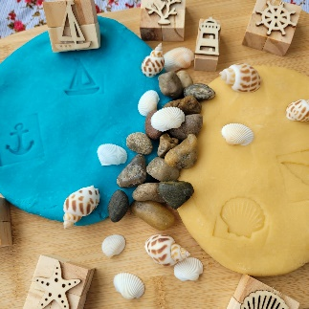
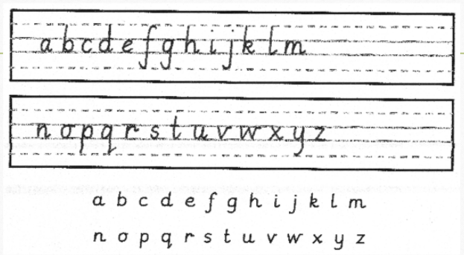
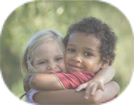
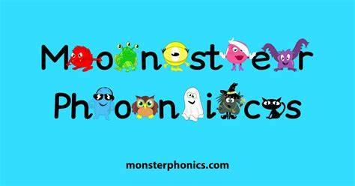
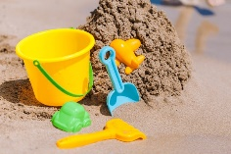
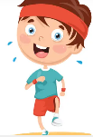
.
Mathematics
Understanding the world
Physical development
Physical development
We follow the White Rose scheme for maths, incorporating numicon and number blocks to support our maths.
Playdough and clay
To support the manipulation and strength in the hand muscles we will be doing Dough Disco in class. This is a programme of activities for the children to do using playdough to music. There will be playdough in provision for the children to play with, mould, cut and roll.
We will then develop our skills further in Art and use clay. Manipulating, rolling and pinching to make seaside sculptures.
Sharing and grouping – The children will recap on sharing and grouping from last half-term. The children will learn how to identify whether a number is odd or even by sharing objects into two groups.
Visualise, build and map – The children will deepen their understanding of different patterns, and will begin to develop a secure knowledge of pattern rules and the ability to verbalise their thinking and explain it to others.
The children will also learn about spatial reasoning. They will replicate scenes in the small-world and construction areas, as this will develop their thinking as to where objects are in relation to each other. This is the beginning of mapping.
Consolidation – We will have opportunities to revisit prior learning.
Letter formation
This is an important skill in learning to write. We continue with our
handwriting sessions in class and will be sending home sheets
to practise letter formation at home.
Please encourage your child to hold their
pencil correctly using a tripod grip.
The natural world
Inline with our topic we will look at our own community Stocksbridge and its surroundings and compare them to the seaside. We will talk about differences and similarities between both places.
We will talk about the importance of how to look after these natural places and the consequences to humans and animals when we don’t.
We will look at animals and plants in seaside habitats. Animals and plants that live under the water, those that live in the air and on land. We will name different and label body parts of different animals e.g. a dolphin, fin, beak, flipper.
We will go back to the community allotment and observe the differences and similarities from the last visit in August. Questioning changes and why and linking our answers to the different seasons.
Threading and Weaving
Linked to D.T this half term we will be threading laces, string and other materials
through cogs, buttons and holes in boxes.
We will be weaving using paper and other material inside and natural materials
outside in the fences and using our loom on the field.
AT HOME: Share some objects (e.g. coins, marbles, toys) between two people. Talk to your child about whether the number of objects they have shared, can be shared out equally or not.
Please complete the maths KIRF. We will be sending these out and putting them on Seesaw.
AT HOME: Please continue to practise handwriting sent home weekly. Practise
buttoning t shirts and zipping coats up. If you would like to have a go at Doh Disco
there are many to choose from on You Tube.
PSED
Expressive arts and design
Jigsaw
Phonics/ English
English We link our writing to our book. This half terms theme is the seaside. We will be writing words and sentences about the seaside.
We are writing sentences that a teacher has dictated and some on our own.
AT HOME: Say a short sentence for your child to write. For example, At the seaside. They could draw a picture too and upload it to Seesaw.
In D.T we will explore different materials and which ones float and which ones sink. We will use our knowledge to make a boat to float on water.
This half-term, the theme is Changing Me.
We will be talking about everyone being unique and special. The children will be able to express how they feel when change happens. They will understand and respect the changes they see in themselves and others.
The children will also share their memories of their best bits from Reception and say what they are looking forward to in Year One.
People and Communities
Reading
Your child is coming home with two books every week. A coloured book and a numbered book. We would like the children to read the numbered book as fluently as they can. The coloured book is to read and about comprehension. Please read together and ask you child questions.
You can still access the e-books on Monster Phonics using your unique log in codes.
Sounds
We are following the Monster Phonics programme and will be teaching the following sounds this term:
Week 1 – CCVCC (Consonant, Consonant, Vowel, Consonant, Consonant Words) – stand, blank, twist, crust
Week 2 and 3 – CVC (Consonant, Vowel, Consonant Words) and Polysyllabic words – shampoo, giftbox, helper, windmill
Week 4 – Words that begin with three consonants – scratch, splash, squash, three.
Week 5 – CCVCC words with previously taught digraphs (two letters that make one sound.) - stamp, blink, frost, crept, grunt
Week 6 and 7 – CVC (Consonant, Vowel, Consonant words) and High-Frequency words.
Art and Design
This half term we will look at people who live and work at the seaside. There jobs and roles around the sea. We will look at the life guards and what they do to help people. We will look at the different shops at the seaside and compare the similarities and differences between Stocksbridge shops and those by the sea.
We will discuss if the seaside is just somewhere for holidays or if people live there like we do here in Sheffield. Asking do children go to school at the seaside? Do adults go to the supermarket? Do people drive there? Or do all people that go to the seaside just go to play on the beach?
We will continue to create still life pictures of shells and other seaside objects using pencils concentrating on shade and tone.
This half term we will look at 3D sculpture and form. Using clay, playdoh and junk modelling to construct different seaside sculptures.
AT HOME: Look at pictures of your family from when they were little. Discuss how they have changed and compare to children’s life now
Keywords
(High-Frequency Words)
These are words that the children should just say and not sound out.
These are the words we are focusing on this half-term:
Week 1 – time, out, house, about
Week 2 – made, make, came
Week 3 – I’m, very, old
Week 4 – called, asked, looked
Week 5 – their, our
Week 6 – Mr, Mrs, don’t
Week 7 – people, could
Music
PE
Outdoor – In this unit, children will practise and further develop their fundamental movement skills through the topic of 'around the world’. The children will learn and develop these skills by playing a variety of games.
We will continue using our music scheme, Sparkyard. This half-term begins with opportunities to tell playful stories using voices and tuned instruments.
AT HOME: Please read your school reading books and practise reading your keywords regularly. Please log reading in your child’s reading diary.
Religious Education (RE)
AT HOME: If you have been to the seaside with your child, talk with them about what they remember. What did they enjoy doing and what did they not enjoy doing.
Indoor – In this unit, the children will create different shapes and then put them into a sequence. They will pretend to be different types of creatures that live under the sea.
Children will learn different stories from different religions. They will find out why these might be special to a believer.
Remember to log any home learning onto Seesaw. If you need reminders of your login details, please get in touch with your child’s class teacher.

Slide 3
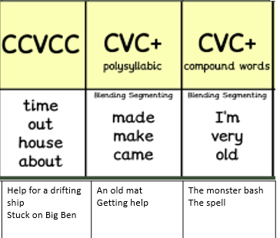
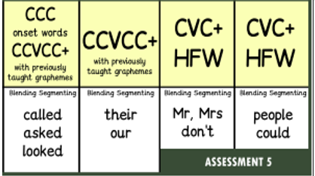
Reception Summer 2
These are the sounds and words that your child should be able to read by the end of this half term. The e-book titles correspond to the sounds and words taught each week.
Recap any books from Summer 1.

