Slide 1
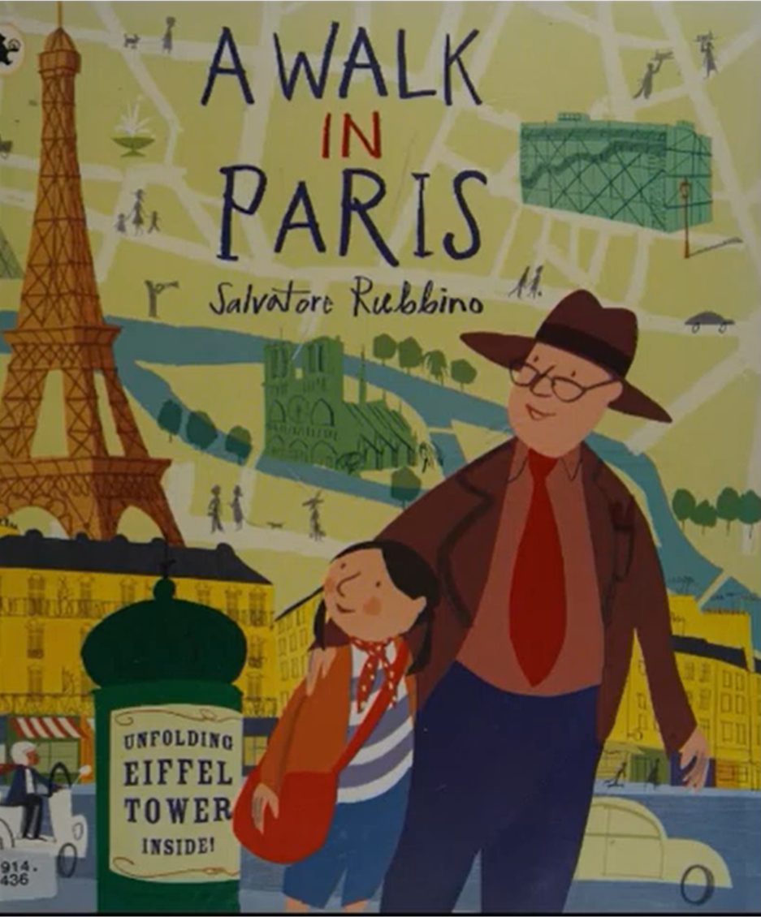
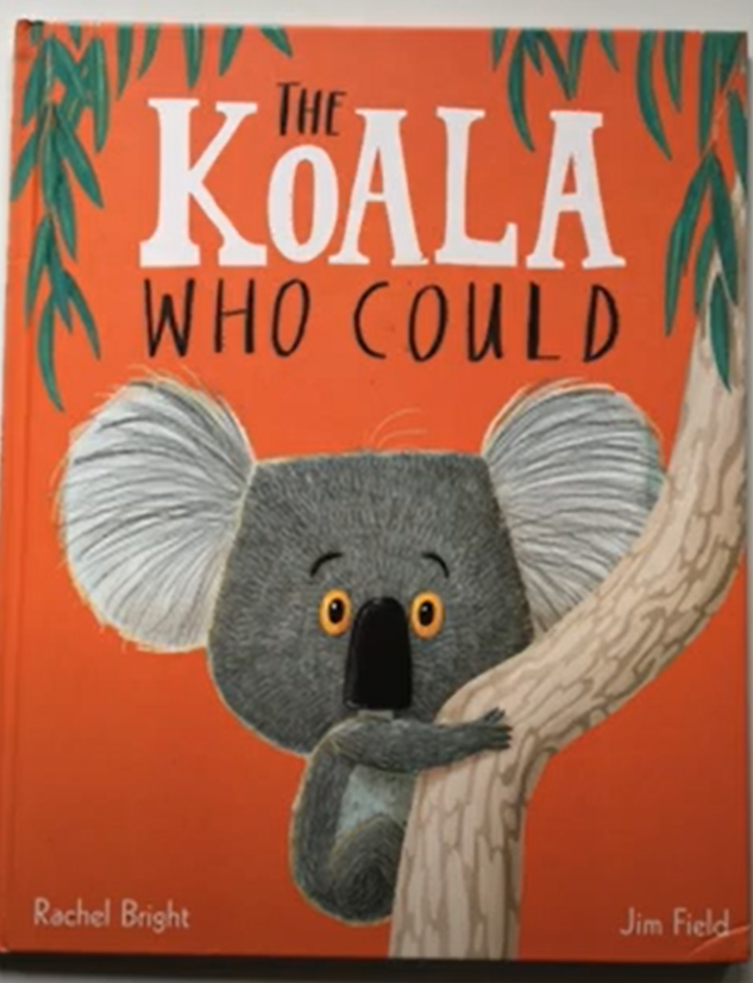
Summer 2 Reception: The places we will go.
You can access our key books either at the library or listen to the story being read via Youtube.
Key books this term
Key Vocabulary
Metro- French train system
Lean- Can they lean?
Boulevard- Streets
Queue- Line up
Bistro- French Café
Formidable- Inspiring
Broad- Wide
Souvenir- A gift from a place to remember it by
Key Questions?
Key Vocabulary
Guava- a type of tropical fruit
Separate- pull apart, not together
Bursts- to break open suddenly
Erupts- break out suddenly
Friendship- a relation ship between friends
Forgiveness- when somebody has done or said something to upset you then you have a change in feelings and forgive their actions.
Key Questions?
Key Vocabulary
Exhibits- a display of artwork.
Enormous- very big
Hotel- somewhere to stay on holiday.
Traditional- Something that happens again and again.
Collapse- fall down
Roaming- moving around
Historical- something that has happened in the past
Climax- The end
Key Questions?
Key Vocabulary
Dawning- when the sun is rising in the morning
Clung- cuddle tight
Preferred- the one you like the best
Dingos- A wild animal that lives in the Australian outback.
Wallop- to hit something very hard
Key Questions?
Key Vocabulary
Unfurl- unfold
Salute- a sign to show respect.
Trill- Repeated high noise.
Preferred- the one you like the best
Flit- To move quickly.
Plume- shows off
Key Questions?
Key Vocabulary
Delicious- very tasty
Village- a community, a small town
Soft-
Juicy- lots of juice inside
Ripe- ready to eat
Tangy- strong flavour
Key Questions?
Key Vocabulary
Whisper- talk quietly
Chattering—talking a lot
Quivers- Shakes
Gangly- tall
Ferocious- scary
Prowling- walking really slowly
Key Questions?

