Slide 1
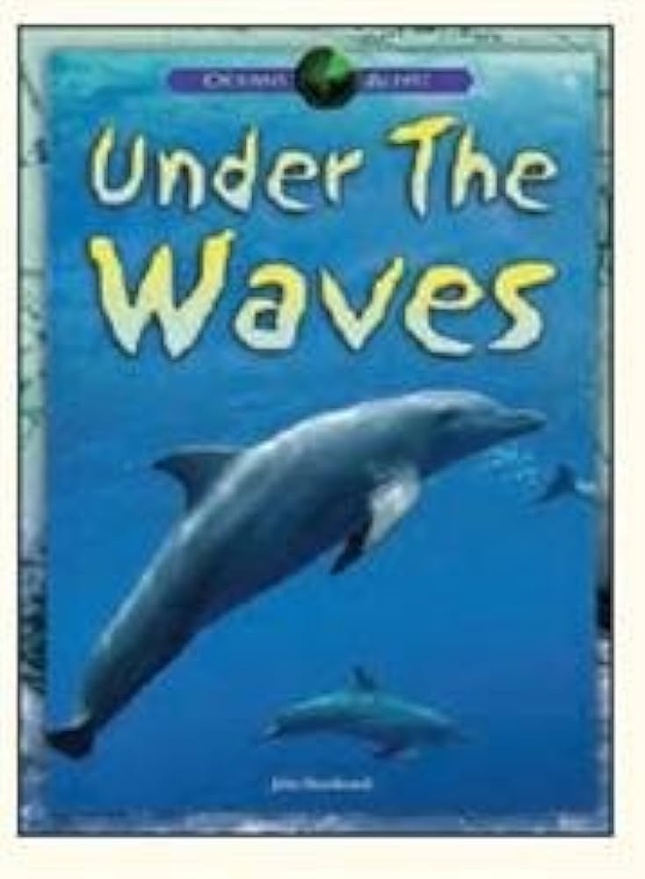
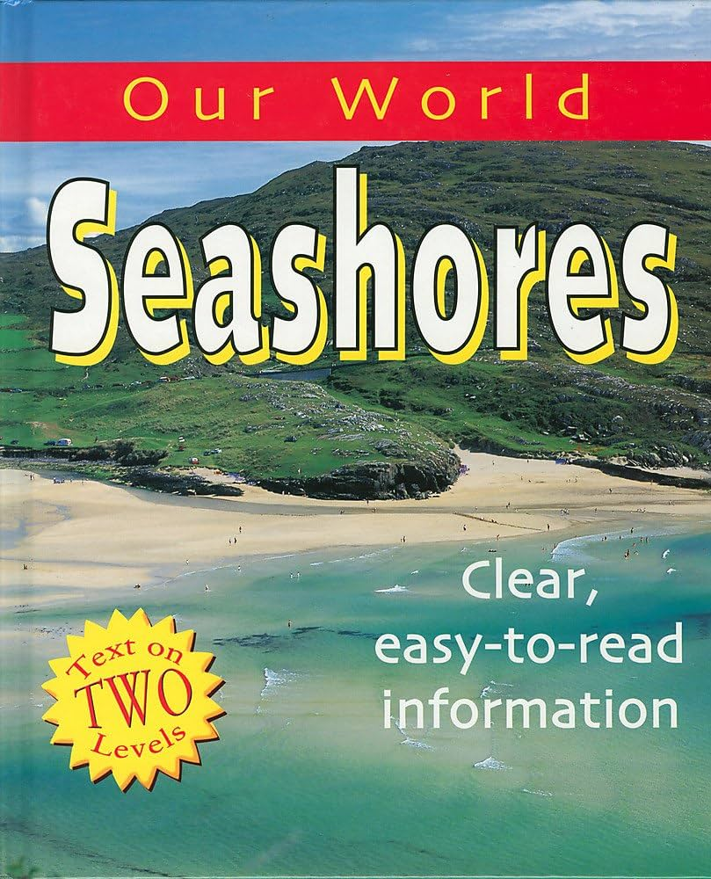

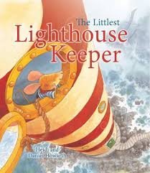
Summer 2:Seasides and Coasts
Key books this term
The secret of black rock
The littlest lighthouse keeper
Under the waves
Our world seashores
Key Vocabulary:
Anchor – heavy object used to moor a ship to the sea bottom.
Translucent – an objects which lets light through.
Glimpse – to partly see an object or person.
Loomed – a large object to gradually come into sight.
Key Questions?
What is the secret of the black rock?
Why do the adults want to destroy it?
What happens to Erin?
Do you think she enjoyed her time in the water?
How did she stop the adults from destroying the rocks?
How does everyone feel about the rock at the end of the story?
Key Vocabulary:
Lighthouse – a tower containing a beacon light used to warn/guide ships.
Scampered – run with quick, light steps.
Trembling – shaking or quivering.
Bay – inlet of sea where the land curves inwards.
Key Questions?
What is a lighthouse?
What does a lighthouse keeper do?
Why is a lighthouse keeper’s job important?
How do lighthouses keep ships and boats safe?
Would you like to be a lighthouse keeper?
Key Vocabulary:
Colonies – groups of living things that live together in the same place.
Coral reef – structure built by a large group of coral with chalky skeletons. Corals are small, sea anemone-like animals.
Currents – flow of ocean water.
Gills – parts of a fish’s body through which it breathes.
Key Questions?
What animals live in the coral reef?
Are all sharks dangerous?
What is your favourite fish in the ocean? Why?
What is a current?
Where is your favourite place in the book?
What is unique about a sargassum fish?
What happens when ocean currents collide?
Key Vocabulary:
Estuary - where a river meets the sea or ocean. There is a mixture of freshwater and saltwater in an estuary.
Food chain - limpets eat seaweed and dog whelks eat limpets. So the seaweed, limpets and dog whelks form a food chain. They rely on each other for food.
Habitat - the place in which a plant or animal live.
Predator - a flesh eating animal.
Rootlet - a small root. Some seaweeds have rootlets to hold onto rocks.
Siphon - a long tube through which some animals eat.
Key Questions?
How could you help to take care of the seashore?
What do turtles do when they visit the seashore?
What do seashore fish do at low tide?
What is the sand on a sandy beach made from?
Why do sea otters wrap themselves in seaweed?
Why do seabirds have different shaped beaks?

Slide 2
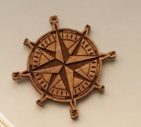
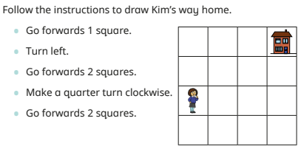
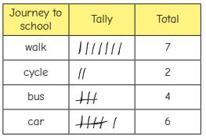


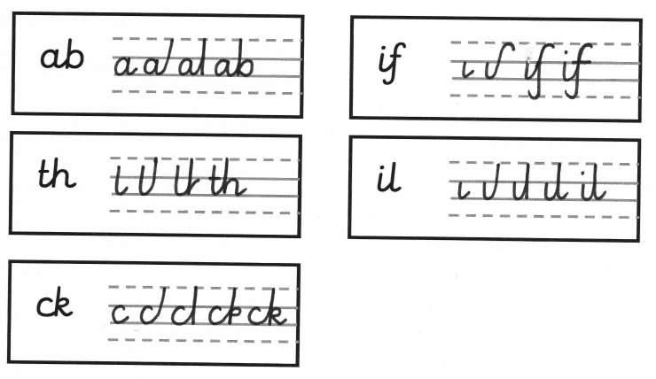
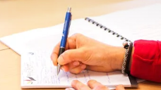

Geography
Mathematics
.
History
We follow the White Rose Scheme for maths, incorporating mathematical apparatus to support understanding.
Children will learn to identify the characteristics of a typical seaside holiday. They learn how seaside holidays have changed over the last 100 years. The children will use photos, paintings and written accounts to compare and contrast the differences.
Children will use maps to identify coastal, landlocked and upland landscapes. Children will learn the geographical features of coastal landscapes and compare and contrast these to the geographical features in our local area. Children will use this knowledge to create their own maps using symbols and keys. We will also be recapping the 4 countries of the United Kingdom.
Statistics
Children will be comparing tally charts and tables to analyse data. They will be collecting their own data and creating block graphs and pictograms.
Science
This half term will be about putting our investigative skills to the test when we go in search of the best material to make a lens in a pair of sunglasses. We will be looking at different materials and their properties and putting them to the test. It’s going to be fun!
Position and Direction
Children will be using positional language (left, right, forwards, backwards) and will be describing turns. This is a very practical and fun unit that you can practise at home!
  AT HOME: Discuss a time with your child when they have visited the seaside.
RSHE
Computing
Learners will be introduced to on-screen programming through ScratchJr. Learners will explore the way a project looks by investigating sprites and backgrounds. They will use programming blocks to use, modify, and create programs. Learners will also be introduced to the early stages of program design through the introduction of algorithms.
Art
Handwriting
English
  Our Jigsaw theme this half term is Changing Me. As part of their RSE learning, children will learn to identify physical differences in their bodies, name body parts, understand privacy and discuss their feelings about being a boy/girl.
Children will be inspired by Van Gogh ‘Boats on the Sea at Saintes Maries-de-la-Mer’ to create their own line drawings building on the skills they have learnt throughout their time in KS1.
Persuasive Writing
This half term will see the children practising their persuasive writing skills, using their own experiences to convince.
We will continue to focus on spelling, punctuation and grammar, including speech marks and apostrophes.
PE
Indoor PE will focus on team building games and playing fairly. In outdoor PE the children will be playing net and wall games, which will develop the children’s understanding of attacking and defending principles.
Reading
We continue to work on reading with fluency, pace and accuracy now the children are becoming less reliant on decoding through phonics. Our daily reading sessions introduces new vocabulary and works on the children’s comprehension skills.
RE
What makes some places special to believers?
The children will learn about mosques, churches and synagogues. They will learn about why these are important to believers and about similarities between them.
Music
The children will be learning and performing a range of songs. You will be able to hear some of these during the Y2 Leavers assembly!
We will also continue with our drumming sessions on a Thursday afternoon.
Spellings
Spellings will continue to be sent home each Friday. It is important that the children practise these and spell them correctly in their independent writing.

Slide 3
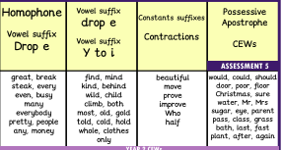
Year 2 Summer 2
These are the sounds and words that your child should be able to read by the end of this half term. The e-book titles correspond to the sounds and words taught each week. These words will also be the weekly spells that will be checked on a Friday.
Week 1 | Week 2 | Week 3 | Week 4 | Week 5 | Week 6 | Week 7
Recap the year’s sounds and key words. Practise spelling words.
E-book Titles | Recap any books that you haven’t read

Slide 4

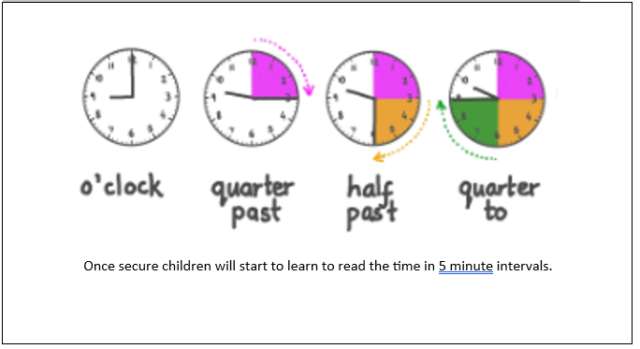
Top tips
The secret to success is practising little and often. Talk about time - Discuss what time things happen. When does your child wake up? What time do they eat breakfast? Make sure that you have an analogue clock visible in your house or that your child wears a watch with hands.
Ask your child the time regularly – You could also give your child some responsibility for watching the clock:
“The cakes need to come out of the oven at quarter past four.”
“We need to leave the house at half past eight.”
I can tell the time to the nearest hour.
I can tell the time to the nearest half hour.
I can tell the time to the nearest quarter hour.
By the end of this half term, children should be able to read the analogue clock times below instantly.

