Slide 1
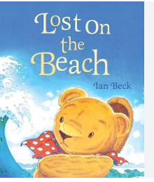
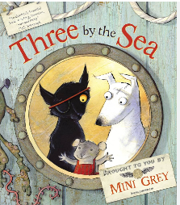

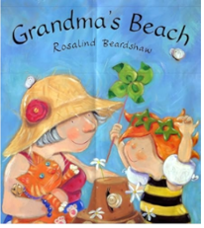
Summer 2: How I do like to be beside the seaside.
Key books this term
Rosie’s Holiday
Grandma’s Beach
Lost on the Beach
Three by the Sea
Key Vocabulary:
Holiday: spend time in a specific place.
Beach: a narrow strip of land that borders a body of water.
Shells: the hard outer layer of a creature.
Key Questions?
Where have you been on holiday?
Have you ever been going on holiday and not wanted to leave your home?
What fun things have you done on holiday?
Why do you think Rosie doesn’t want to go on holiday?
Did Rosie change her mind in the end?
Why do you think she changed her mind?
Key Vocabulary:
Seaside: area near the sea where people spend their holidays and enjoy themselves.
Rock pool: small pools of water that form along the coastline.
Sandcastle: a model of a castle built out of sand.
Tide: the rise and fall of sea levels.
Key Questions?
If you were going to the beach, what would you pack?
What would you wear if you were going to the seaside?
What has Grandma done for Emily?
When Emily is on Grandma’s back, what seaside activity are they doing?
Do you think Emily had a good time at Grandma’s beach? How do we know?
Key Vocabulary:
Handkerchief: a square of cotton.
Crab: a creature, with claws, found at the beach.
Seagulls: a type of seabird that lives around the seaside.
Paddle: move through the water on a boat or shaft.
- Waves: disturbances in the surface of the ocean.
- Surfing: a sport that is riding the waves.
Key Questions?
Have you ever lost anything? How did it make you feel?
Have you ever got lost from your family or friends? How did it make you feel?
How do you think Teddy was feeling when he felt trapped?
Have you ever seen a seagull or crab?
How do you think Lily would have felt if she knew what had happened to Teddy?
Key Vocabulary:
Sea: a large body of salty water.
Shore: the land along the edge of the sea.
Beach hut: a small wooden, often brightly coloured box, near the beach for people to sunbathe and sleep in.
Discontented: not happy or satisfied with something.
Eiderdowns: a duvet.
Fondue: melted cheese.
Key Questions?
Have you ever been in the sea? What did it feel like?
What might go wrong for the mouse, dog and cat?
How do you think the cat, dog and mouse are feeling about this stranger?
Do you think they are pleased he’s come?
Why were the three friends arguing?
Why did mouse want to go somewhere else?
Should mouse have gone into the water on his own if he can’t swim?

Slide 2
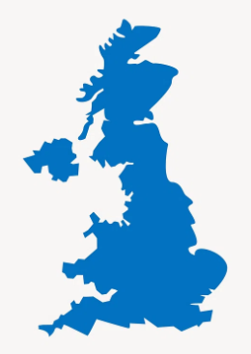


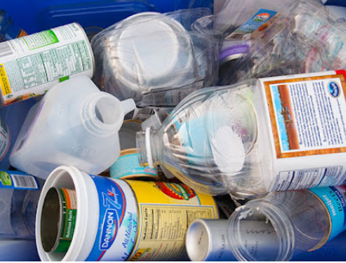
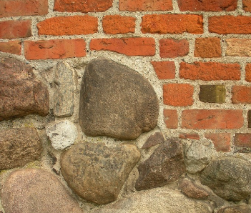
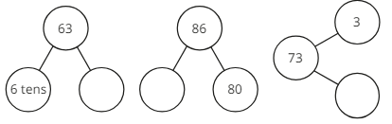
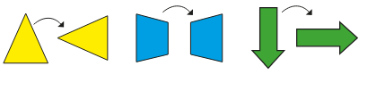
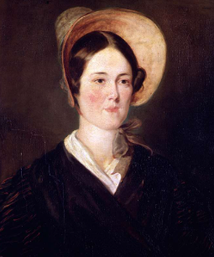
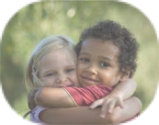
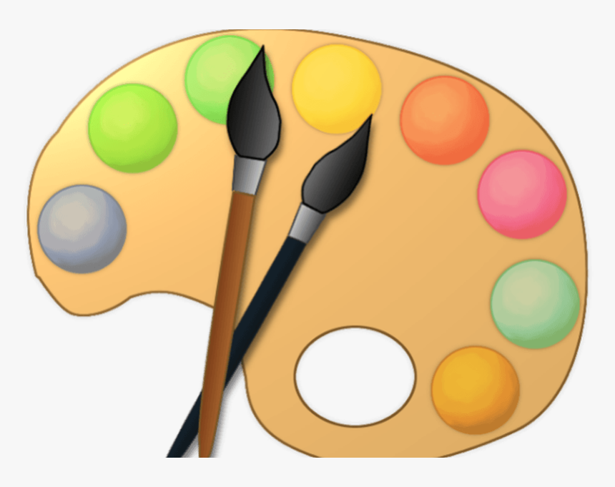

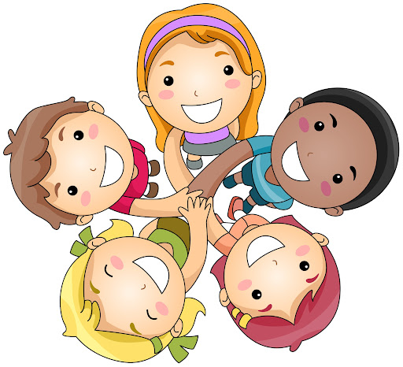

Place Value (within 100)
Science
.
Mathematics
Children will be learning to describe the simple physical properties of a variety of everyday materials. Using their knowledge on properties children will be grouping together a range of everyday materials using their simple physical properties.
Measurement – money and time
Children will explore numbers 50 to 100. They will practise counting forwards and backwards. Children will explore through the use of apparatus and visual representations the number of tens and ones in a number from 50 to 100. They will use the numberline method to plot numbers. Children will also compare two numbers.
Children will learn to recognise coins and notes and will use their knowledge of coins to count. .
Children will learn about the days of the week and months of the year.
Children will also focus on seconds, minutes and hours supporting them in telling the time to the half hour and to the hour.
Geography
The children will be continuing to learn how to use simple compass directions (North, South, East and West) and will begin to focus on the human and physical features of a seaside town and compare these to the features of Stocksbridge. Children will also be devising their own map with a key.
The children will be learning about the life of Grace Darling and the significant part she played in the rescuing of survivors from a wrecked merchant ship in 1838. We will also be focusing on how visits to the seaside have changed over time.
Geometry – Position and direction
Children will learn how to describe turns and positions. They will use mathematical language such as forwards, backwards, above, below, left and right. Children will describe turns using half turn, full turn, quarter turn or three-quarter turn.
  AT HOME: Practise counting in steps of 2, 5 and 10.
Reading
Please continue to practise reading regularly at home. It doesn’t matter what the reading material is- comics, leaflets, books, poetry etc. It all counts. School reading books will also be sent home.
We aim to promote a love of reading in school and all of our learning comes from quality books.
English
RSHE
Art
History
Phonics
We are continuing with our new scheme Monster Phonics and the children are loving it. Please keep up to date with the sounds and words we are learning each week using the grid on the following page.
Please read the e-books on the monster phonics website. You should have received a new log in from Monster Phonics directly. If you haven’t use this link.
https://ebooks.monsterphonics.com/register/standard-school/?ca=282bccec0f3a2379c9ff4c6075b28fa1
The children will be developing a wide range of art and design techniques in using colour, pattern, texture, line, shape, form and space.
Children will know about great artists, craft makers and designers, and understand the historical and cultural development of their art forms,
whilst making links to their own work.
  Jigsaw
  We follow a scheme called Jigsaw to focus on PSHE and RSHE in KS1. This term we will be focusing on change. We will be discussing the life cycle and how our bodies can change, as well as learning how to cope with changes and moving forwards.
Year 1 Writing – Persuasion.
In Year 1 this term we will be analysing captions, pictures, posters and adverts that are aiming to persuade. Through the use of games and role play children will begin to explore what it means to persuade or be persuaded and which different methods are effective.
We will also be taking a look at acrostic poems about the seaside. The children will be analysing and exploring how acrostic poems are written in preparation for writing their own.
R.E
The children will focus on how we should care for the world and how different religions do this. We will also learn about caring for each other and recognising that each person is unique.
Music
The children will be learning how to play and sing melodies that move up and down by step.

Slide 3
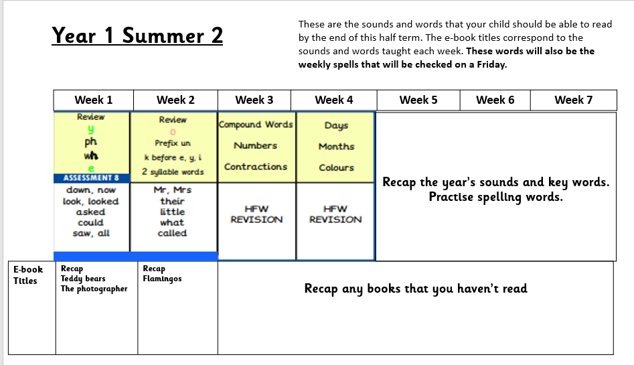

Slide 4
