Slide 1
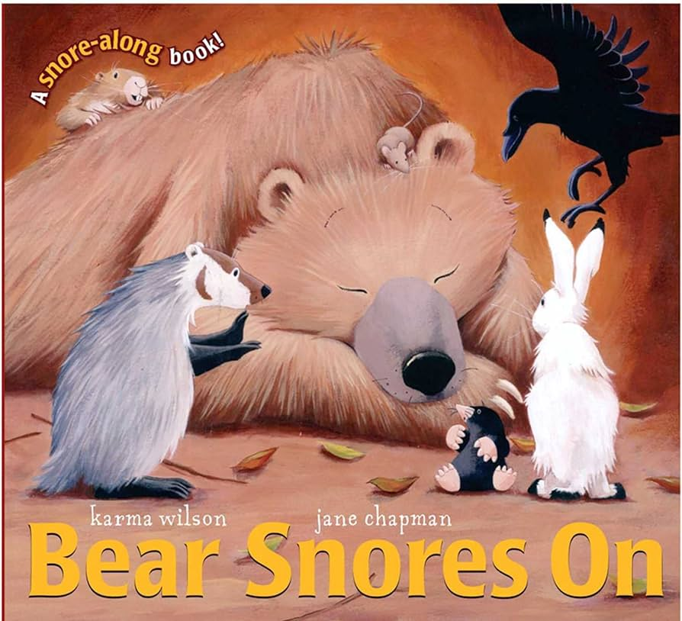
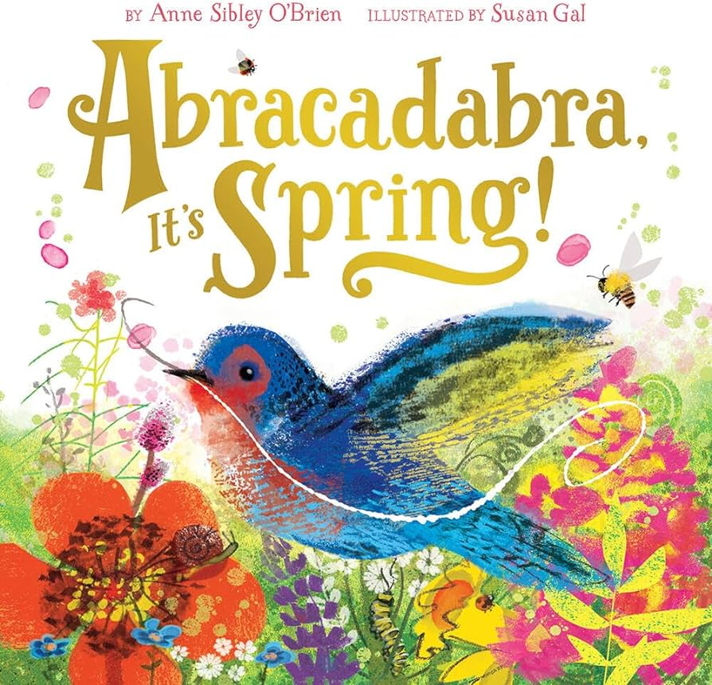
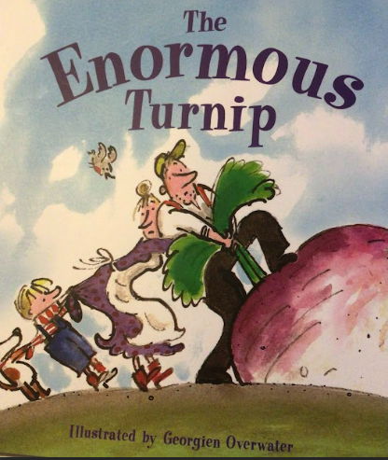
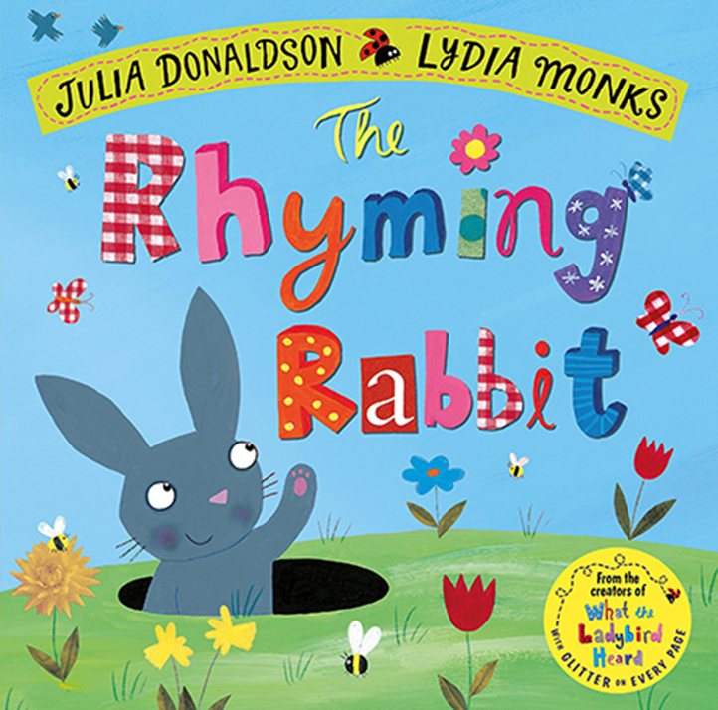
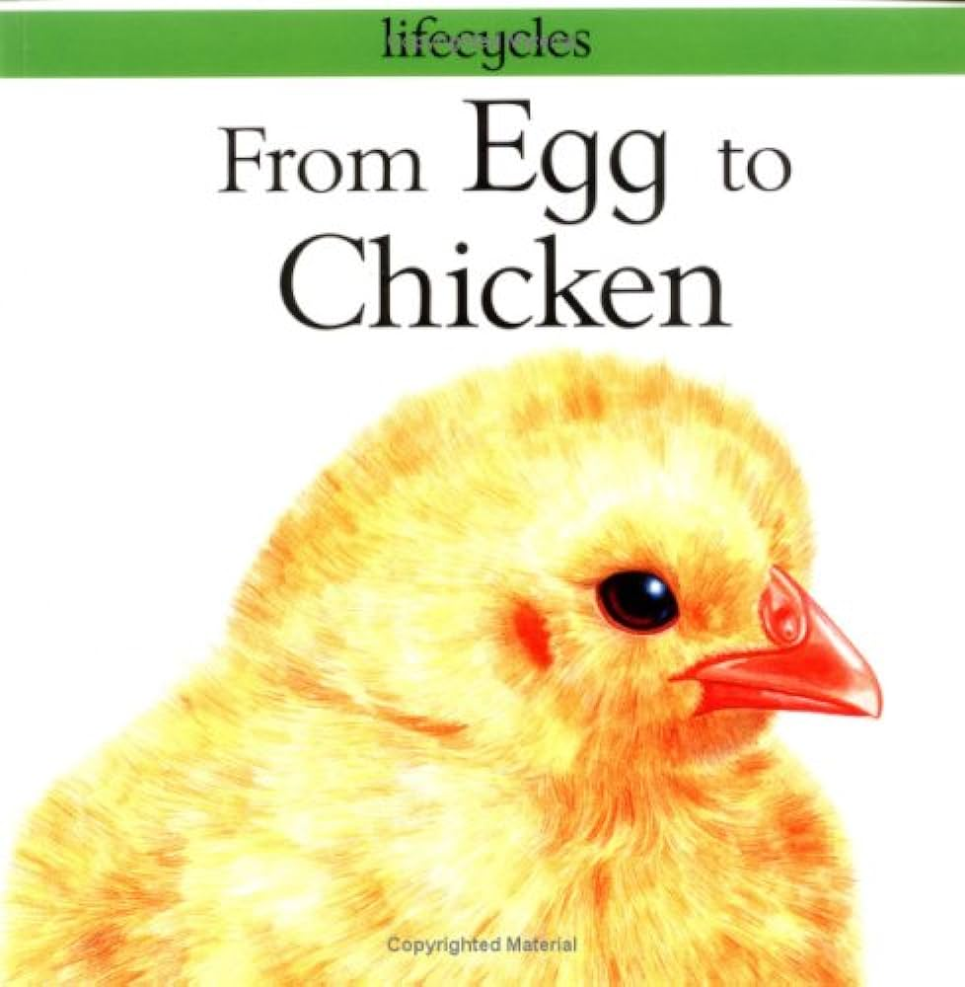
Spring 2: Spring
Key books this term:
Key Vocabulary
Cave - A natural chamber found on a hillside or cliff.
Lair - Where a wild or dangerous animal lives.
Howls - A long cry from a wolf or a dog.
Whimpers - A quiet crying noise.
Blustery - Very windy.
Hibernation - When animals sleep for a long time from Winter to Spring.
Key Questions?
I wonder why the bear needs to hibernate?
What does the mouse do in the cave? Why does he do this?
I wonder why the other animals come into the cave?
When the bear wakes up how is he feeling?
How would you feel if your friends had a party without you?
Do you know what others animals hibernate?
If you had to hibernate what would you need to get have a good long sleep?
Key Vocabulary
Crocus- A type of flower that grows in spring time
Buds- A new growth on a tree or plant
Unfurl- uncurl
Hatching- When something breaks their shell and comes out
Blossoms- The flowering part of a tree or plant
Key Questions?
What do you know about spring?
Can you hear some of the rhyming words in the story- what are they?
I wonder why the pictures in the story are so bright and colourful?
In Spring many baby animals are born can you remember any from the story?
you remember the names of the baby animals?
Key Vocabulary
Hoe- Tool used for gardening
Seeds- Small pods that flowers and plants from
Enormous- Very, very big
Baffled- Confused
Heave- To pull really hard
Key Questions?
How did the enormous turnip get there?
What did the turnip need to help it grow?
Who helped the man to heave the enormous turnip out of the ground?
If you grew vegetables how would you get them out of the ground?
What did they do with the enormous turnip when they pulled it out of the ground?
Have you tired turnips before? If so what did they taste like?
Key Vocabulary
Rhyming- Two words which end in the same sounds e.g cat, mat.
Swishing- Moving slowly from side to side
Marvellous- Something that is great
Mole- A small animal that lives under ground
Cunning- Sneaky and sly
Key Questions?
Why do you think rhyming rabbit likes to rhyme?
What does he rhyme about?
Do you know any words that rhyme?
Could you make a rhyme up like rhyming rabbit?
Why are rhyming rabbits rhymes in speech bubbles?
Key Vocabulary
Lifecycle- The different stages of life that an animal of plant change through
Hen- A female chicken
Yolk- The yellow part of an egg
Brooding- When the hen sits on her eggs to keep them warm
Chick- A baby chicken
Key Questions?
Why do hens need to keep their eggs warm?
If you had to keep an egg warm how would you do that?
I wonder why eggs need shells?
Do you know what other animals lay eggs?
Can you tell me what the life cycle of a chicken is?
-

Slide 2
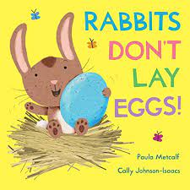
Key Vocabulary
Tunnel- A passage underground
Preen- When animals clean their feathers
Shrieked- A high pitched scream like noise
Nest- Where animals lay their eggs
Magnificent- Very beautiful and impressive
Barn- A large farm building for storing hay and shelter for animals
Key Questions?
Why was Dora the duck cross?
What job’s did Rupert try on the farm?
What job do you think you are good at? Why did Rupert feel sad?
How did Rupert get to the carrots?
What happened when Dora saw the carrot in the barn?
Which vegetables would you like to dig up and eat?
If you were an animal on a farm what would you be and why?
-

Slide 3
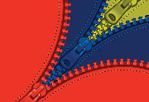
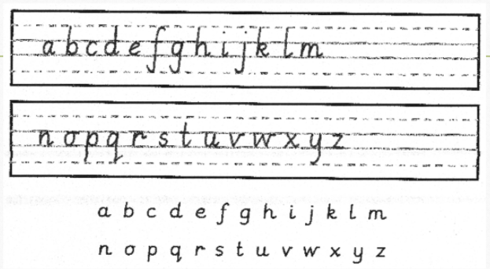
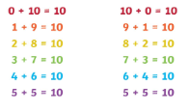
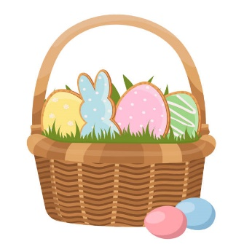
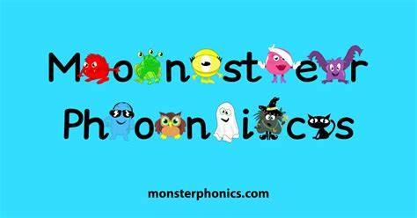
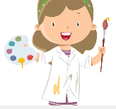
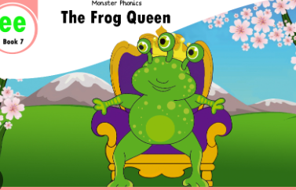
Length, height and time – The children will explore and compare the length and height of different objects. They will also talk about time, order and sequence of different events. For example, sequencing a set of pictures that show instructions of how to carry out a task.
Building 9 and 10 – The children will learn to recognise the numerals, matching the numeral to the correct quantity, subitising (recognising the amount without counting), 1 more, 1 less and composition of the numbers (making the number, e.g. 10 can be made of 7 + 3.)
Explore 3-D shapes – The children will learn the
names of different 3-D (solid) shapes. They will go
on shape hunts looking for these shapes in their
environment. They will also make patterns using
the shapes.
Mathematics
Physical development
Understanding
the world
Coats and zips
If your child can not yet zip up their own coat, please keep practising with them at home. We know that sometimes winter coat zips can be tricky.
We follow the White Rose scheme for maths, incorporating numicon and number blocks to support our maths.
People and Communities
This half-term, we will learn about Easter and understand that this is a story from the bible. We will talk about how some people celebrate it.
This half-term will also
bring our ‘Mother’s Day’
(special people/carers/grandparents) celebrations. This will be taking place on Friday 8th March. (We will be sending out more information about this in the next week.)
Letter formation
This is an important skill in learning to write. We continue with our
handwriting sessions in class and will be sending home sheets
to practise letter formation at home.
Please encourage your child to hold their
pencil correctly using a tripod grip.
Scissor Skills
Scissors are an important part of continuous provision. They are a hard tool to learn how to control and use correctly so we ensure lots of scissor skills opportunities are provided. Scissors help to develop children’s fine motor skills by using muscles which are normally not used in other fine motor activities. Strengthening the hand muscles is important for many daily experiences children have including fastening zips and writing.
AT HOME: Learn what numbers when added together make 10.
Expressive Arts and Design
PSED
Role play
The children will be able to perform and role play in a range of different spaces. Including; our home corner.
Phonics/ English
AT HOME: Please read your school reading books and practise reading your key words regularly. Please log reading in your child’s reading diary.
Jigsaw
The Natural World
This half-term, the theme is Healthy Me. The children will learn which foods are healthy and which are unhealthy. They will also learn the importance of exercise and sleep for our bodies.
Art and Design
In our Welly Wednesday sessions, we will look for signs of Spring in our school grounds and on a local walk. We will also visit the local allotment to do some planting.
We will continue to learn about the natural world and how it is changing. We will talk about how humans are changing the world for the better. We will look at eco-friendly ways to support our environment.
We will record how much traffic passes by our school and will think about how pollution affects our environment and how we can make a change.
Sounds
We are following the Monster Phonics programme and will be teaching the following sounds this term:
Week 1 – or – fork, sort, born
Week 2 – oa – boat, road, soap
Week 3 – er – hammer, letter, dinner
Week 4 – igh – high, light, bright
Week 5 – air – fair, hair, chair
Week 6 – oi – oil, coin, soil
Get active with phonics We make phonics fun and engaging by using a range of teacher led learning and hands on activities. For children learning in an active way helps them to retain information better. Here are some great active ideas for support your child with their phonics awareness https://phonicshero.com/getting-physical-phonics/
The children will explore colour mixing this half-term. They will learn how to make different shades of the secondary colours (orange, purple and green).
The children will do observational drawings and paintings of Spring flowers. They will add detail, patterns and colour to their artwork.
Oral blending
We are continuing with our reading and writing skills this half term.
Children will practise blending using trickier sounds. For example, you hear ‘t-r-ee’ and you merge these sounds together to make the single word ‘tree’. It is a key skill of early reading and is starting to support their developing writing skills too.
AT HOME: Ask your child what foods
do they like to eat. Then talk about
whether these foods are healthy
or unhealthy.
Music
We will continue using our music scheme, Sparkyard. The children will develop their recognition of classroom percussion instruments, using them to play simple accompaniments and simple rhythm patterns. They will also begin to explore ways to change sounds and create simple patterns, e.g. playing loudly, quietly, slowly or quickly.
PE
eBooks
Monster Phonics have a range of eBooks that children will be reading at school. You can support your children by accessing them at home here:
https://ebooks.monsterphonics.com/
Outdoor -
In this unit, children will develop their ball skills through the topic of 'weather'. Children will develop fundamental ball skills such as throwing and catching, rolling a ball, using targets, dribbling with feet, kicking a ball, bouncing and catching a ball.
Keywords (High-Frequency Words)
These are words that the children should just say and not sound out.
These are the words we are focusing on this half term:
Week 1 – it’s, do, so
Week 2 and 3 – come, some, were, one
Week 4 and 5 – like, when, little, what, by
Week 6 – day, away, play, children
Religious Education (RE)
Parents have been sent unique log in details.
Indoor -
In RE, the children will explore the question,
‘Why do some Christians put a cross on their Easter gardens?’ They will learn the Palm Sunday Story and the Easter story.
In this unit, children will develop their expressive movement through the topic of 'places'. Children explore space and how to use space safely. They explore travelling actions, shapes and balances.
AT HOME: Talk to your child about how we can look after our planet.
Remember to log any home learning onto Seesaw. If you need reminders of your login details, please get in touch with your child’s class teacher.

Slide 4
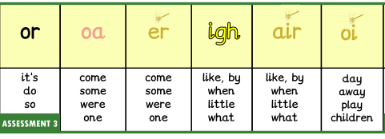
Reception Spring 2
Week 1 | Week 2 | Week 3 | Week 4 | Week 5
Week 6
E-book Titles | A kitten was born | A load on the road | A monster dinner | A good night Owls at night | A trip to the fair | A spoil spell

