Slide 1
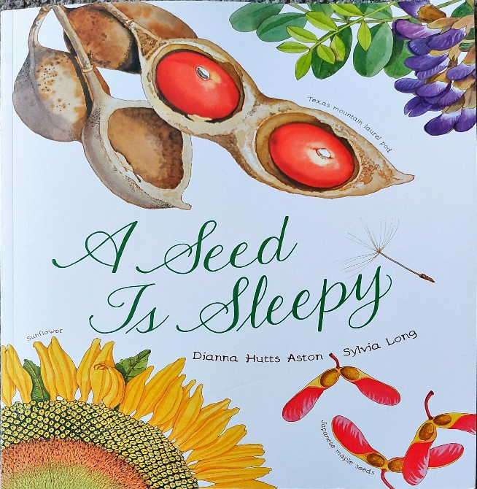
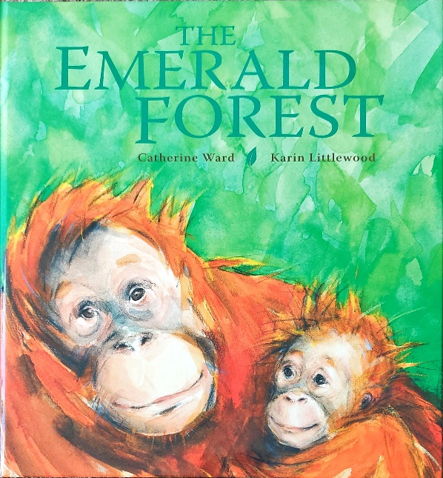
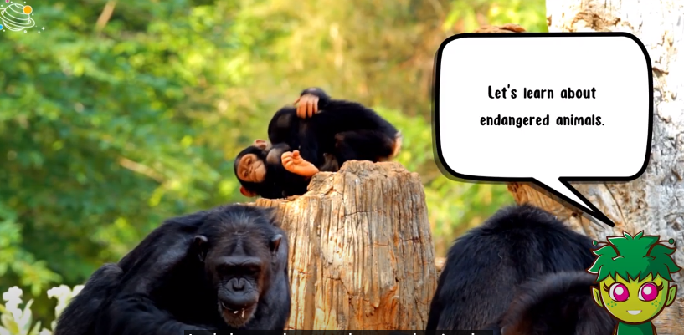
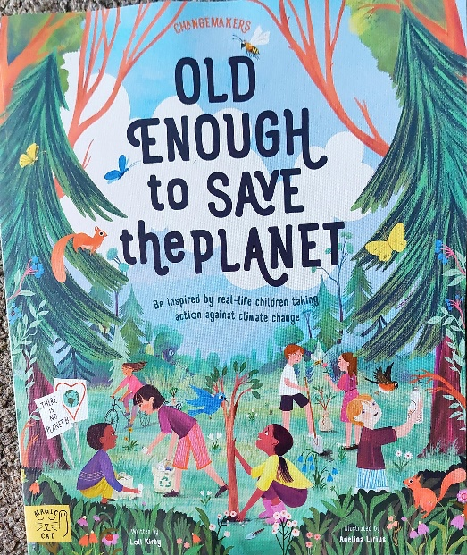
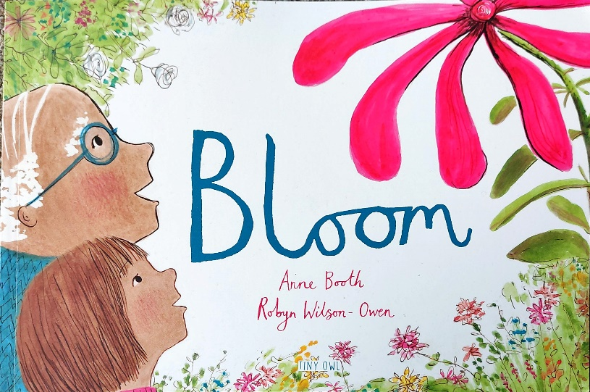
Spring 2 Y2 : Nurturing Nature
Key books this term
Short video clip
Endangered Animals
Old enough to save the planet
A seed is sleepy
Bloom
The Emerald Forest
https://www.youtube.com/watch?v=TqpCSoevdSc
Key Vocabulary:
Activist: a person who campaigns to change something they feel passionate about.
Reforestation: this is where you replant trees in forest areas that have been destroyed or damaged.
Pollution: this happens when the environment is made dirty by waste, chemicals and other harmful substances. There are three main types of pollution: air, water and land.
Elimination: this is the process of getting rid of something.
Key Questions?
What does an activist do?
What small thing could you do to look after the planet?
Why do we need to look after our planet?
Do you need to be an adult to be an activist?
Why are trees chopped down?
What is done to destroyed forest areas?
How can we reduce pollution?
Key Vocabulary:
Fruitful: a tree, plant or land producing a lot of fruit.
Flowering plants: types of plants which produce flowers, fruits and seeds.
Pod: a case that hold a plant’s seeds.
Germinate: where a seed begins to grow and put out shoots.
Ancient: something that is very old or something that has existed for a long time.
Key Questions?
What does a seed need to grow?
Why are the seeds described as being clever?
How can seeds spread?
What seeds have you seen before?
Have you eaten any seeds?
Where are seeds kept on a plant?
What are ancient seeds?
What is the process of a seed turning into a flower?
Key Vocabulary:
Furious: when someone is very cross and angry.
Gardener: this is type of job where someone looks after gardens. They may plant flowers or cut the trees and grass to make the garden neat.
Lonely: this is where someone feels alone and doesn’t have anyone to talk to.
Bloom: when a flower blooms it opens up.
Key Questions?
Why does the flower make the girl happy?
Why was the man annoyed at the girl speaking to the flower?
Why did the flower refuse to open?
Why is the old man so lonely?
Why do people not like him?
What does the man learn at the end?
Do you think the man is happier at the end? Why?
Key Vocabulary:
Emerald: a green precious stone.
Droning: a continuous low humming sound
Canopy: the uppermost branches of the trees in a forest
Clambered: limb or move in an awkward and laborious way
Key Questions?
Why were the machines in the forest?
Why was the orang-utan worried for her children?
Where did the human take the orang-utans? Why did she help them?
What could we do to ensure that the orang-utans have a home?
Key Vocabulary:
Endangered: seriously at risk of extinction.
Ivory: a hard creamy-white substance composing the main part of the tusks of an elephant, walrus, or narwhal, often (especially formerly) used to make ornaments and other articles.
"a dagger with an ivory handle“
Encroachment:
entry to another's property without right or permission.
Species:a class of things of the same kind and with the same name
Key Questions?
Why are animals becoming endangered and what is being done about it?
Which animals are endangered?
How does climate impact on an animal’s survival?

Slide 2

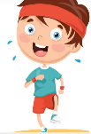



Science
.
Music
Drumming lessons will continue evry Thursday.
Mathematics
As our theme suggests ‘Nurturing Nature’ is all about the environment that we live in and the world around us. Alongside looking at seasonal changes, we will be learning about common wild and garden plants, including deciduous and evergreen trees. We would like all the children to be able to describe the structure of flowering plants and trees.
If anyone has any plants, flowers, seeds or compost that they are willing to donate to school, it would be very much appreciated.
Length and Height
The children will be using a ruler to measure items in centimetres and a meter stick or tape measure to measure items in metres. The children will be adding and subtracting lengths and heights to solve mathematical word problems.
Practise counting in 2s, 5s and 10s
This term, the children will learn how songs and music can communicate different moods and emotions. They will investigate different ways to express the mood of a song by adding facial expressions and changing the timbre and dynamics of their voice. They will develop their understanding of musical mood through simple songs, where they will be introduced to major and minor tonality.
Use a ruler or tape measure to practise measuring things at home
During this topic we hope to inspire the children to take action against climate change. It would be wonderful if you could point out anything you do or have at home that contributes to saving out planet. This might be anything from recycling, solar panels, avoiding single use plastic, growing your own food or even planting trees. Please upload your photos to seesaw and we will share these as a class. Thank you.
Multiplication and Division
The children will make connections between repeated addition as multiplication (e.g. 3x2 is the same as 3 lots of 2).
We will explore division through sharing.
.
RSHE
I
ndoor – Gymnastics
The children will practise the basic skills of jumping, rolling, travelling and balancing. They will begin to understand the use of levels, directions and shapes when travelling and balancing.
Outdoor – invasion games
The children will develop their understanding of the principles of defending and attacking for invasion games. They use and develop skills such as sending and receiving with both feet and hands, as well as dribbling with both feet and hands. They have the opportunity to play uneven and even sided games. They learn how to score points in these types of games and learn to play to the rules.
.
PE
Art
Phonics
Much of our phonics teaching is now working on spelling patterns and rules. Please encourage your children to practise writing at home as this gives them chance to apply the spelling patterns they have learnt.
English
Jigsaw – Healthy Me
In this topic, the children will continue their learning about staying healthy, They will know the importance of eating healthy and what it means to be relaxed. The children will learn about the safe use of medicines.
The children will be refining the printing skills they learnt in Y1 to produce a leaf print. They will need to think carefully about lines and shapes.
  AT HOME: Please read your school reading books and practise reading your tricky words regularly. Please log reading in your child’s reading diary.
Writing
This half term we will be working on writing Non-chronological reports. This will involve the children writing about a subject or theme that they have researched. We will be using our current theme of ‘nurturing nature’ to let children take charge of their own learning and to research what they are interested in.
Grammar
As always we will be practising our capital letters and full stops.. The children will be encouraged to stretch their sentences using conjunctions. The children will use apostrophes to show the contracted form of a word, e.g can’t instead of can not.
Handwriting
We will continue practising letter formation and the positioning of letters using our handwriting lines. The children are very excited to be learning letter joins this half term.
Reading
Please continue to practise reading regularly at home. It doesn’t matter what the reading material is- comics, leaflets, books, poetry etc. It all counts. School reading books will also be sent home.
We aim to promote a love of reading in school and all of our learning comes from quality books.
.
Please read the e-books on the monster phonics website. You should have received a new log in from Monster Phonics directly. If you haven’t use this link.
https://ebooks.monsterphonics.com/register/standard-school/?ca=282bccec0f3a2379c9ff4c6075b28fa1
Computing
The children will develop their understanding of what a branching database is and how to create one. They will use yes/no questions to gain an understanding of what attributes are and how to use them to sort groups of objects.
RE
The children will learn about the concept of ‘Gospel’ and the good news of forgiveness, peace and love that Christians believe Jesus brings. We will learn about the instructions that Jesus gives in the Bible and how Christians follow his example and these instructions in order to behave in a Christ like way.

Slide 3
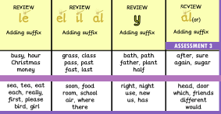
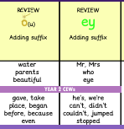
These are the sounds and words that your child should be able to read by the end of this half term. The e-book titles correspond to the sounds and words taught each week. These words will also be the weekly spells that will be checked on a Friday.
Year 2 Spring 2
Week 1 | Week 2 | Week 3 | Week 4 | Week 5 | Week 6
E-book Titles | Review Castle rescue Sea turtles | Review Fossils on the beach The little witches and the channel tunnel | Review Flying | Review | Review Uncle Wonder Mary Seacole | Review Harvey goes missing

