Slide 1
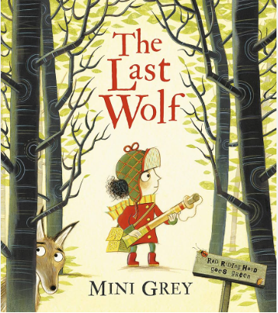
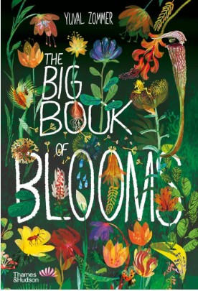
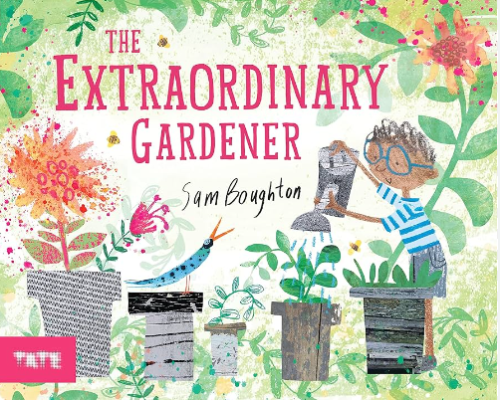
Spring 2 Y1 : Nurturing Nature
Key books this term
The Extraordinary Gardener
This Moose Belongs To Me
The Last Wolf
The Big Book of Blooms
Key Vocabulary:
Extraordinary – something that is unusual or remarkable.
Gardener – a person who tends to a garden as a hobby or for a living.
Imagination – to be creative and form new ideas in the mind.
Roamed – move about or travel aimlessly.
Soared – fly or rise high in the air.
Discovered – find unexpectedly or during a search.
Scent – a distinctive smell. A smell that is pleasant.
Key Questions?
Why do you think some of the pages are in black and white?
What might Joe’s idea be?
What was Joe waiting to happen?
How do you think Joe felt when his seed wasn’t growing?
Why do think Joe’s garden made the neighbours happy?
Key Vocabulary:
Moose – from the deer family. A herbivore known as the ‘eater of twigs.’
Proximity – the state or condition of being near.
Dumbstruck – so shocked or surprised, being unable to speak.
Enraged – very angry or furious.
Perilous – full of danger or risk.
Key Questions?
If you could have any pet, what would it be and why?
Do you think the moose understands how to be a good pet?
Do you think the moose is listening to Wilfred?
Why was Wilfred embarrassed and enraged?
What does ‘enraged’ mean?
Does Winfred actually own the moose?
Key Vocabulary:
Wolf – also known as the grey wolf and is native to North America.
Popgun – a child’s toy gun which shoots a harmless pellet or cork.
A-stalking – approach or pursue something.
Slithered – move smoothly over a surface.
Lynx – is considered a medium-sized cat.
Graze – to feed on.
Key Questions?
Which well-known story is this story similar to?
Do you think Red is going to find a wolf?
Should Red wandered deeper into the forest? Why?
How do you think Red was feeling when she lost her path and tripped?
What is a Lynx?
Why do you think there isn’t endless forests or wildlife to graze on anymore?
How could Red help the animals?
Key Vocabulary:
Blooms – produces flowers.
Flowers – is also known as bloom or blossom. A flower is the reproductive part of a plant.
Pollen - a powdery substance produced by most flowers or seeds of a plant.
Petal – each of the segments of a flower usually coloured.
Stamen – the male reproductive part of a flower.
Stem – transports water and nutrients from the roots to the leaves.
Vein – supports the structure of a leaf.
Stigma – part of the female reproductive system. It catches the pollen.
Photosynthesis – leaves take the energy from sunlight and make it into a sugary food.
Germination – the growth of a seed into a young plant or seedling.
Key Questions?
Do you think this book will be fiction or non-fiction?
What flowers can you name?
Can you name the parts of a flower?
Do you have a favourite flower?
Have you ever planted any flowers? How did you nurture it?

Slide 2
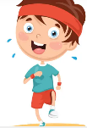
Science
.
Mathematics
Place Value (within 50)
The children will extend their learning to counting to 50. Children will have frequent opportunities to count from 20 to 50, starting at different points. Children will use apparatus to look at the tens and ones in a number up to 50.
Measurement (Length and Height)
Children understand that height is a type of length
and that the language they use changes, depending
on what type of length they are describing and
comparing.
Measurement (Mass and Volume)
Children will begin to use balancing scales to compare two objects. They will learn that the heavier object is lower on the scale.
Music
As our theme suggests ‘Nurturing Nature’ is all about the environment that we live in and the world around us. Alongside looking at seasonal changes, we will be learning about common wild and garden plants, including deciduous and evergreen trees. We would like all the children to be able to describe the structure of flowering plants and trees.
If anyone has any plants, flowers, seeds or compost that they are willing to donate to school, it would be very much appreciated.
This term, the children will learn how songs and music can communicate different moods and emotions. They will investigate different ways to express the mood of a song by adding facial expressions and changing the timbre and dynamics of their voice. They will develop their understanding of musical mood through simple songs, where they will be introduced to major and minor tonality.
Download and play the White Rose maths 1 minute maths game
During this topic we hope to inspire the children to take action against climate change. It would be wonderful if you could point out anything you do or have at home that contributes to saving out planet. This might be anything from recycling, solar panels, avoiding single use plastic, growing your own food or even planting trees. Please upload your photos to seesaw and we will share these as a class. Thank you.
Art
.
Children will be developing a wide range of art and design techniques in using line and shape through the use of printing. Children will produce a leaf print demonstrating these skills.
RSHE
PE
Jigsaw – Healthy Me
In this topic, the children will continue their learning about staying healthy, They will know the importance of eating healthy and what it means to be relaxed. The children will learn about the safe use of medicines.
Indoor – Gymnastics
The children will practise the basic skills of jumping, rolling, travelling and balancing. They will begin to understand the use of levels, directions and shapes when travelling and balancing.
Outdoor – Invasion Games
The children will develop their understanding of the principles of defending and attacking for invasion games. They use and develop skills such as sending and receiving with both feet and hands, as well as dribbling with both feet and hands. They have the opportunity to play uneven and even sided games..
Phonics
We are continuing with our new scheme Monster Phonics and the children are loving it. Please keep up to date with the sounds and words we are learning each week using the grid on the following page.
English
AT HOME: Please read your school reading books and practise reading your tricky words regularly. Please log reading in your child’s reading diary.
Writing
This half term we will be working on writing Non-chronological reports. This will involve the children writing about a subject or theme that they have researched. We will be using our current theme of ‘nurturing nature’ to let children take charge of their own learning and to research what they are interested in.
Grammar
We will be continuing to write sentences using capital letters, full stops and finger spaces accurately.
We will be stretching our sentences by using the coordinating conjunction ‘but’, alongside adding the ‘es’ and ‘s’ suffixes to familiar words to create plurals.
Handwriting
We will continue practising letter formation and the positioning of letters using our handwriting lines. It is essential that the children form their letters correctly as this will help when they move onto joining their letters in Year 2.
.
Please read the e-books on the monster phonics website. You should have received a new log in from Monster Phonics directly. If you haven’t use this link.
https://ebooks.monsterphonics.com/register/standard-school/?ca=282bccec0f3a2379c9ff4c6075b28fa1
Computing
This unit introduces learners to data and information. Labelling, grouping, and searching are important aspects of data and information. During this unit, learners will be logging on to the computers, opening their documents, and saving their documents.
RE
The children will explore Jewish worldviews and ways of life. They will learn about texts from the Torah and their importance for Jewish people today. Later in the unit, pupils will find out about Shabbat and Chanukah, discussing why Jewish people mark these times and their importance.
Reading
Please continue to practise reading regularly at home. It doesn’t matter what the reading material is- comics, leaflets, books, poetry etc. It all counts. School reading books will also be sent home alongside the assigned e-books via Monster Phonics.
We aim to promote a love of reading in school and all of our learning comes from quality books.

Slide 3
These are the sounds and words that your child should be able to read by the end of this half term. The e-book titles correspond to the sounds and words taught each week. These words will also be the weekly spellings that will be checked on a Friday.
Year 1 Spring 2
Week 1 | Week 2 | Week 3 | Week 4 | Week 5 | Week 6

