Slide 1
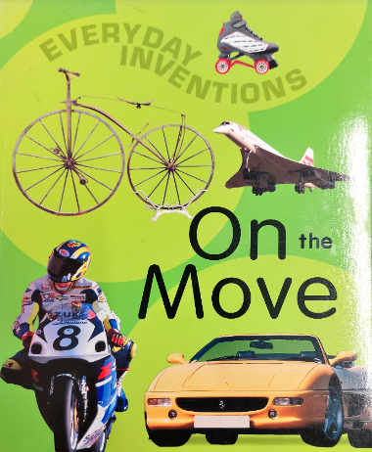
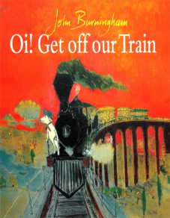
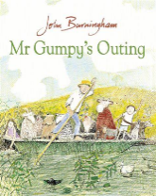
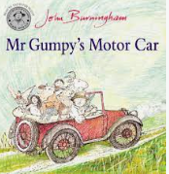
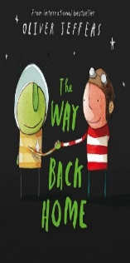
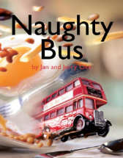
Spring 1 Reception: Ticket to Ride.
You can access our key books either at the library or listen to the story being read via Youtube.
Key books this term
:
Key Vocabulary
Non fiction: provides information
Contents page: a list that lets the reader go to the
page they want.
Glossary – an alphabetical list of words within the text and their meanings.
Index- an alphabetical list of words within the text
and the page number they are on.
Inventions- a unique idea which is completely new.
Transport- a way to travel or move.
Engine- a machine that helps something move
Wheels- round objects that are found on cars, bicycles etc.
Key Questions?
- What are the different types of transport?
What transport have you used before?
Does all transport have wheels?
Does all transport stay on the ground?
What is the difference between a fiction book and a non fiction book?
Key Vocabulary:
Train- a type of transport that travels on a track.
Journey- travelling from one place to another.
Town- a built up area with houses and shops
Marshes- a wetland with plants and water.
Draining- Water going away
Key Questions?
Why does a train need a track?
What makes the smoke come out of a train?
Where would you want to go on a train?
Where would you swim on a hot day?
Why will there be no fish left?
Why do the animals all want to get on the train?
Key Vocabulary:
Boat: A small vessel for travelling over water.
River: A large natural stream of water.
Trample: Tread on and crush.
Lane: A narrow road.
Cart-track: A rough track or road across fields.
Vehicle: A type of transport.
Passenger: Someone travelling in a vehicle.
Key Questions?
Mr Gumpy let the children come along as long as they promised not to….?
Why did the boat tip over?
How do you think Mr Gumpy and his passengers felt when the boat tipped over?
Mr Gumpy’s motor car chugged. Can you think of another type of transport which chugs?
Why didn’t Mr Gumpy like the look of the clouds?
Why did the passengers in his car need to get out and push?
Key Vocabulary:
Aeroplane: A flying vehicle with wings.
Pilot: Someone who drives a plane.
Spluttered: When an engine makes spitting sounds.
Petrol: A liquid which powers the engines to move.
Steer: Control where a vehicle goes.
Martian: An alien.
Parachute: Material which fills with air and slows a fall down.
Machine: A device that does a task (give examples e.g. A washing machine).
Spanner: A tool which helps to turn nuts and bolts.
-Key Questions?
Why did the plane splutter?
Who did the boy meet on the moon?
What do you think the boy and the Martian were afraid of?
What happened to the Martian’s engine?
Why were they in trouble?
How did the boy float back down to earth?
Could you climb a rope to the moon in real life?
Key Vocabulary:
Bus: A large vehicle which drives on the road.
Single-decker: a bus with one floor.
Double-decker: a bus with two floors.
Driver: The person who drives the bus.
London: the biggest city in England.
Traffic: Lots of vehicles moving on the same road.
Bus Stop: A place where the bus stops so that you can get on or off.
Reflection: When you can yourself or an object back (give examples e.g. the pond, a mirror).
Key Questions?
Why is the bus naughty?
How has he made a mess?
Does a bus go fast or slow in baked beans?
Does a bus go faster or slower in water?
Why are the people waiting at the bus stop?
How did the bus fall in the pond?
How does the boy save the bus?

Slide 2


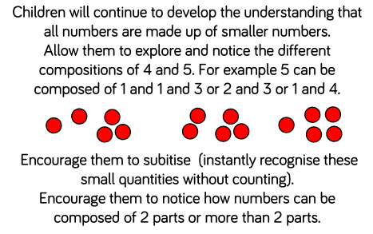
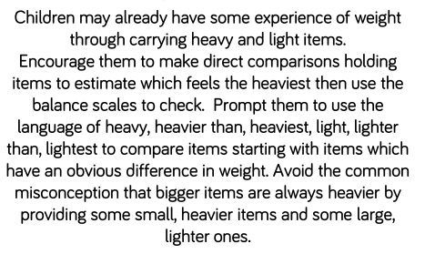
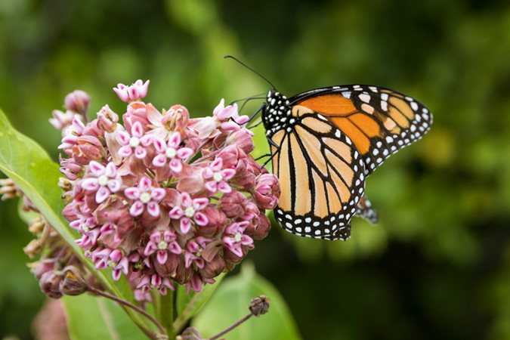
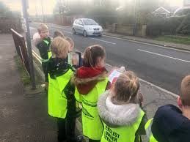
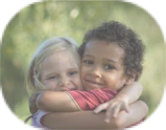
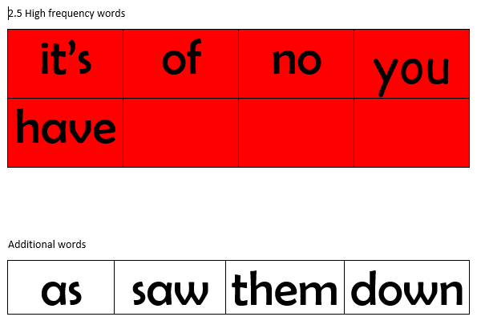
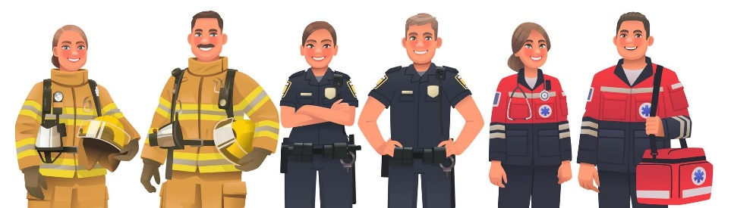
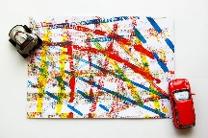
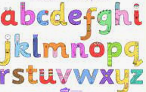
Physical development
Mathematics
Understanding the world
.
Letter formation:
This is an important skill in learning to write. We continue with our handwriting sessions in class and will be sending home a book to practise letter formation at home.
Please encourage your child to hold their pencil correctly using a tripod grip.
We follow the White Rose scheme for maths, incorporating numicon and number blocks to support our maths.
This half term we are introducing the number zero. Comparing and working with numbers to 5.
We will then look at weight using the language heavy, heavier, heavier than, light, lighter and lighter than. Capacity using the language full, empty, half full, nearly empty.
Coats and zips and gloves
Some children can fasten their own coats, which is fantastic. If your child can not yet do this independently, please keep encouraging them to practise. As the weather becomes cooler and gloves are brought to school, please allow your children time to practise putting these on at home- putting 30 pairs of gloves on 29 children is incredibly time consuming!
  :
The natural world
We will continue to learn about the natural world and how it is changing. How man is changing the world for the better and not. We will looki at eco friendly ways to support our environment.
We will record how much traffic passes by our school and will think about how pollution effects our environment and how we can make a change.
Gross motor
The children use their gross motor skills to perform every day functions, such as walking, running, playground skills (e.g. climbing) and sporting skills (e.g. catching, throwing and hitting a ball with a bat). They will have the opportunity to use balance bikes and scooters. In PE, the children will use apparatus to aid rolling, jumping and climbing.
PSED
Expressive arts and design
English
One of the best things you can do to help children learn to read is to drop the /uh/ sound when saying a letter sound. The technical term for this is a 'schwa' and avoiding adding it to the end will mean you are using the 'pure sound'. The common phonemes where an /uh/ is unnecessarily added are:
mmmmm not muh
ssssss not suh
llllll not luh
rrrr not ruh
p p p not puh
Modelling the 'pure sounds' means that it is easier for children to push them all together to form the word. So, instead of saying 'suh', 'u', 'nuh' use 'ssss', 'u', 'nnnn' to make the word 'sun'.
Listening to adults use the correct pronunciation also means that children are more likely to say the sounds correctly and this gives them a greater chance to blend them to form words independently.
People and Communities
This half term will look at different people in our community and what vehicle they drive. This will include: the police, firefighters, ambulance crews and life guards. We will compare the different vehicles that are used on land, in the air and in the water.
Writing: We will continue working on hearing and writing the beginning, middle and end sounds in Consonant Vowel Consonant words (for example, cat, dog, bus). As children do this independently we will begin to write short sentences and captions. We will also practise writing the tricky words matched to our reading scheme.
  Jigsaw We follow a scheme called Jigsaw to focus on building positive relationships and develop self esteem in learning. It links well into our Early Years curriculum (EYFS). The topic focus for this half term is ‘Dreams and goals”. This encourages children to think about what they would like to achieve and how they might achieve it.
Role play
The children will be able to perform and role play in a range of different spaces. Including; our home corner, or transport scenes.
They will look at how different characters interact in different places.
Art and Design
The children will use a range of different media to create works linked to vehicles and transport. Rolling wheels in paints on a small scale and on a large scale. We will make different our own vehicle that moves.
Tricky words: Ideally children should now be moving on to 2.5 key words. If they aren’t, please don’t panic. Tricky words are words that can not be sounded out and need plenty of practise to read. Games such as matching pairs or snap can help move the children on. Constant exposure through placing words on the stairs, cupboard doors, in the bathroom can also really help your children read and recognise them. If you would like any extra sets of words or more game ideas please just ask.
Music
We will be:
Listening and responding to different styles of music
Embedding foundations of the interrelated dimensions of music
Learning to sing or sing along with nursery rhymes and action songs
Improvising leading to playing classroom instruments
Share and perform the learning that has taken place
Sounds:This half term we will be introducing Phase 3 sounds which include digraphs and trigraphs. We will use this terminology with the children. Digraphs are 2 letters that make 1 sound (ee, ai, ow etc.) and trigraphs are 3 letters that make 1 sound (igh, ear, air, etc). Each sound has an action which we will send home.
We will also continue to practise the single letter sounds.
  AT HOME: Practise your reading book, key words and sounds as often as you can. Please bring your book bag and reading diary everyday.
  AT HOME:. Explore stories that celebrate achieving goals for example ‘Love Monster’ by Rachel Bright Book: ‘Don’t worry, Hugless Douglas’ by David Melling
  AT HOME:Listen to a range of different genres of music, classical, pop, rock, indie and discuss if you like them or not and why.
  AT HOME: Talk to your children about how the different people in our community help us.
Remember to log any home learning onto Seesaw. If you need reminders of your login details, please get in touch with your child’s class teacher.

