Slide 1
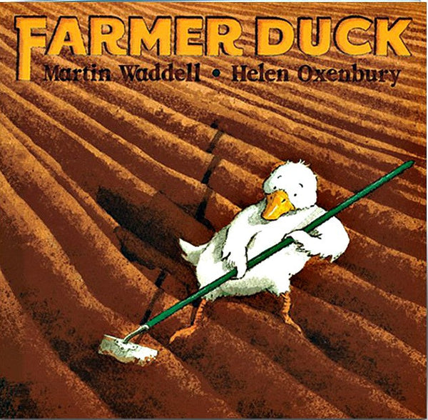
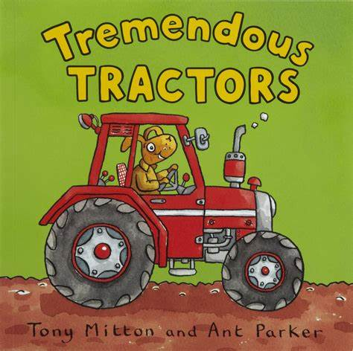

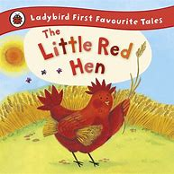
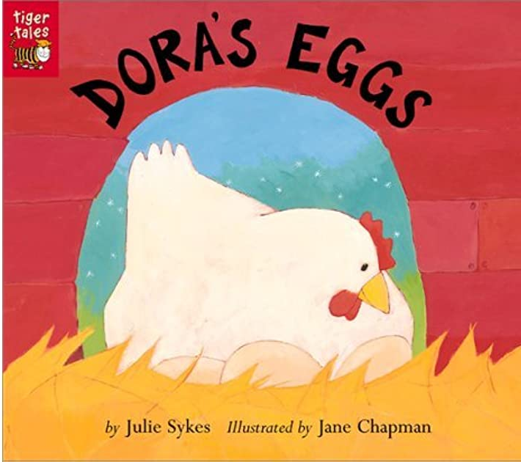
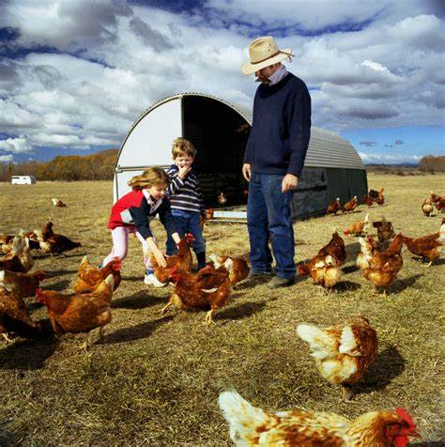
We will also look at different non-fiction books that are about farms, animals and growing.
Summer 1: Down on the Farm
Key books this term:
Key Vocabulary
Chores - A task someone needs to complete.
Livestock - Animals that live on a farm.
Poultry - A bird that lives on a farm. Chicken, turkey, ducks and geese.
Herd - A large group of animals
Silo- A tall tower on the farm used to store grain.
Crops - A plant that is grown for a specific purpose of food.
Key Questions?
What is a chore and why do the farmer’s children do these?
If you owned a farm, what crops would you grow?
Would you own any livestock or poultry? If so, what would you own?
Key Vocabulary
Tractor - A powerful vehicle used on farms.
Treads - The grooved rubber on a tyre.
Plough - A piece of farming equipment with lots of blades on. It is pulled by the tractor to turn over the soil.
Harrow - A piece of equipment pulled by a tractor to pull out weeds or cover up seeds.
Bale - A large bundle of something. Normally hay on a farm.
Key Questions?
I wonder how farmers used to do these jobs before tractors were invented?
How do you plant seeds in your garden?
If you were a farmer, what equipment would you need?
Key Vocabulary
Vegetable - Part of a plant that is used for food.
Crinkly - Very wrinkly.
Rhubarb - A type of fruit.
Beetroot - A type of vegetable grown under the ground.
Tangle - Twisted together.
Evening - A time of the day before bedtime.
Key Questions?
What is Oliver’s favourite food? Is it a vegetable?
What vegetables does Oliver try while staying at his Grandad’s house?
Where do the vegetables come from?
Do you grow vegetables in your garden? If you do, what do you grow?
If you could grow some vegetables, which would you grow?
What is your favourite vegetable and why?
Key Vocabulary
Housework - Jobs done around the house it keep it clean and tidy.
Wheat - A type of grain grown to make other foods.
Ripe - Food that is fully grown and ready to eat.
Mill - A place where grains are ground into flour.
Flour - A powder used as an ingredient for cooking in cakes and breads.
Key Questions?
Are the Little Red Hen’s friends helpful? Can you explain your answer?
Does the Little Red Hen get her ingredients for her bread from the shop? Where does it come from?
If you were the Little Red Hen, what would you say to your friends who did not help you?
Key Vocabulary
Smooth - A surface that has no lumps and bumps.
Duckling - A baby duck.
Piglet - A baby pig.
Lamb - A baby sheep.
Calf - A baby cow.
Puppy - A baby dog.
Key Questions?
Can you tell me how Dora felt about her eggs at the beginning of the story?
As Dora visited the other animals, did her feelings towards her eggs stay the same? Why?
How did Dora feel when her chicks hatched?
Have you seen any of the baby animals before? Where did you see them? What do you know about them?
-

Slide 2
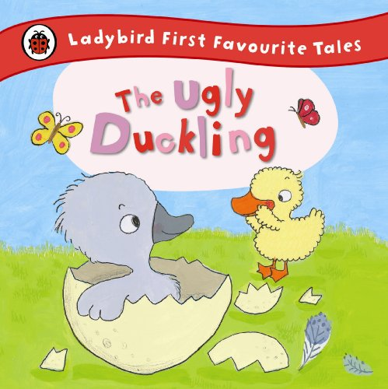

Key Vocabulary
Ugly -Something that doesn’t look very pretty.
Whispered - Spoken very quietly.
River - A natural flowing water course.
Waddled - Walk in slow steps swaying side to side.
Flock - A group of birds.
Key Questions?
Why were the other animals unkind to the grey duckling?
How would you feel if someone was unkind to you like that?
How could the other animals have been kinder to the grey duckling?
Have you seen a real swan before? Can you tell me about it?
I wonder what all those animals would say to the grey duckling when he turned into a swan.
-

Slide 3
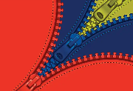

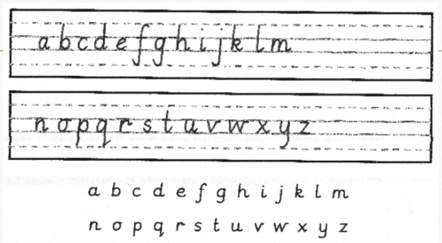

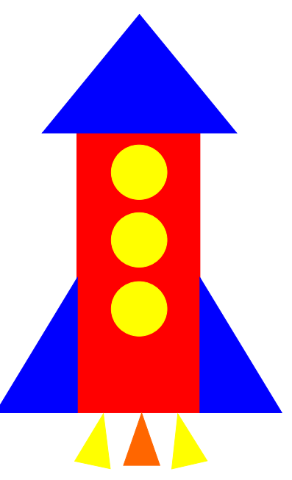
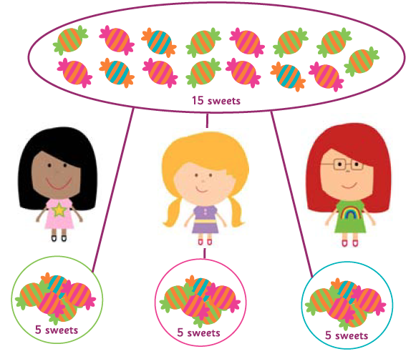
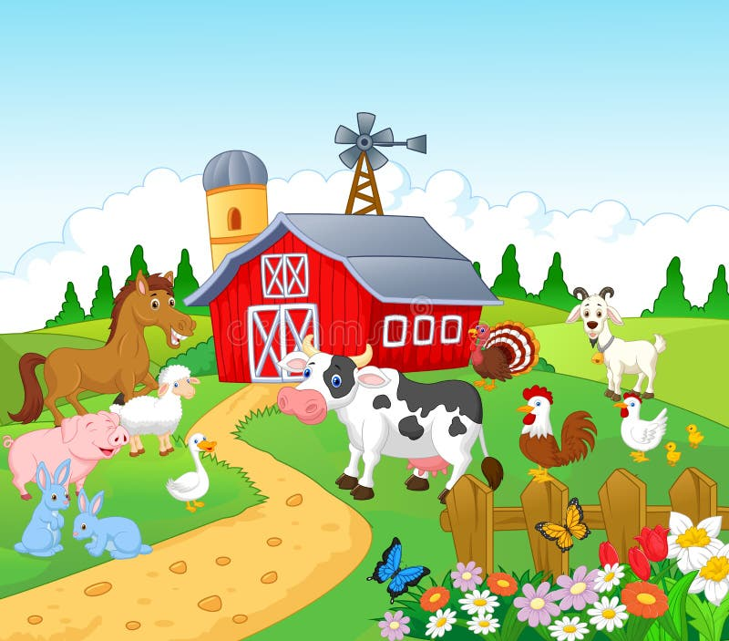


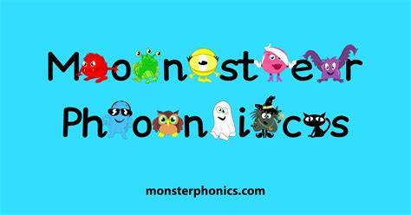
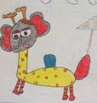



Physical development
Mathematics
Understanding
the world
Coats and zips
If your child can not yet zip up their own coat, please keep practising with them at home. We know that sometimes winter coat zips can be tricky.
We follow the White Rose scheme for maths, incorporating numicon and number blocks to support our maths.
To 20 and Beyond - The children will become more familiar with numbers beyond 10 and the pattern (stable order) of numbers to 20 and beyond. Children will be familiar with larger numbers from daily routines such as counting children or the days in the month.
How Many Now? - Children will use real objects to see that the quantity of a group can be changed by adding more or taking away. The ‘first, then, now’ structure is a very effective way to help build their understanding by creating mathematical stories in meaningful contexts.
Manipulate, Compose and Decompose - During this topic, children will explore shapes. They will have the opportunity to turn, rotate and flip them to make shape arrangements, while embedding previous learning around the properties of shapes. Composing and decomposing shape arrangements will allow children to see how different shapes can be made up of smaller shapes.
People and Communities
The Natural World
We will be learning about what a farm is. The children will learn about different farm animals, as well as the different jobs there are on a farm.
The children will look at photos of different types of farms and compare the similarities and differences between the photos.
In our Welly Wednesday sessions, we will talk about how to look after the environment. For example, recycling and planting seeds. The children will be visiting the local allotment to plant some vegetables.
Letter formation
This is an important skill in learning to write. We continue with our
handwriting sessions in class and will be sending home sheets
to practise letter formation at home.
Please encourage your child to hold their
pencil correctly using a tripod grip.
Scissor Skills
Scissors are an important part of continuous provision. They are a hard tool to learn how to control and use correctly, so we ensure lots of scissor skills opportunities are provided. Scissors help to develop children’s fine motor skills by using muscles which are normally not used in other fine motor activities. Strengthening the hand muscles is important for many daily experiences children have, including fastening zips and writing.
  AT HOME: While you are out and about, see if your child can point out and read the numbers on doors around your neighbourhood.
PSED
Expressive Arts and Design
Phonics/ English
  Jigsaw
  AT HOME: Please read your school reading books and practise reading your keywords regularly. Please log reading in your child’s reading diary.
This half-term, the theme is Relationships.
We will be talking about families, friends and what it means to be a good friend to others. Our Jigsaw sessions will support the children to develop their resilience. They will learn a range of verbal tools and strategies to resolve arguments.
Art and Design
Sounds
  We are following the Monster Phonics programme and will be teaching the following sounds this term:
  Week 1 – ear – fear, hear, tear ure – pure, cure, manure
  Week 2 – CVCC (Consonant Vowel Consonant Consonant) words – tusk, gift, jump, help, pond
  Week 3 – CCVC (Consonant Consonant Vowel Consonant) words – crab, stop, frog, plum, grin
  Week 4 and 5 – CVC words and words with taught digraphs (two letters that make one sound) – cat, dog, chin, path, moon
  Week 6 – CCVCC (Consonant Consonant Vowel Consonant Consonant) words – stamp, blink, frost, crept, grunt
We will be having fun creating mixed up animals on Switchzoo.com and then creating our own mixed up animals using paints, pens, crayons, pastels (children’s choice).
eBooks
  Monster Phonics has a range of e-books that children will be reading at school. You can support your children by accessing them at home here:
  https://ebooks.monsterphonics.com/
  Get active with phonics
  We make phonics fun and engaging by using a range of teacher-led learning and hands-on activities. For children, learning in an active way helps them to retain information better. Here are some great active ideas to support your child with their phonics awareness. https://phonicshero.com/getting-physical-phonics/
  AT HOME: Talk about who is in your family and why they are important. Also, talk about what resilience means.
Music
We will continue using our music scheme, Sparkyard. This half-term begins with opportunities to tell playful stories using voices and tuned instruments.
PE
Outdoor - Athletics/ Sports Day.
The children will be learning and following the rules of different games and races, while supporting their teammates through positive praise.
Parents have been sent unique log in details.
Keywords (High-Frequency Words)
  These are words that the children should just say and not sound out.
  These are the words we are focusing on this half-term:
  Week 1 – day, away, play, children
  Week 2 and 3 – Revision of the High-Frequency Words learned so far.
  Week 4 and 5 – your, here, saw
  Week 6 – time, out, house, about
Religious Education (RE)
This unit focuses on special places for Muslims and Christians. Within the unit, pupils reflect upon places that are special in their own lives and find out about places that are holy and important for many Christians and Muslims.
Indoor - We will be learning basic gymnastic skills through the topic of ‘Traditional Tales’. Children will explore creating shapes, balances jumps and rolls. They will develop an awareness of space and how to use it safely. The children will perform basic skills on the floor and on the apparatus.
  AT HOME: Talk about different animals you could find on a farm. Learn the names of mothers and babies. For example, mare and foal, cow and calf, cat and kitten etc.
Remember to log any home learning onto Seesaw. If you need reminders of your login details, please get in touch with your child’s class teacher.

Slide 4
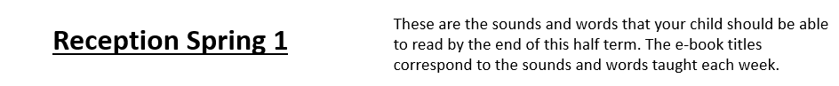
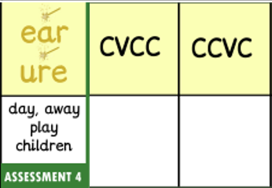
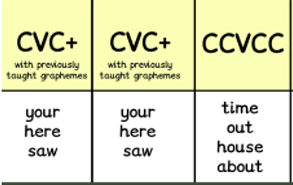
Reception Summer 1
Week 1 | Week 2 | Week 3 | Week 4 | Week 5
Week 6
E-book Titles | A fix for ears The cat and the cure | A wish at the camp The best band | The frog twin The sled on the hill A crisp day A jump in the truck Thank you monsters The thrill stars | An old mat | Getting help | A spring day The day she shrunk

