Slide 1
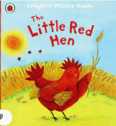
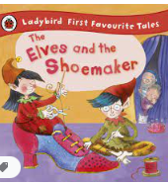
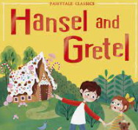
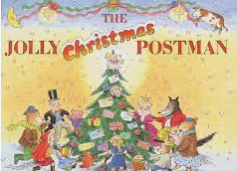
Autumn 2 Reception: Traditional Tales
Key books this term
Key Vocabulary:
trespassing: without permission
experience.
enormous: extraordinarily large.
tempting: very appealing.
latch: a metal bar with a catch and lever used for fastening a door or gate.
Key Questions?
Why did Goldilocks go into the bear’s house?
What was the first thing the bears saw when they came home?
Why did Goldilocks jump out of bed when she saw the bears?
Who were the characters in the story? What was the plot?
Key Vocabulary:
cottage: a small house typically in the country.
Harvest: gathering crops.
grain: a single fruit or seed of a cereal
sprouted: start to grow.
determined: making a firm decision.
uncooperative: unwilling to help others or do what they ask.
Key Questions?
What words would you use to describe the little red hen?
How do you think the little red hen felt doing all of the work herself?
What lesson did the animals learn?
Key Vocabulary:
shoemaker: a person who makes or repairs shoes.
leather- a material made of animal skin.
polish: make a surface shine.
stitched: to sew
finest: nicest
Key Questions?
How do most fairy tales begin/end?
What are the shoes in the story made from?
What does the shoemaker do with the shoes?
How does the shoemaker repay the elves for being so kind?
Key Vocabulary:
ill treated: treated in a cruel manner
crumbled: broken into smaller pieces
grab- hold something suddenly
overjoyed- very happy
slammed- forcefully shut
-Key Questions?
What was the woodcutter so worried about?
What happened to the trail of bread crumbs?
How were the children treated by the old witch?
How did Gretel get rid of the old witch?
Key Vocabulary:
cottage- a small house typically in the country
elope- run away
sleighing – To travel on a sledge in the snow
mile- a very long way
vanished- something that has disappeared
delicious- something that is tasty
completed- finished
Key Questions?
- Why do you think the Jolly Postman is jolly?
- Who do you think lives at four bears cottage?
-- Who would send Little Red Riding Hood a card?
- What is the postman travelling on?
- Would you deliver to Mr Wolf?
- Why is the post man cold?
- How does the postman get home?
- What would you write to Father Christmas?

Slide 2
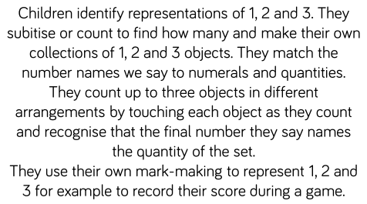
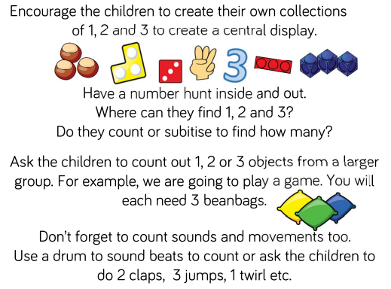
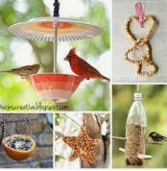
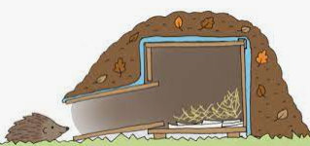
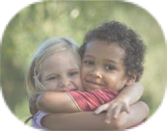
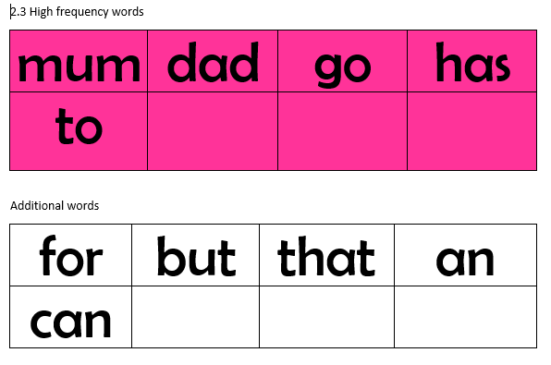
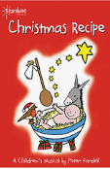
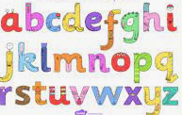
Physical development
Mathematics
Understanding the world
.
Letter formation:
This is an important skill in learning to write. We have now started handwriting sessions in class and are currently working on the ‘c’ letter shapes- c o a d g.
Please encourage your child to hold their pencil correctly using a tripod grip.
We follow the White Rose scheme for maths, incorporating numicon and number blocks to support our maths.
This half term we begin looking at numbers- starting with 1, 2 and 3.
Coats and zips and gloves
Some children can fasten their own coats, which is fantastic. If your child can not yet do this independently, please keep encouraging them to practise. As the weather becomes cooler and gloves are brought to school, please allow your children time to practise putting these on at home- putting 30 pairs of gloves on 29 children is incredibly time consuming!
AT HOME:
The natural world
We will continue to learn about the wildlife that frequent our school grounds, for example rabbits, hedgehogs and squirrels. We will discuss hibernation and make our own animal habitat. As the weather gets colder, we will make bird feeders and watch and identify the birds that we see.
Gross motor
The children use their gross motor skills to perform every day functions, such as walking, running, playground skills (e.g. climbing) and sporting skills (e.g. catching, throwing and hitting a ball with a bat). They will have the opportunity to use balance bikes and scooters. In PE, the children will use apparatus to aid rolling, jumping and climbing.
PSED
Expressive arts and design
People and Communities
This half term will see the children becoming excited about many festivals including Halloween, Bonfire Night, Diwali and Christmas. There will also be discussions around Remembrance Day and the significance of poppies.
English
AT HOME: Practise your reading book, key words and sounds as often as you can. Please bring your book bag and reading diary everyday.
Jigsaw We follow a scheme called Jigsaw to focus on building positive relationships and develop self esteem in learning. It links well into our Early Years curriculum (EYFS). The topic focus for this half term is ‘Celebrating differences”. This encourages children to think about how our differences make us unique.
Oral blending
Blending in phonics is combining broken up sounds to make a word.
For example, you hear ‘p-i-g’ and you merge these sounds together to make the single word ‘pig’. It is a key skill of early reading.
Sounds
We continue to learn the single sounds of the alphabet. We say the pure sound (for example ‘ssssss’ and without the ‘uh’ sound on the end) as this helps us when we blend sounds together to read words. Please practise your sounds regularly usng the flash cards sent home from school. As your child becomes confident, try putting 2 or 3 sounds together to read simple words, for example ‘it’ ‘tap’
Role play
The children will be able to perform and role play in a range of different spaces. Including; our home corner.
Nativity
This half term the children will have the opportunity to speak and sing in our Reception Nativity Play. Get ready to practise song words and using big clear speaking voices!
Tricky words: These are words that you cannot sound out. They have a tricky part- for example: said. The tricky part is the ‘ai’ making the ‘e’ sound. Please practise reading these words regularly at home. You could play different games with them.
CVC Words
We are now working on hearing and writing the beginning, middle and end sounds in Consonant Vowel Consonant words (for example, cat, dog, bus)
Music
We will be:
Listening and responding to different styles of music
Embedding foundations of the interrelated dimensions of music
Learning to sing or sing along with nursery rhymes and action songs
Improvising leading to playing classroom instruments
Share and perform the learning that has taken place
AT HOME:. Explore stories that celebrate differences, for example Barry the Fish with Fingers or The Proudest Blue.
AT HOME: Talk to your children about how people across the community celebrate different festivals.
AT HOME: Practise the Nativity songs. A copy of these will be sent home in due course.
Remember to log any home learning onto Seesaw. If you need reminders of your login details, please get in touch with your child’s class teacher.

