Slide 1
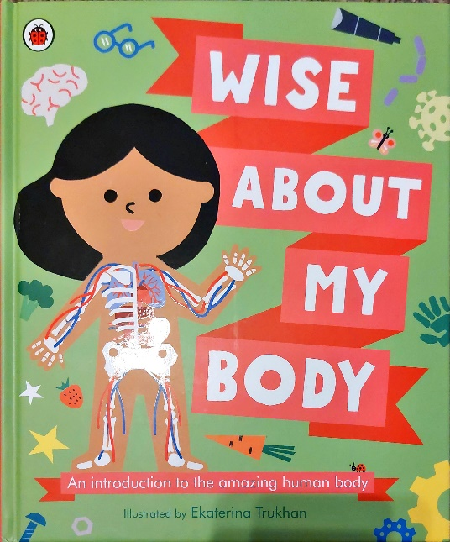
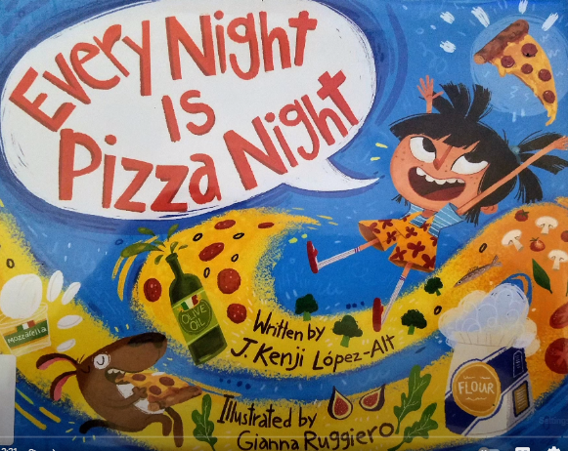
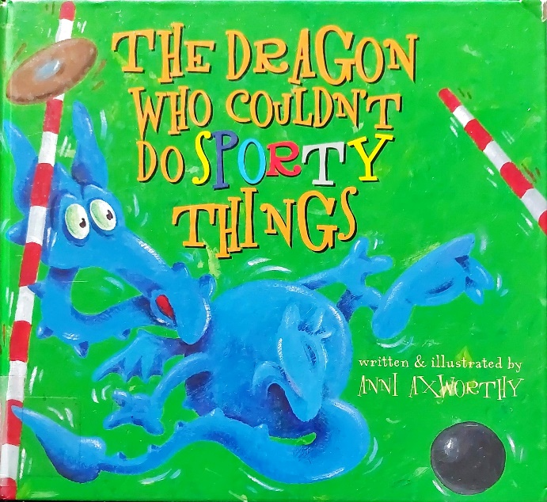
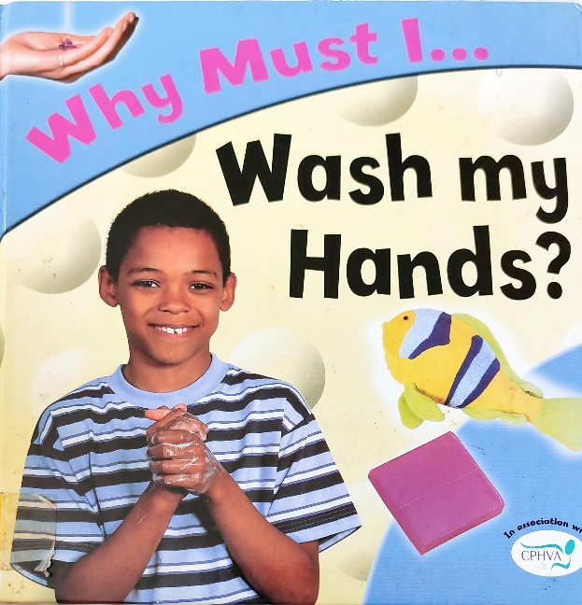
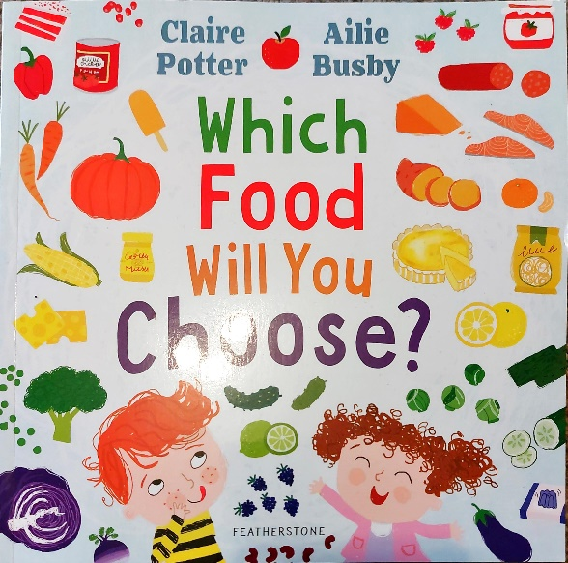
Spring 1 Y2 : Healthy Me
Key books this term
Which food will you choose?
Wise about my body
Every night is pizza night
The dragon who couldn’t do sporty things
Wash my hands
Key Vocabulary:
Beige: a pale sandy colour.
Flask: a container for liquids.
Honeydew: a type of melon which had a greenish, yellow peel and a pale green inside.
Gazillions: a very large number or amount used for emphasis.
Coriander: this is a herb that’s used in cooking.
Key Questions?
Why is the mum sick of beige food?
What games do you think they’ll play in the supermarket?
Why should we eat different coloured foods?
What would you make with these foods?
Key Vocabulary:
Disabilities: A physical or mental condition which limits a person’s movements.
Genes: Tiny pieces of information from our parents, which determine what we look like.
Organs: a large internal body part, which helps to keep us alive.
Key Questions?
Thinking about our genes, who do you most look like in your family?
Can you name any internal organs?
Do you know anyone with a disability? What do you know about their condition?
Key Vocabulary:
Bibimbap: a Korean rice dish.
Data: facts and data collected for analysis.
Tagine: a North African stew of spiced meat and vegetables.
Empanada: a Spanish pastry filled with savoury ingredients.
Key Questions?
How do the parents feel about having pizza every night?
Why does Pipo think pizza is the best?
Is it healthy to have pizza every night?
Why is it good to try new foods?
Do you think she’ll prefer the other foods to pizza?
Key Vocabulary:
Exhausted: where you are extremely tired.
Shot put: an athletic contest where you throw a heavy round ball as far as possible.
Javelin: a light spear thrown in a sports game.
Pole vault: an athletic event where you attempt to jump over a high bar.
Key Questions?
Does the dragon live a healthy lifestyle?
Why is it good to do sports?
What can you practise at an athletics class?
Why did the dragon put on weight?
How do the family feel seeing the dragon win the event?
Key Vocabulary:
Molecules: Small particles in soap.
Germs: Tiny living things that can cause and spread diseases and viruses.
Sweat: your body’s way of cooling down.
Head lice: Tiny insects that live in your hair.
Nits: Head lice eggs.
Key Questions?
When and why should we wash our hands?
Does washing our hands with just water get rid of germs?
Why should you shower after going swimming?
How can head lice be spotted?

Slide 2
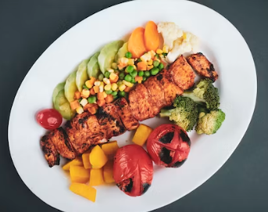
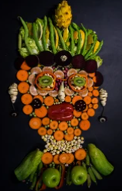
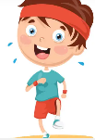
.
Music
We will be continuing with our drumming lessons, but these will move to a Thursday.
Science
Design and Technology
This half term is all about food technology. The children will understand where food comes from and have a basic understanding of what constitutes a healthy and balanced diet. They will prepare a healthy dish.
Mathematics
As our theme is all about keeping healthy and looking after ourselves, our science will be focusing on the importance of exercise, eating the right amounts of different types of food, and hygiene. Children will also learn that animals including humans have offspring that turns into adults.
Money
The children will learn to count money in pence. They will make amounts using different coins and explore which amount is greater. Children will apply their knowledge of addition and subtraction to add amounts and work out change.
Practise at home by counting loose change and combining amounts!
Download and play the White Rose maths 1 minute maths game
This term, the children will learn how songs and music can communicate different moods and emotions. They will investigate different ways to express the mood of a song by adding facial expressions and changing the timbre and dynamics of their voice. They will develop their understanding of musical mood through simple songs, where they will be introduced to major and minor tonality.
Multiplication and Division
The children will make connections between repeated addition as multiplication (e.g. 3x2 is the same as 3 lots of 2).
We will explore division through sharing.
Special Activities this half term will include:
First Aid for Children
Using a smoothie making bike
.
Art
RSHE
The children will be refining their colour mixing skills using powder paint. We will be studying the work of artist Guiseppe Arcimboldo.
PE
Indoor – Fitness
The children will take part in a range of activities to develop components of fitness. The children will begin to explore and develop agility, balance, co-ordination, speed and stamina.
Outdoor – Sending and Receiving
The children will develop their sending and receiving skills including throwing and catching, rolling, kicking, tracking and stopping a ball. They will also use equipment to send and receive a ball. Children will be given opportunities to work with a range of different sized balls. They will apply their skills individually, in pairs and in small groups and begin to organise and self-manage their own activities.
.
Phonics
Much of our phonics teaching is now working on spelling patterns and rules. Please encourage your children to practise writing at home as this gives them chance to apply the spelling patterns they have learnt.
English
AT HOME: Please read your school reading books and practise reading your tricky words regularly. Please log reading in your child’s reading diary.
Jigsaw – Dreams and Goals
In this topic, the children are learning how to better themselves by setting realistic goals and making steps towards achieving them. We will be talking about New Year’s Resolutions.
Writing
This half term we will be working on Narrative writing. This will involve the children writing stories that have been adapted from a borrowed structure.
Grammar
As always we will be practising our capital letters and full stops. We will be using the past tense (-ed) and commas too. The children will be encouraged to stretch their sentences using conjunctions.
Handwriting
We will continue practising letter formation and the positioning of letters using our handwriting lines. It is essential that the children form their letters correctly as this will help when we move on to joins in Spring 2.
Reading
Please continue to practise reading regularly at home. It doesn’t matter what the reading material is- comics, leaflets, books, poetry etc. It all counts. School reading books will also be sent home.
We aim to promote a love of reading in school and all of our learning comes from quality books.
.
Please read the e-books on the monster phonics website. You should have received a new log in from Monster Phonics directly. If you haven’t use this link.
https://ebooks.monsterphonics.com/register/standard-school/?ca=282bccec0f3a2379c9ff4c6075b28fa1
RE
Computing
We will find out about Islam, key beliefs and ways of living for Muslims. The children will learn about some of the key Muslim beliefs about God found in the Shahadah and learn about the 99 names of Allah. We will learn about the five pillars of Islam and how these impact upon the lives of believers. Children will know about the importance of prayer and what it means for Muslims all over the world
The children will develop their understanding of the various aspects of using a computer to create and manipulate text. They will become more familiar with using a keyboard and mouse to enter and remove text.

Slide 3
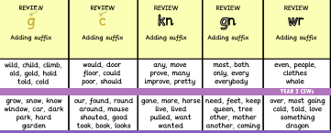
These are the sounds and words that your child should be able to read by the end of this half term. The e-book titles correspond to the sounds and words taught each week. These words will also be the weekly spells that will be checked on a Friday.
Year 2 Spring 1
Week 1 | Week 2 | Week 3 | Week 4 | Week 5
E-book Titles | Review Lost in the woods Magic stranger The sun and shadows | Review The sad prince and princess | Review The life of a knight | Review Gnomes underground | Review Tricky witch wrecks her wrist

