Slide 1
Mrs T’s Weekly challenge
Let’s make music

Slide 2
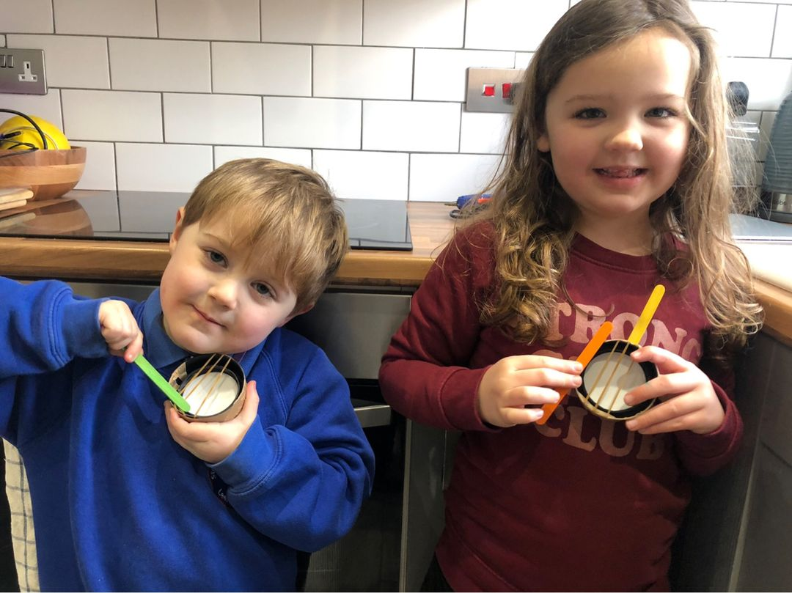
Mini violins from brother and sister. Brother even managed to get his under his chin.

Slide 3
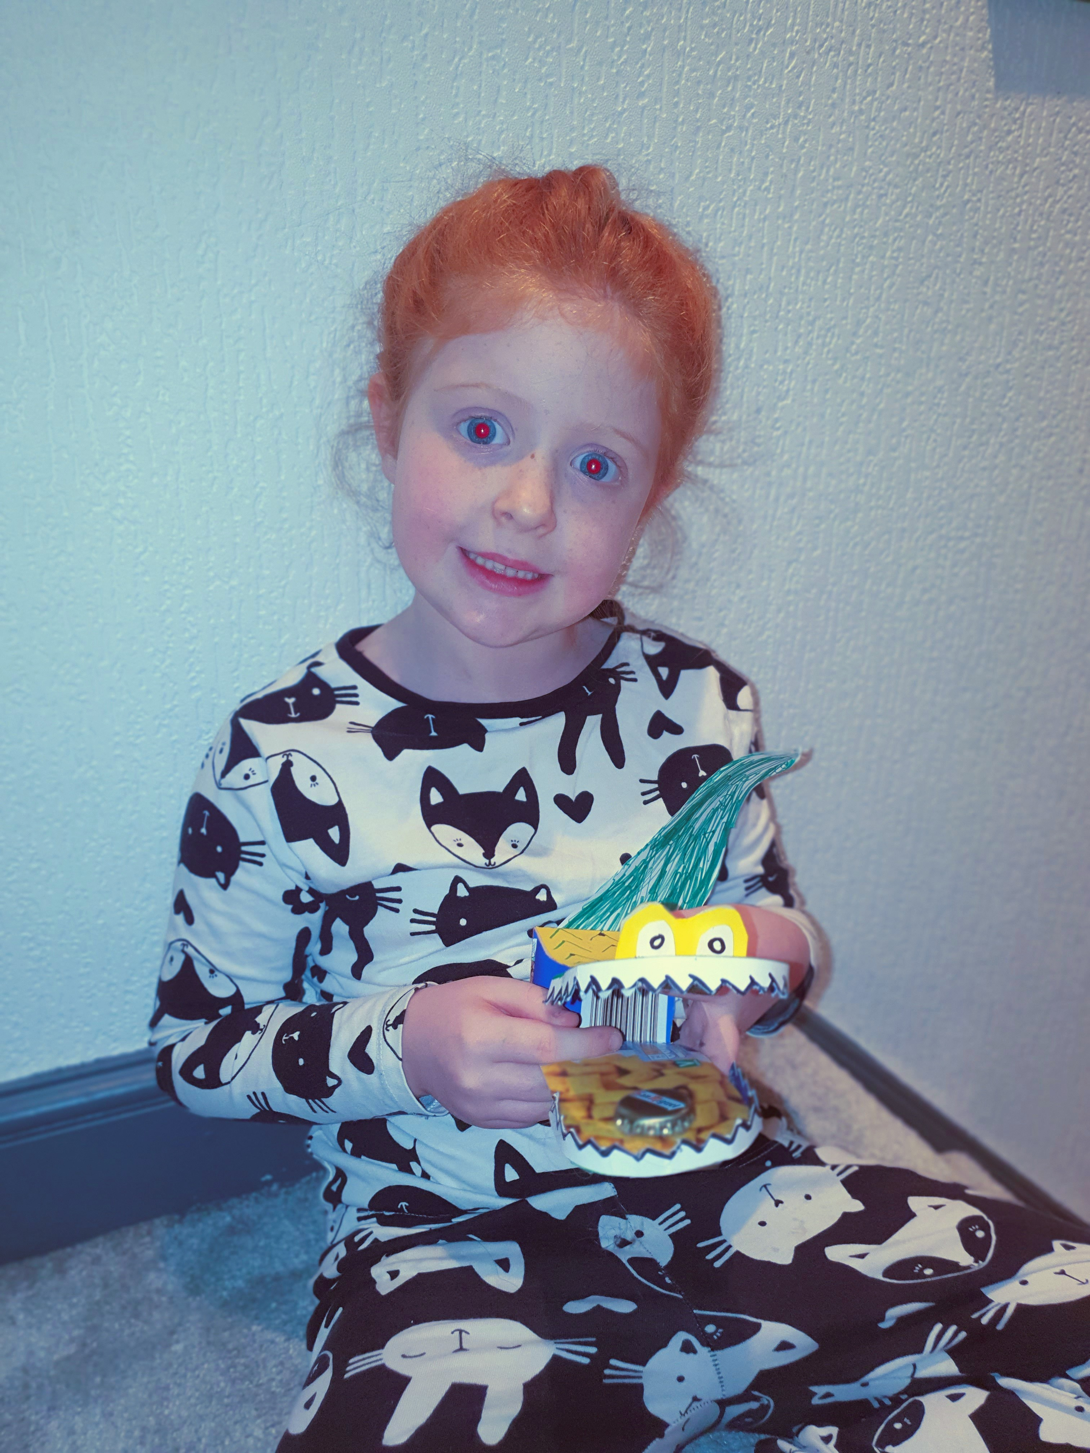
Crocodile Castanets. Brilliant.

Slide 4
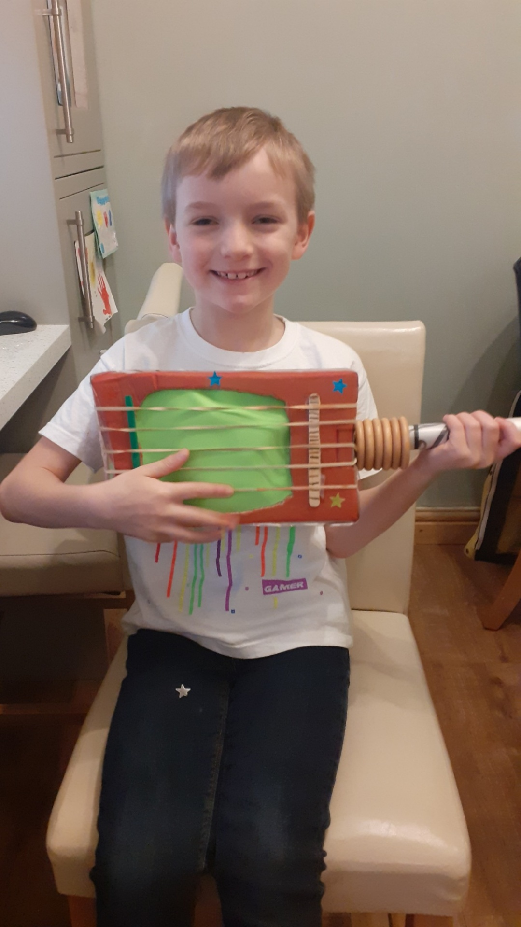
Look at that guitar. It’s amazing.

Slide 10
Well done to all our little musicians.

