Slide 1
Mrs T’s Weekly challenge – 25.1.2021
Let’s send in messages and pictures to our Alpine Lodge Friends.

Slide 2
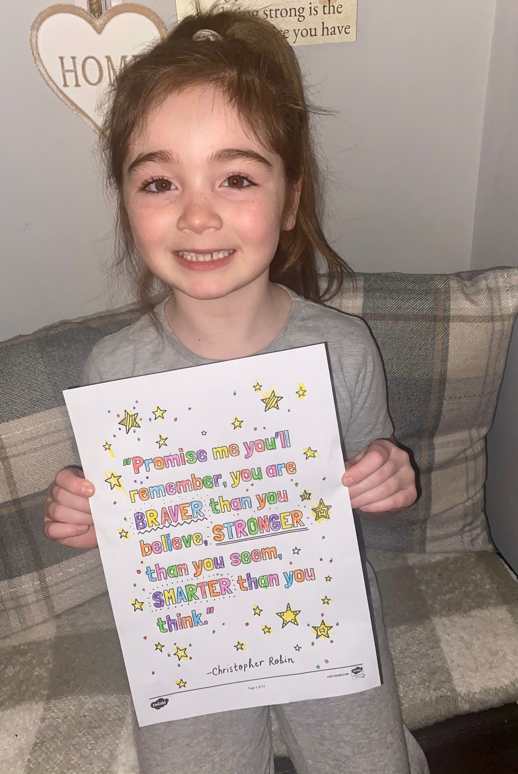

Slide 3
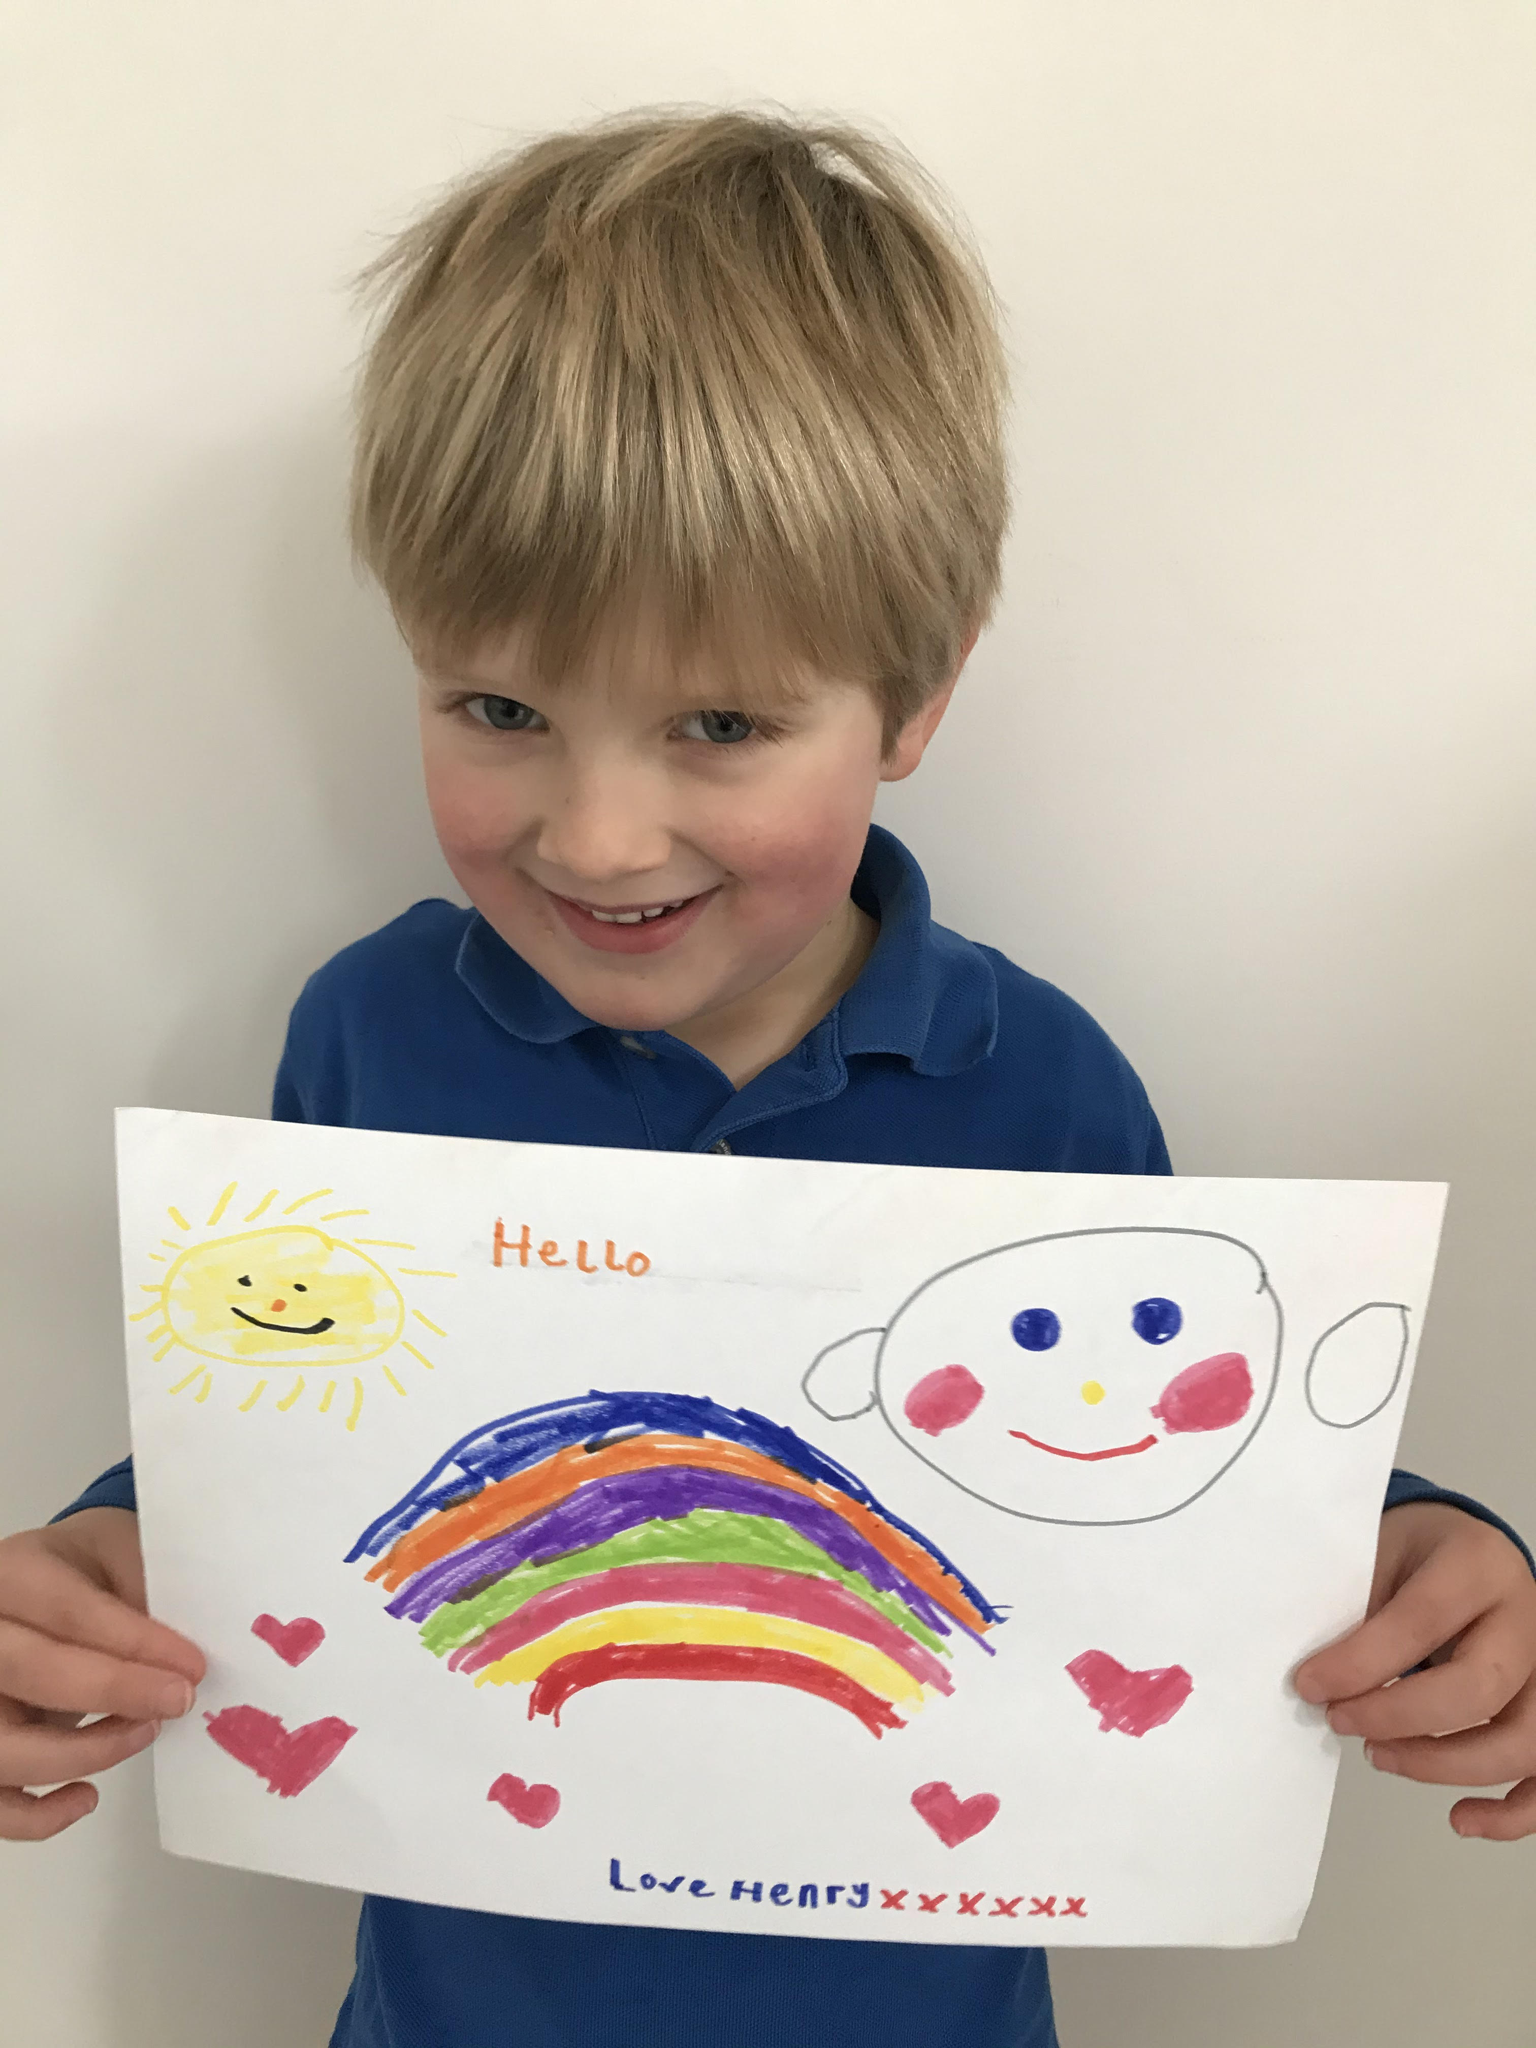

Slide 4
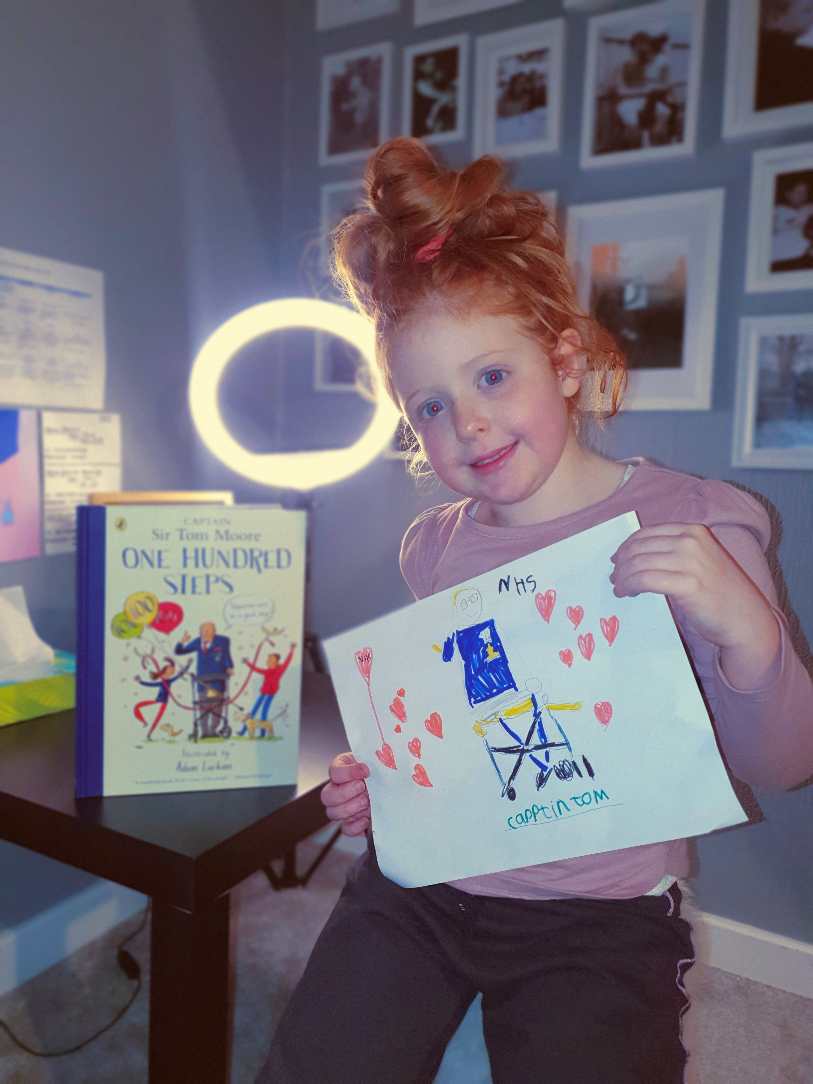
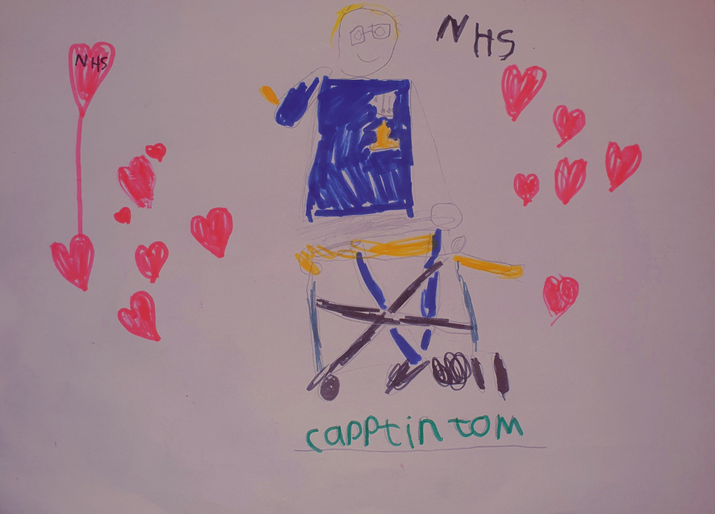

Slide 5
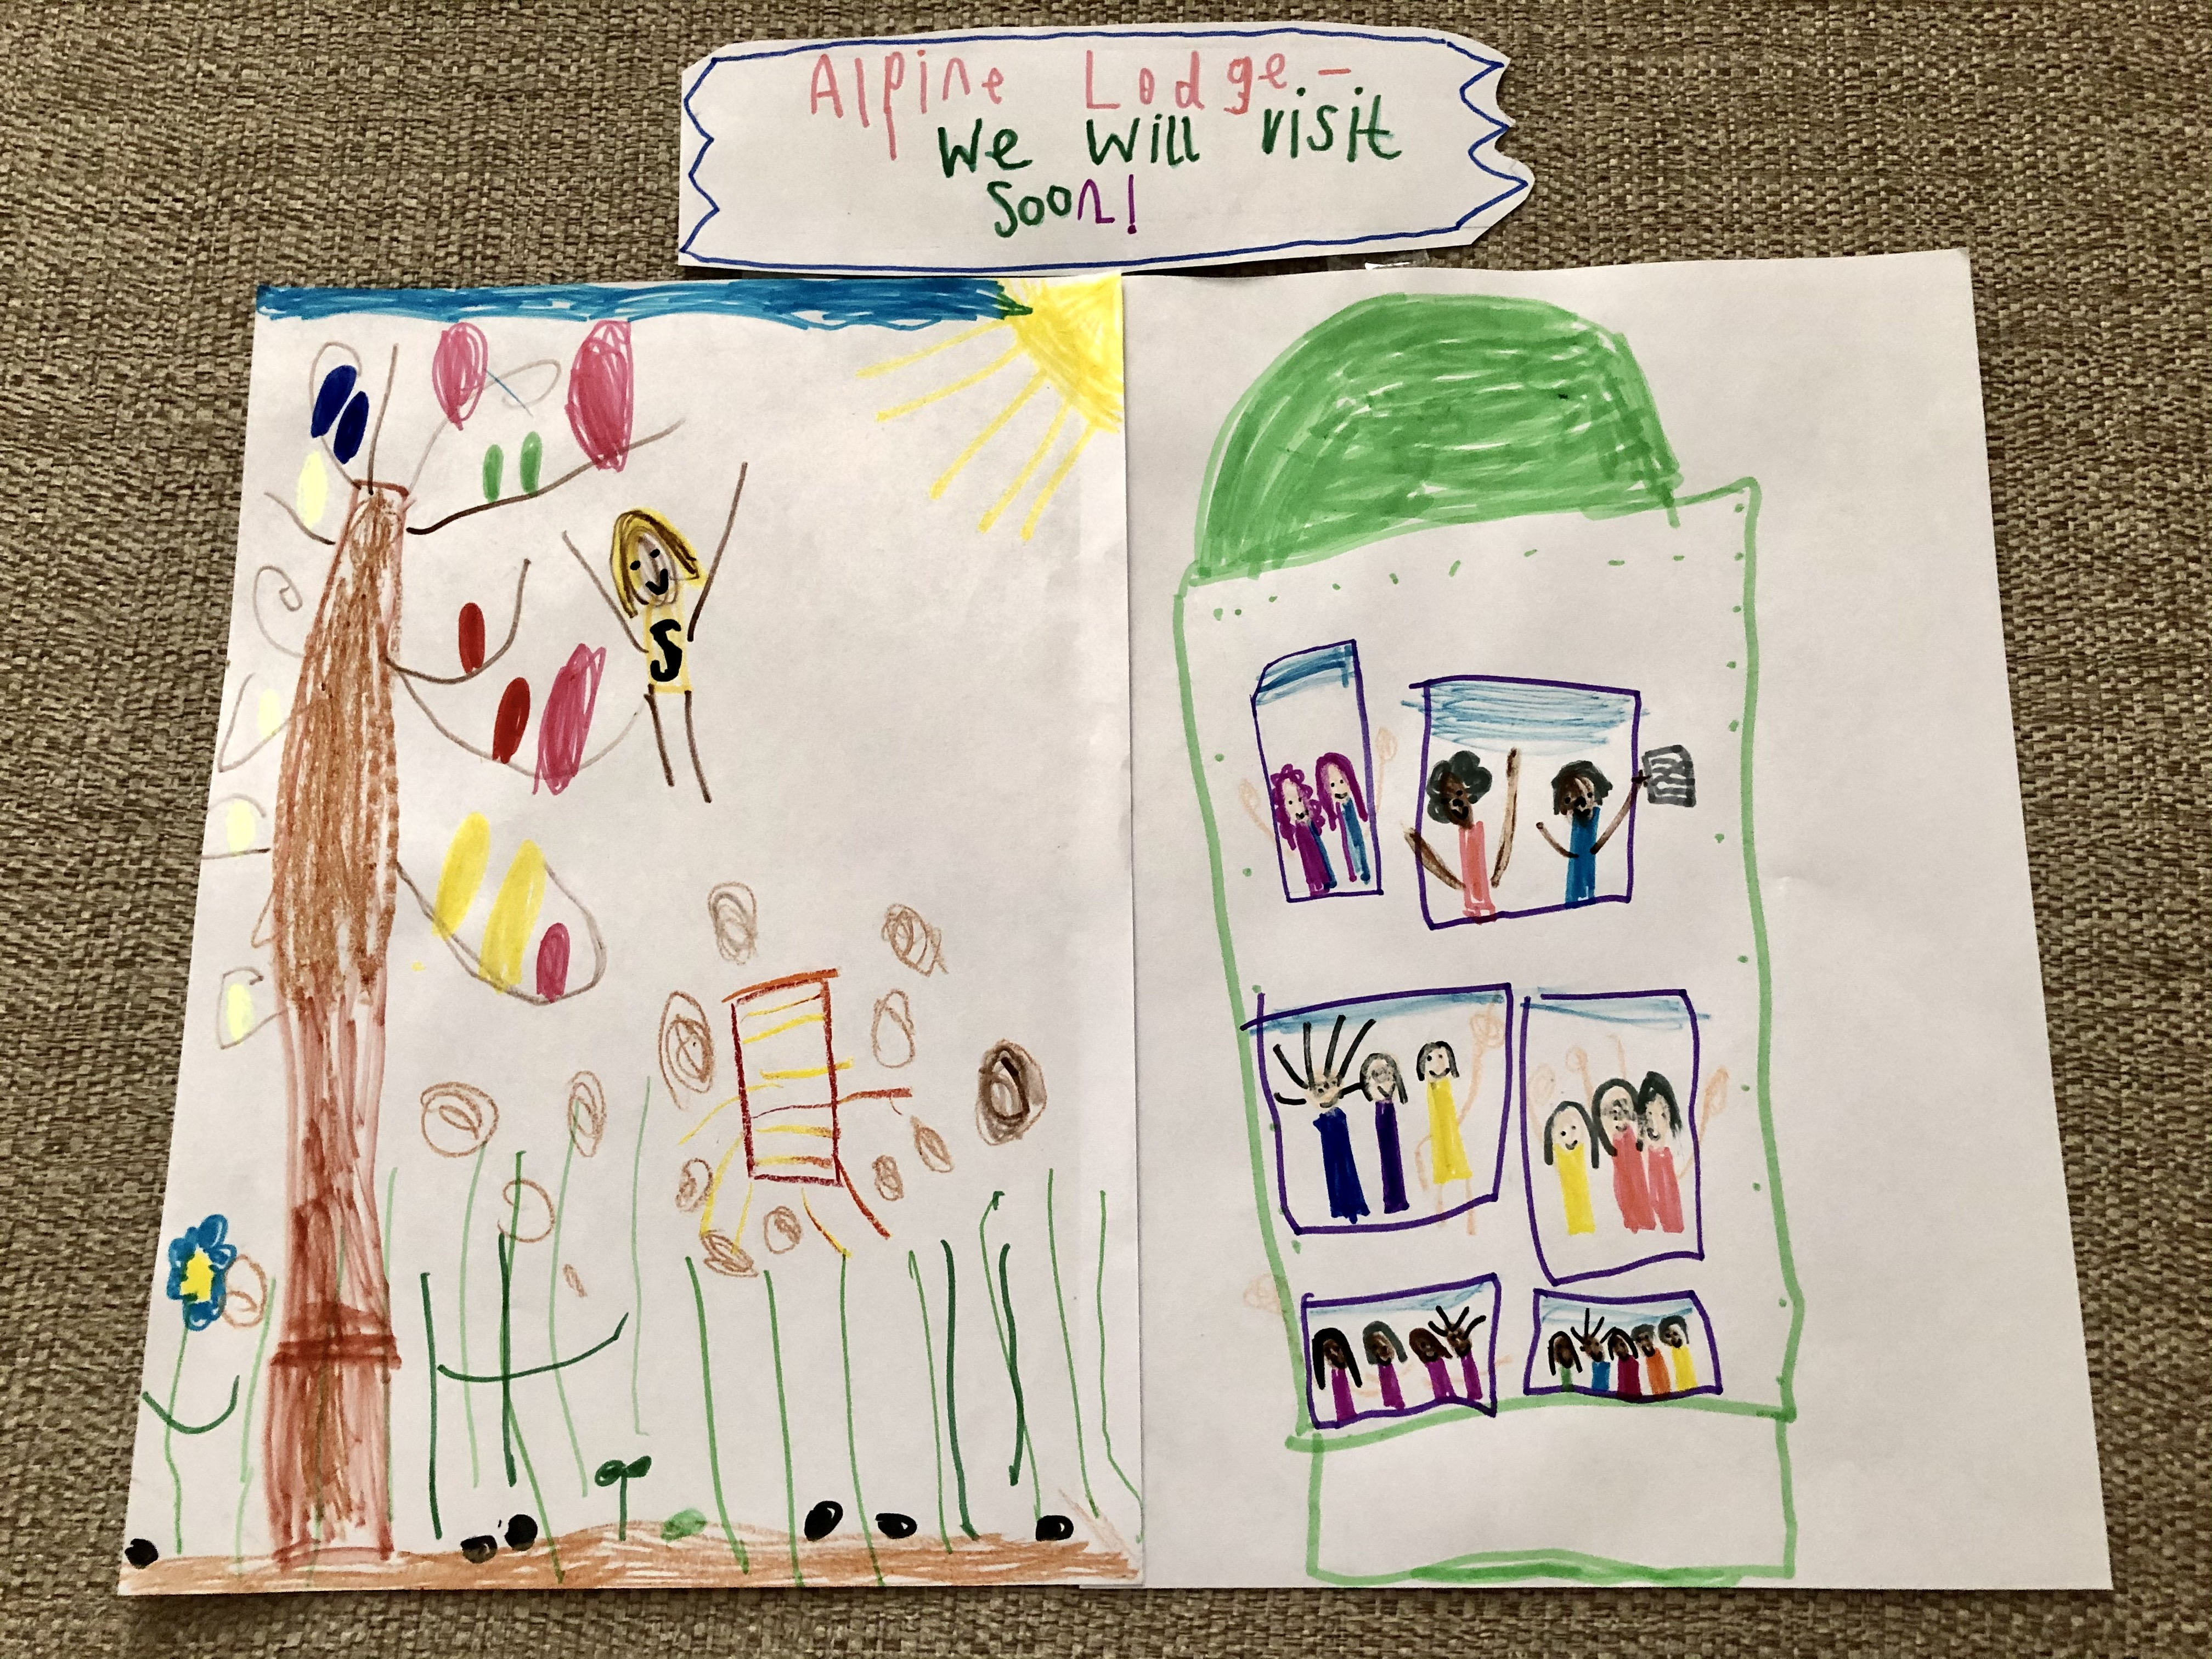

Slide 8
We’re looking forward to the time when we can come across and spend time with you all again - to play games and to share our songs.

