Slide 1
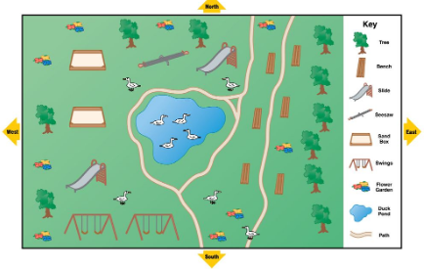
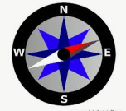
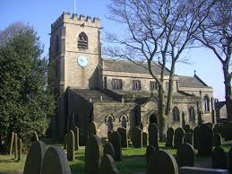
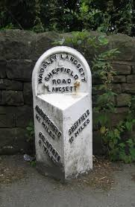
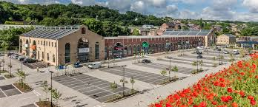
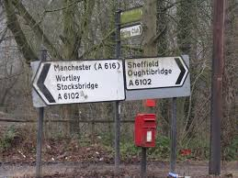
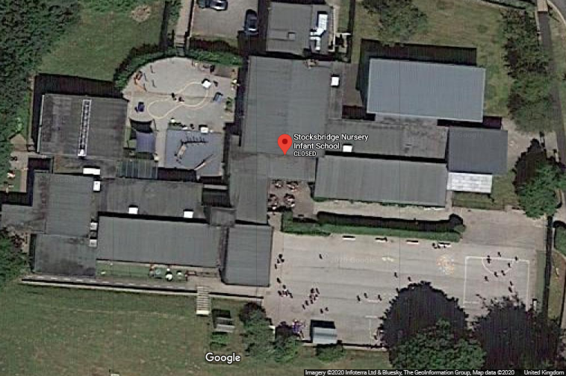
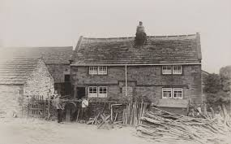
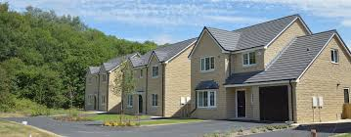
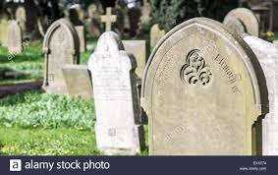
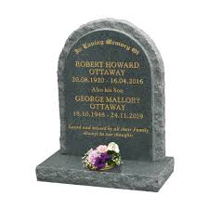
What’s that on top of the hill?: KS1 Knowledge Mat
Vocabulary
hill | A piece of land that rises higher than everything surrounding it. It looks like a little bump in the Earth.
valley | A valley is a low area between hills or mountains typically with a river running through it.
aerial | A view taken from above. Maybe known as a ‘bird’s eye view.’
past | Something that has already happened.
present | Something that is happening now.
future | Something that hasn’t happened yet.
This is a simple map with a key. A key tells us what the things are on a map.
This is an aerial view of Stocksbridge NI School
Old | New

Slide 2
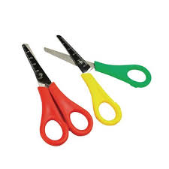
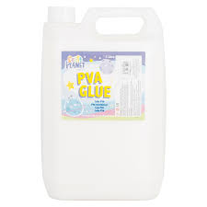
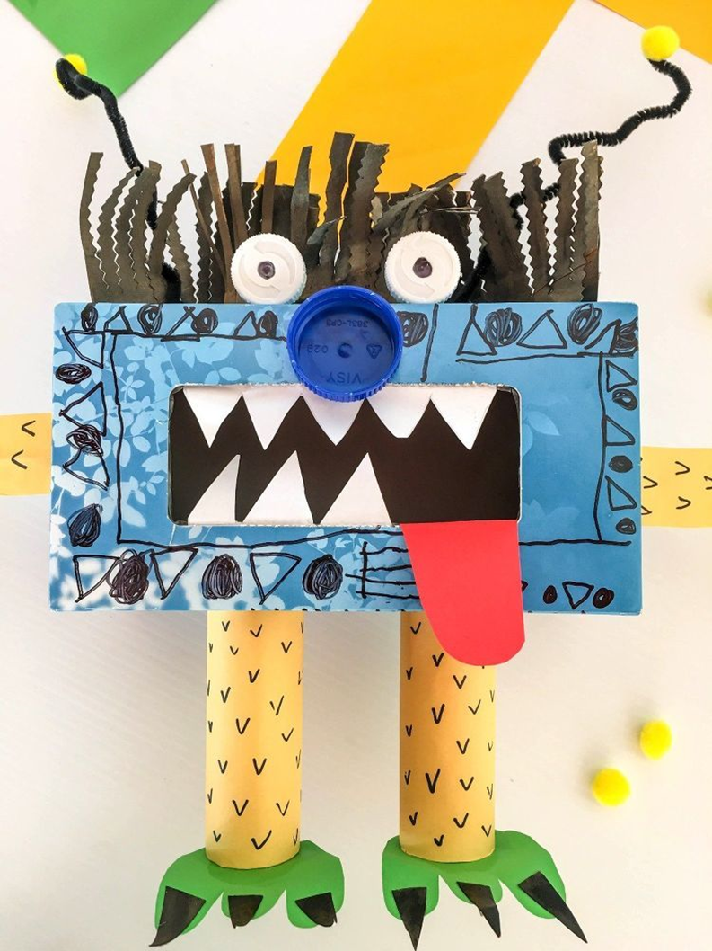
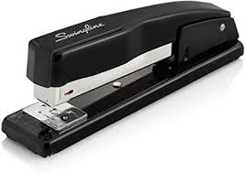
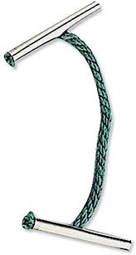
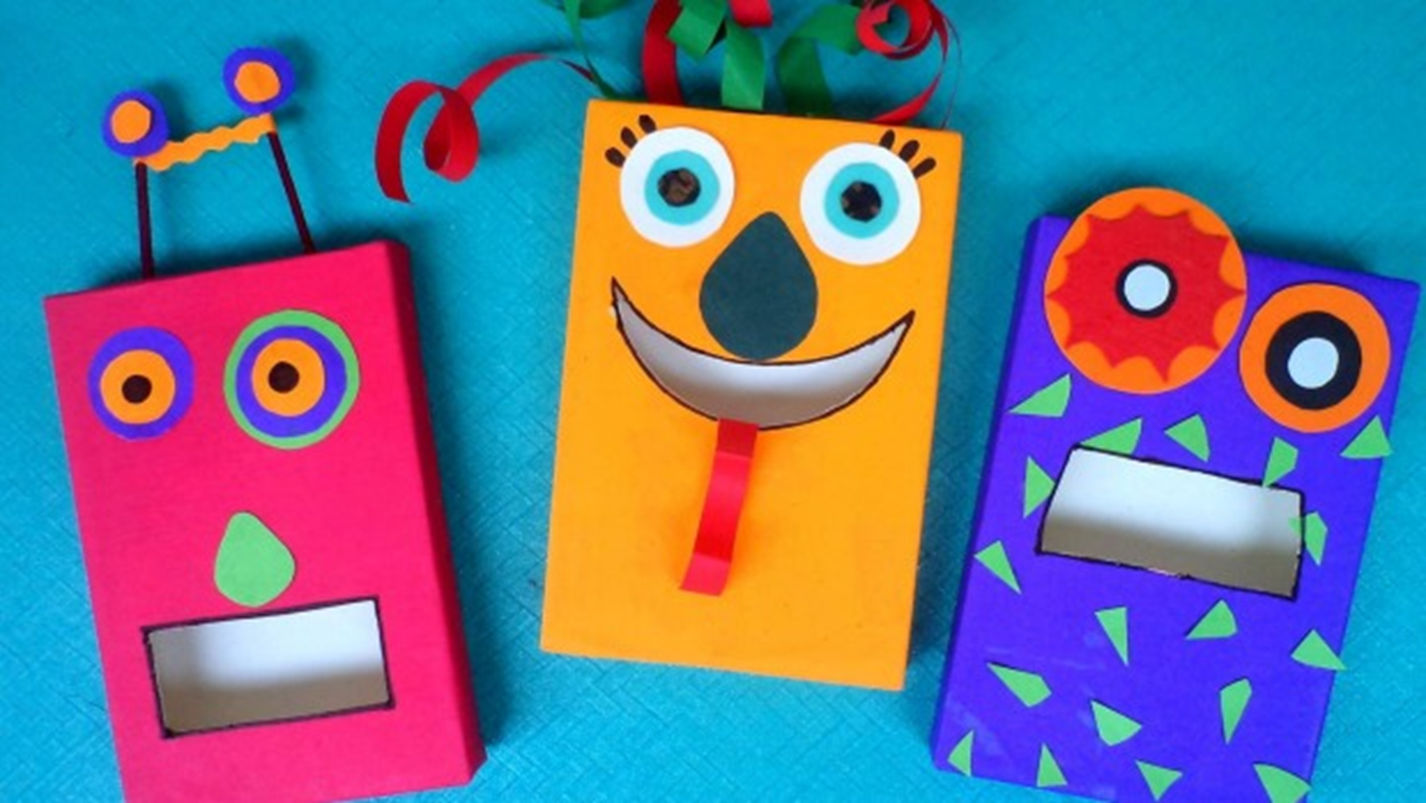
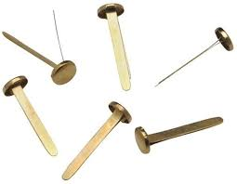
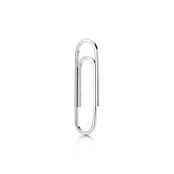
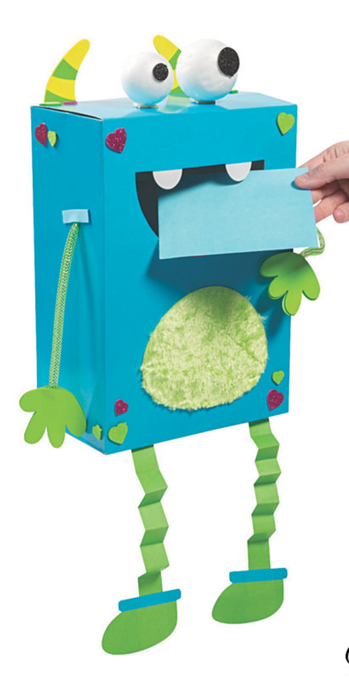
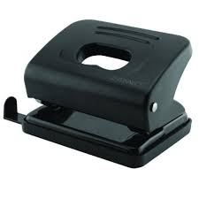
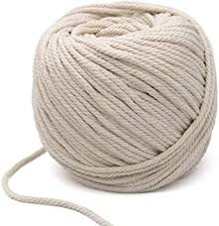
Materials
Material | Material information | Properties
Wood | The material that comes from a tree. It varies in hardness. It is used to make paper. | Y1- Hard, rough Y2- solid, variable, malleable,
Plastic | A ‘man-made’ material that can be shaped or moulded to any shape. | Y1- Hard, strong, colour, Y2- waterproof, long lasting, different forms, flexible,
Metal | A tough and strong material which can be heated and shaped into anything. | Y1- shiny, hard, heavy Y2- durable, solid, reflective, dull, shiny
Rubber | A raw ‘natural material’ comes from a tree. Can be moulded into many shapes. | Y1- squishy, bendy, soft Y2, malleable, flexible, odour
Glass | Made from sand, a transparent material that is in a solid form. | Y1- see through, hard Y2, transparent, solid
Fabric | Made of natural materials woven together to make clothes, cloths etc. | Y1- soft, coloured Y2- flowing, lightweight, absorbent
Rock | Found in natural forms, comes in a range of colours, sizes and textures. | Y1- hard, rough, smooth Y2- crumbling, grainy, textured
Scissors
PVA glue
Stapler
Treasury tag
Split pins
Paper clip
Hole punch
String

