Slide 1
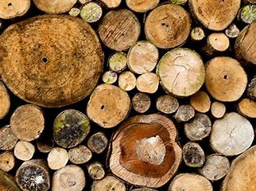
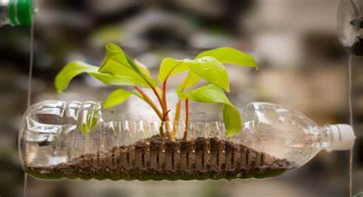
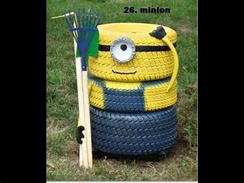
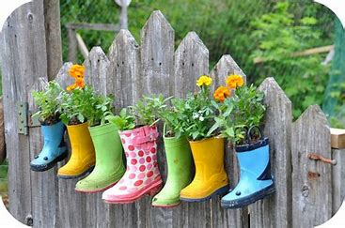
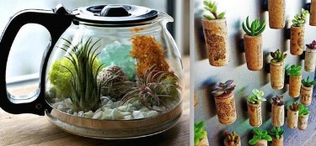
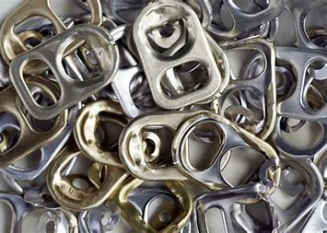
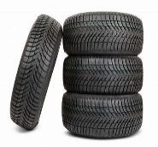
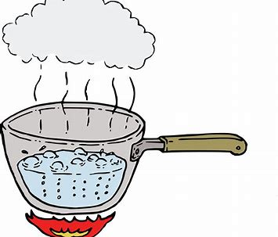
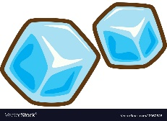
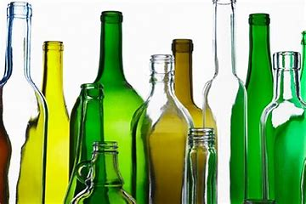
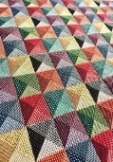
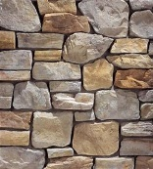
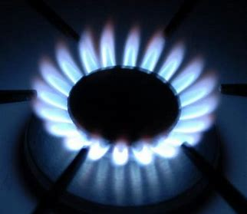
KS1: Reduce, Reuse, Recycle
Subject Specific Vocabulary
Material | Material information | Properties
Wood | The material that comes from a tree. It varies in hardness. It is used to make paper. | Y1- Hard, rough Y2- solid, variable, malleable,
Plastic | A ‘man-made’ material that can be shaped or moulded to any shape. | Y1- Hard, strong, colour, Y2- waterproof, long lasting, different forms, flexible,
Metal | A tough and strong material which can be heated and shaped into anything. | Y1- shiny, hard, heavy Y2- durable, solid, reflective, dull, shiny
Rubber | A raw ‘natural material’ comes from a tree. Can be moulded into many shapes. | Y1- squishy, bendy, soft Y2, malleable, flexible, odour
Glass | Made from sand, a transparent material that is in a solid form. | Y1- see through, hard Y2, transparent, solid
Fabric | Made of natural materials woven together to make clothes, cloths etc. | Y1- soft, coloured Y2- flowing, lightweight, absorbent
Rock | Found in natural forms, comes in a range of colours, sizes and textures. | Y1- hard, rough, smooth Y2- crumbling, grainy, textured
Gas | We can’t see gas but it is all around us. There are different types of gas. | Y1- Cannot see it Y2- invisible, odour
Liquid | Liquids can flow and take on the shape of their container. | Y1- wet, runny, Y2- no shape, slippery
Did you know?
Many of the materials we use or look at can be recycled, reused or reduced. We can recycle plastic, paper, metals. We can reuse bottles, cardboard in many ways. What could you reuse?
Changing materials
Freeze
When the temperature is below 0 a liquid freezes.
Boil
When the temperature is above 100 a liquid boils.
Squash
When a material is pushed together with force it is squashed and changes
shape.
Squeeze
When a material is pushed together with force, but springs back to the same shape.
Stretch
When a material is pulled apart and then its elasticity puts it back to the same shape.
Bend
When a material is flexible to bend up and down and can be returned to its original
shape

