Slide 1
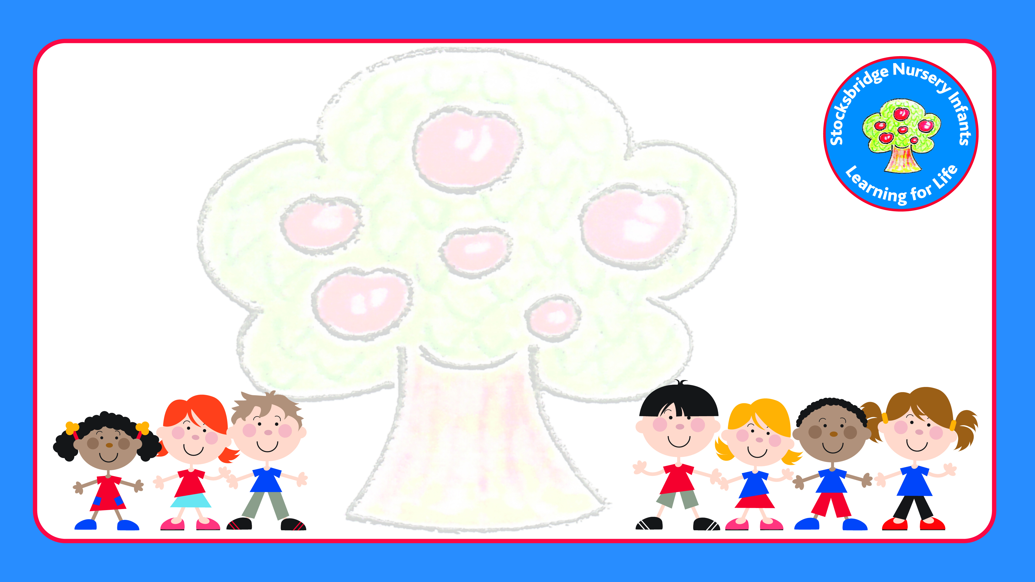
Stocksbridge Nursery Infants
Teaching Handwriting
Your name

Slide 2
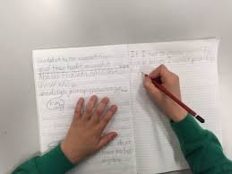
Bottom Back Chair
Posture
6 Feet on the floor
Two hands to write with
Tummy Near Table

Slide 3
Picture Space
Language of handwriting

Slide 4
Tripod grip
3 fingers gripping the pencil- one thumb, two fingers.
Pencil sits ‘back in his bed.’
1cm of the yellow/black of the pencil showing. 2-3cm if left handed.

Slide 5
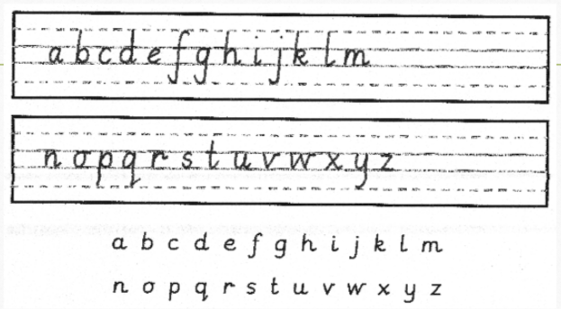
What is our handwriting style?
Picture Space

Slide 6
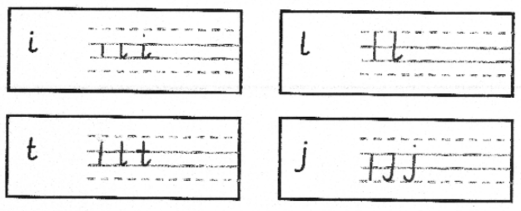
Straight line family

Slide 7
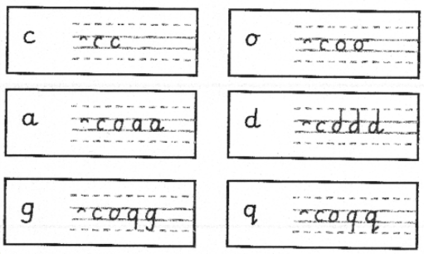
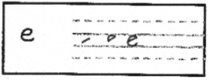
Coat hanger family
Picture Space

Slide 8
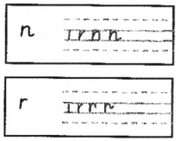
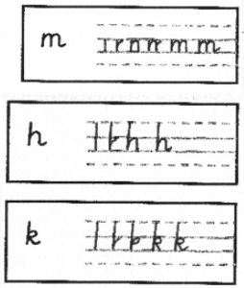
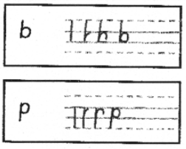
Bridge Family

Slide 9
Zig Zag family

Slide 10
Smile family

Slide 11
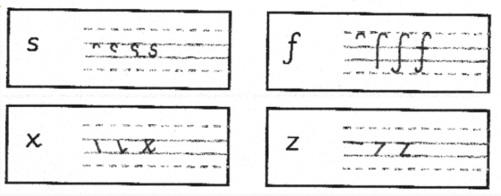
Misfits family

