Slide 1

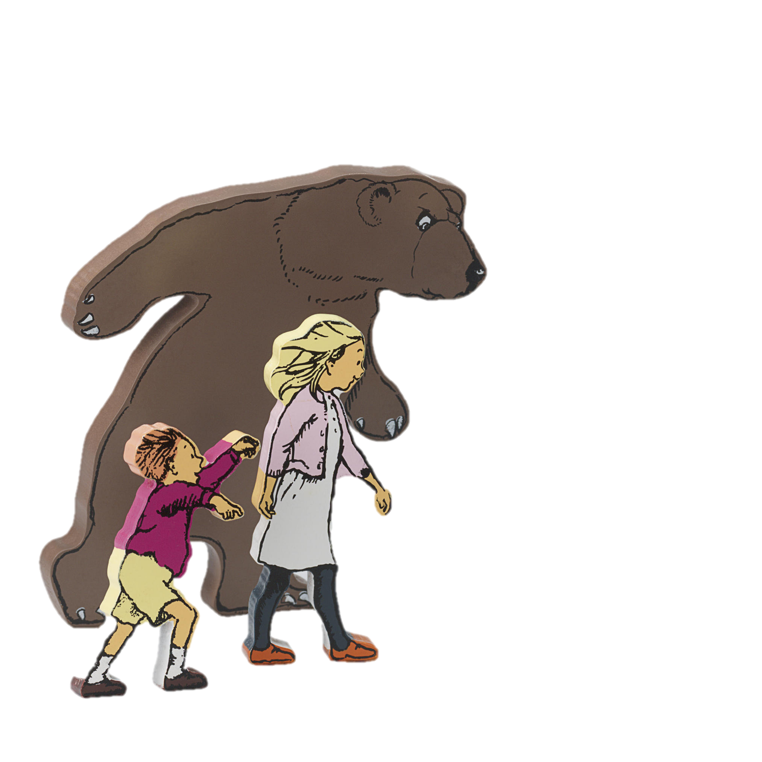
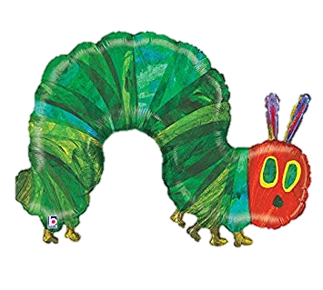
Reading at
Stocksbridge Nursery Infant School

Slide 2
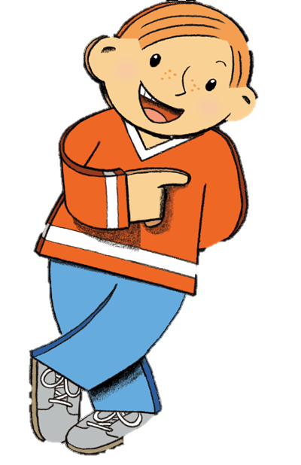

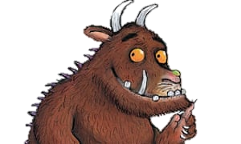
Why is reading so important?
When children learn to read at an early age, they have greater general knowledge, expand their vocabulary and become more fluent readers. They also have improved attention spans and better concentration. It opens up the curriculum and through stories, helps them make sense of the world.

Slide 3

By the end of reception
Children can read and understand simple sentences. They use their phonic knowledge to decode regular words and read them aloud accurately. They also read some common irregular words. They demonstrate understanding when talking to others about what they have read.
Notes:
This is the aim for the majority of children by the end of their reception year

Slide 4
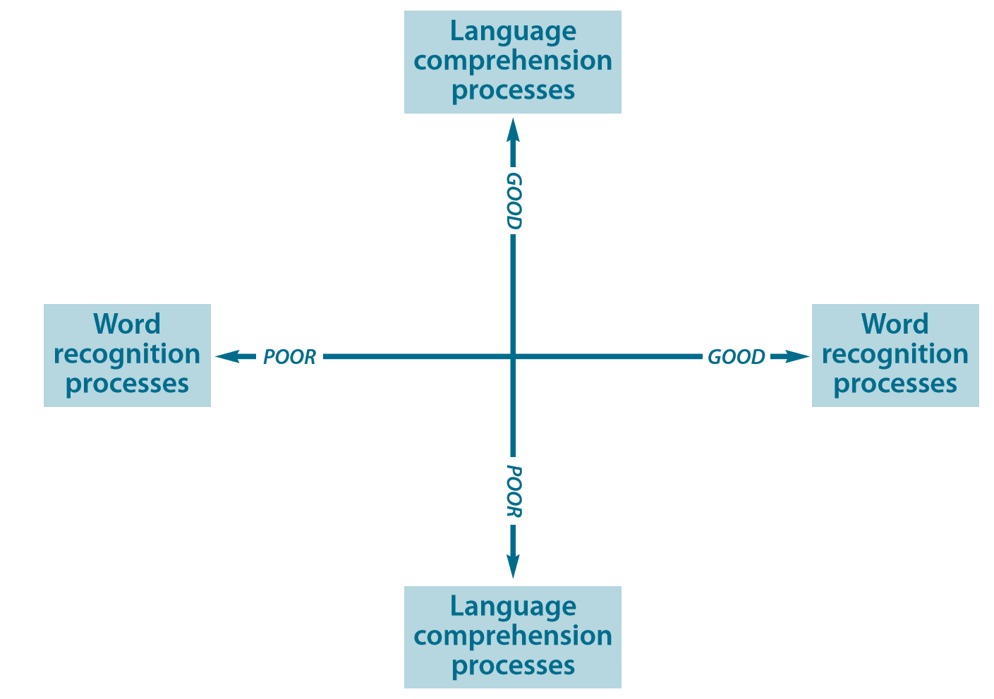
Background to the teaching of reading

Slide 5
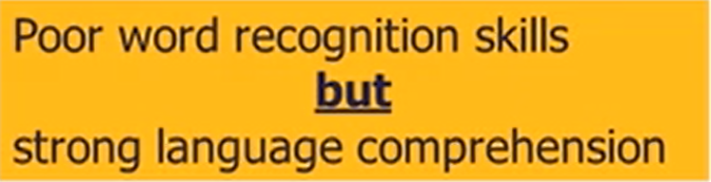
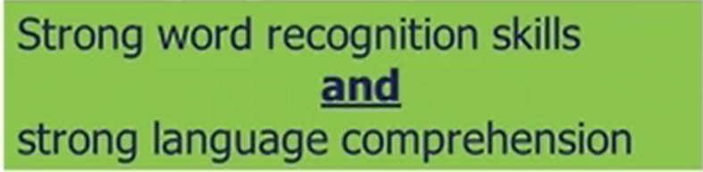
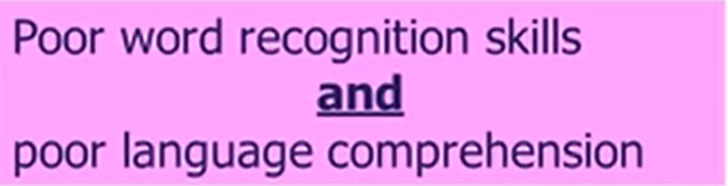
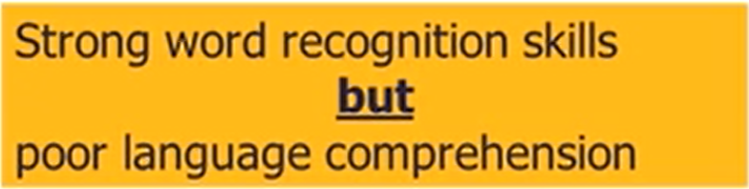
Background to the teaching of reading

Slide 6
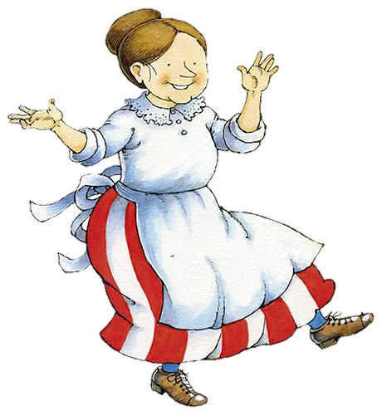
Learning to read
Children learn to read using phonics (their knowledge of how our letters are put together to make sounds).
Children learn to read using other strategies.
The emphasis is on phonics.
We’ve organised our books so that the children practise their phonic skills using one type of book. These have numbers on their spines.
They use other books to practise other strategies. These are organised in colours.

Slide 7
At Stocksbridge Nursery Infant school we use Letters and Sounds to teach phonics.
The document breaks it down into 6 phases. We have extended ours to 8 phases. Letters and Sounds was develop before the new National Curriculum which came out in 2014. The expectations for Year One and Two have been raised. Our program includes these raised expectation.
The expectations are high!
Phase 1 taught in Nursery.
Phase 2 & 3 taught in Reception. The expectation is 80+%
Phase 4 & 5 taught in Year 1. The expectation is 80+%
Phase 6, 7 & 8 taught in Year 2.
It is carried on into Y3 and beyond.
Notes:
Government guidelines

Slide 8
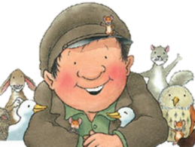
Letters and Sounds
Phase One:
The activities are designed to help children –
Discriminate sounds in the environment (a telephone ringing, a siren, a text alert.)
Discriminate sounds instruments make – loud sounds, quiet sounds, squeaky sounds. Lots of making instruments, playing instruments
Identify rhythm and rhyme- rhyming books, nursery rhymes, rhyming pairs
Alliteration – words that begin with the same letter
Voice sounds – listening to and remembering sounds
Oral blending and segmenting
https://www.phonicsplay.co.uk/ParentsMenu.htm
https://www.phonicsbloom.com/uk/game/list/phonics-games-phase-1
Notes:
Government guidelines

Slide 9
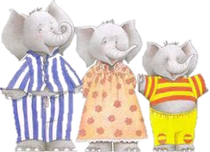
Oral Blending
Hearing a series of spoken sounds and merging them together to make a word
e.g. b-u-s
b-ir-d
Sh-i-p
We try and do it lots through the day
P-u-sh your chair under
S-t-a-n-d u-p!
Where is my p-e-n?
Notes:
Government guidelines

Slide 10

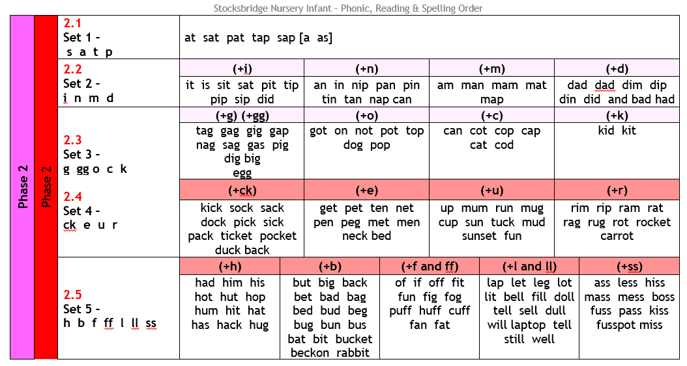
Letters and Sounds
Phase Two
Notes:
Government guidelines

Slide 11
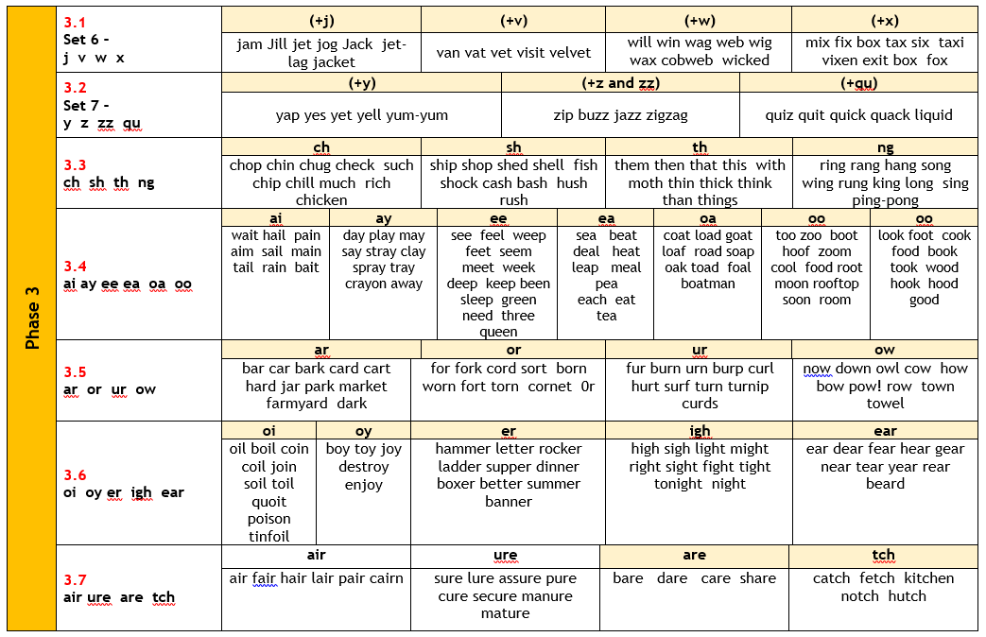
Letters and Sounds
Phase Three
https://www.bbc.co.uk/bitesize/topics/zvq9bdm
Notes:
Government guidelines

Slide 12
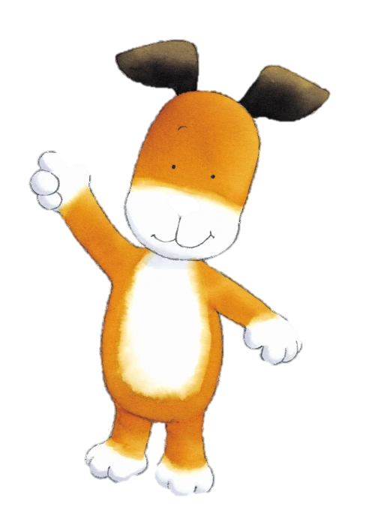
Teach phonics every day using a similar approach all the way through school.
Phoneme is the sound we say. Grapheme is the letters we write to make the sound.
Sing the alphabet – hundreds on the internet but make sure it’s shows the grapheme in lower case and upper case. Not just uppercase.
Gross motor skills – large scale movements with scarves, streamers, paper strips, painting with brushes and water, big chalk movements on playground wall or yard.
Dough disco – using play dough. https://www.youtube.com/watch?v=i-IfzeG1aC4&safe=active + lots more examples on you tube.
Introduce phoneme using Geraldine the Giraffe – from YouTube and using our puppet
Introduce new phoneme/grapheme using flash card
Revise other sounds learned
Play a game
Practise writing grapheme
It develops as we move through the year groups.

Slide 13
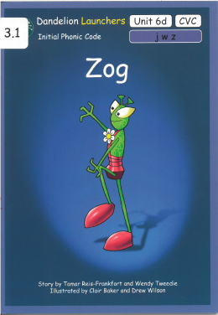
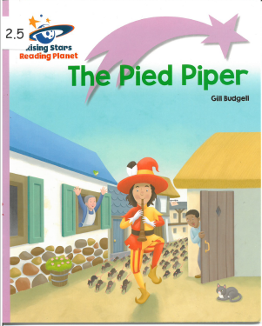

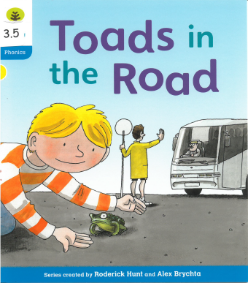
Our phonics books are labelled with the same numbers.
Your child will bring home a book to practise the phonics they are learning in school. These books are to practise blending.

Slide 14

Blending for reading
Blending is for reading
Being able to say the letter sounds (phonemes) in a written word and blend them together to pronounce the word
e.g. c-u-p = cup
p-i-ck = pick
t-e-ll = tell
sh-i-p = ship
r-ai-n = rain
m-oo-n = moon
c-are = care
Take care to say the pure sounds.
http://www.phonicsinternational.com/hear_the_sounds/hear_the_sounds_1.htm
https://www.youtube.com/watch?v=IwJx1NSineE&safe=active
Notes:
Government guidelines

Slide 15

Segmenting
Segmenting is for writing.
This is being able to identify the sound in a spoken word and write down the grapheme which represents the sound (or the phoneme)
e.g. mug = m-u-g
sick= s-i-ck
sell = s-e-ll
play = p-l-ay
Notes:
Government guidelines

Slide 16
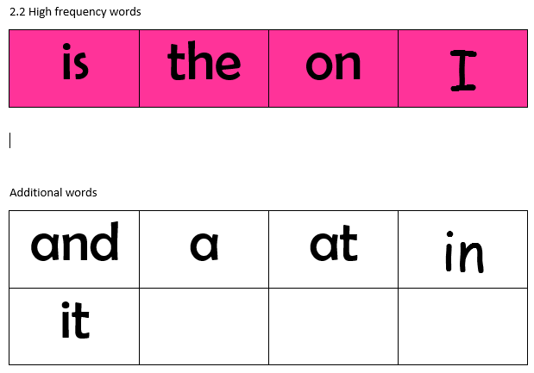
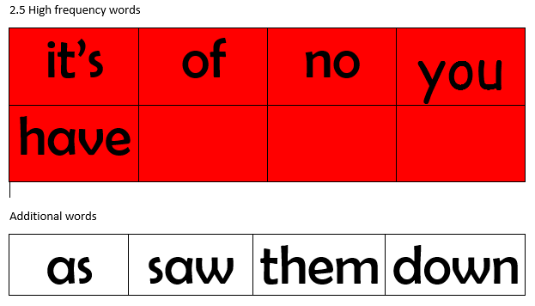
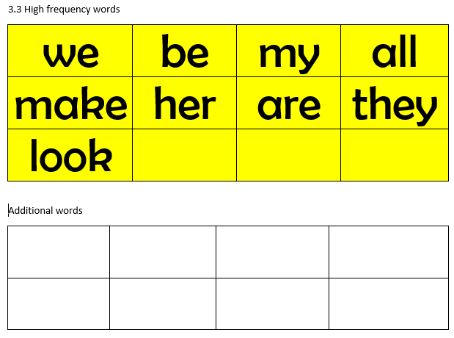
Keywords, Tricky words or Common
Exception Words
If we only rely on words which we can decode (sound out) our choice of books would be very limited….and boring. We have revised our keyword lists so that they are in line with our phonics books.
Notes:
Government guidelines

Slide 17
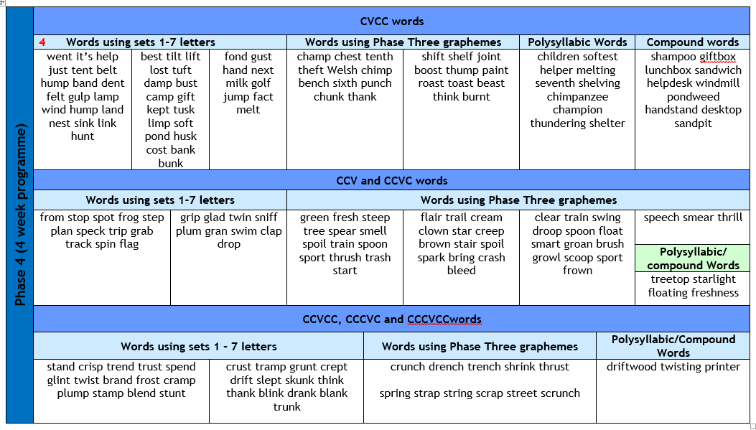
Letters and Sounds
Phase Four
Notes:
Government guidelines

Slide 18
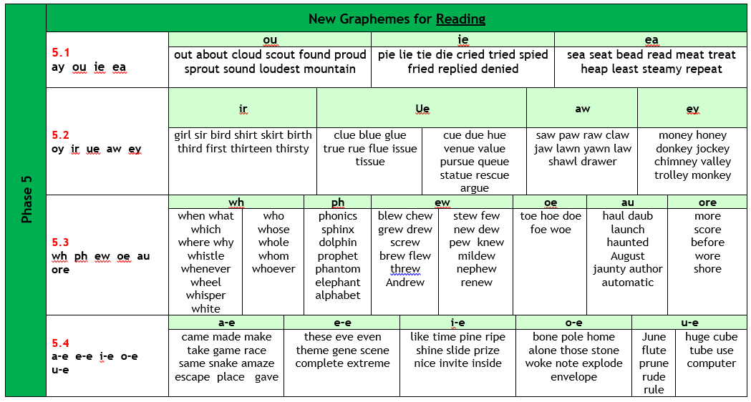
Letters and Sounds
Phase Five
Notes:
Government guidelines

Slide 19
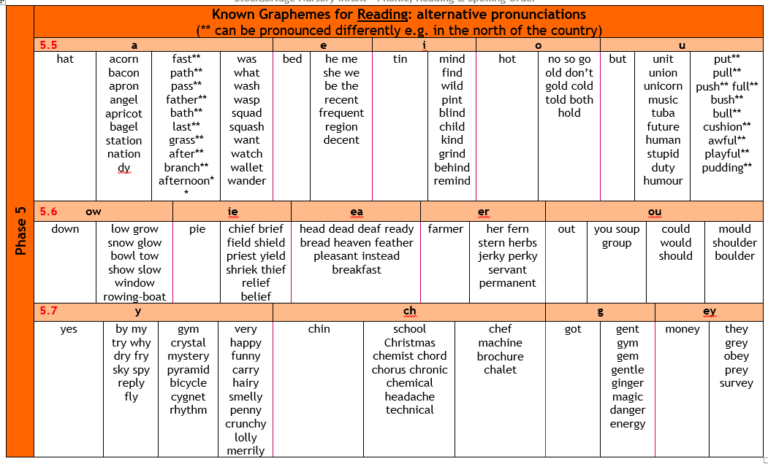
Letters and Sounds
Phase Five
Notes:
Government guidelines

Slide 20
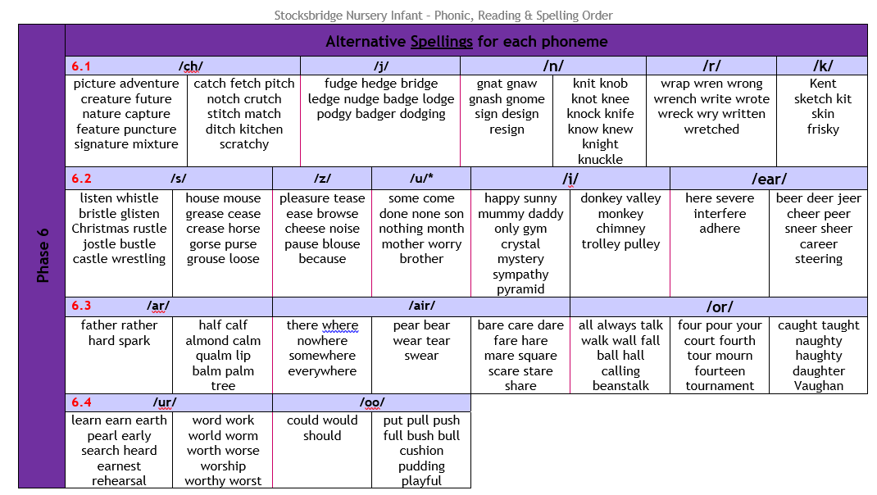
Letters and Sounds
Phase Six
Notes:
Government guidelines

Slide 21
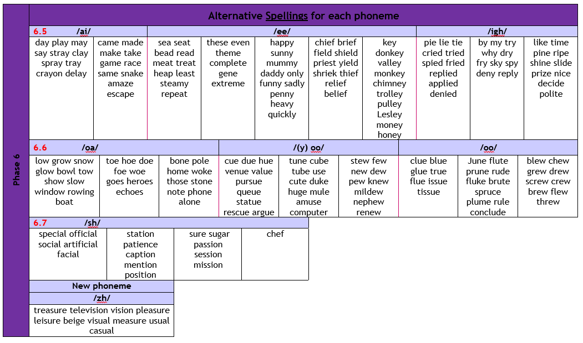
Letters and Sounds
Phase Six
Notes:
Government guidelines

Slide 22
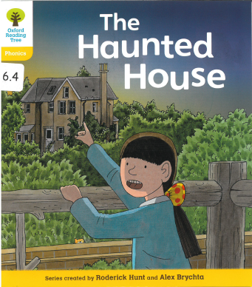
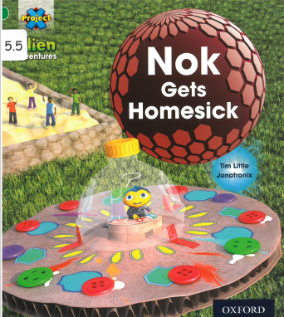

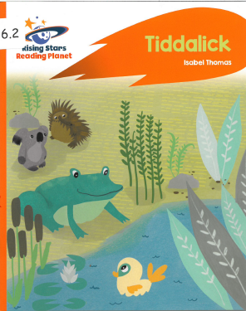
Our phonics books are labelled with the same numbers as our phases.
Because we have fine tuned the books to our phonics sequence, there are some parts with no books as yet. We are in touch with publishers to write some!

Slide 23
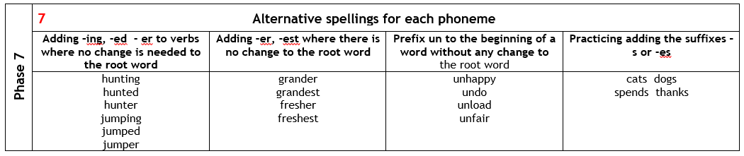
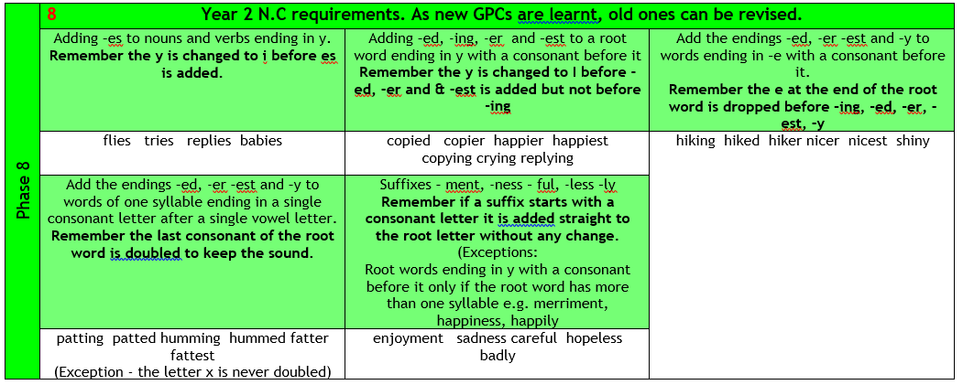
Beyond phonics.
Phase 7 & 8 focus on spelling & grammar
Notes:
Government guidelines

Slide 24

Learning to read
Children learn to read using phonics (their knowledge of our letters are put together to make sounds).
Children learn to read using other strategies.
The emphasis is on phonics.
What are the other strategies children use?

Slide 25
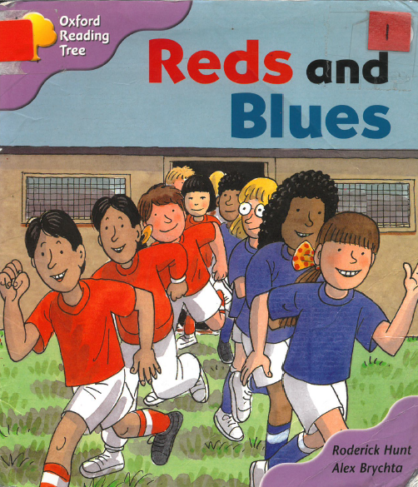

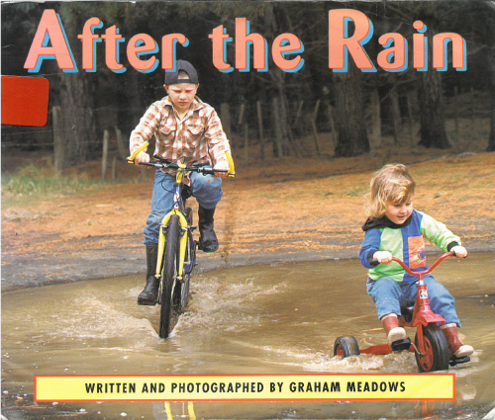
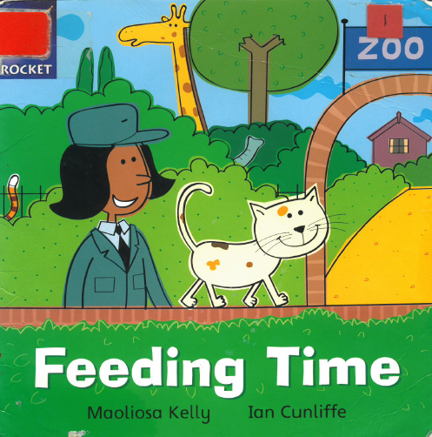
Strategies to Learn to Read
Making up stories using the pictures. A very important early step prior to reading.
Using their key word knowledge
Using the picture clues to help them read unfamiliar words.
Recognise where words or phrases are repeated…they get used to
the pattern of the book.
Notes:
Government guidelines

Slide 26
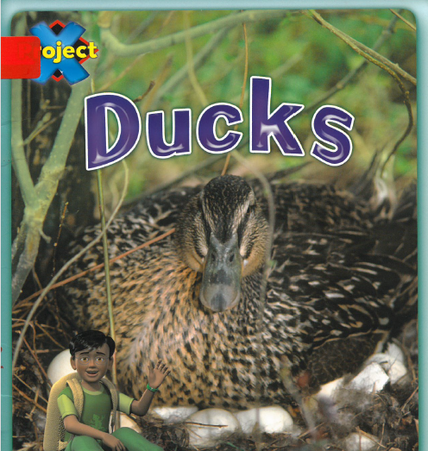
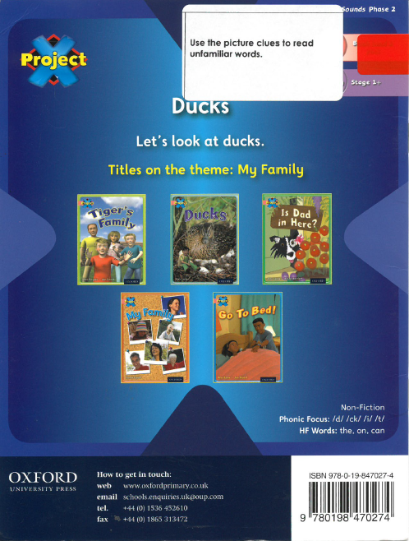
Strategies to Learn to Read
Books to practise all these other strategies have colour labels on them as previously.
We are slowly putting stickers on the back of
these books to explain which strategy they are
designed to practise.
Notes:
Government guidelines

Slide 27
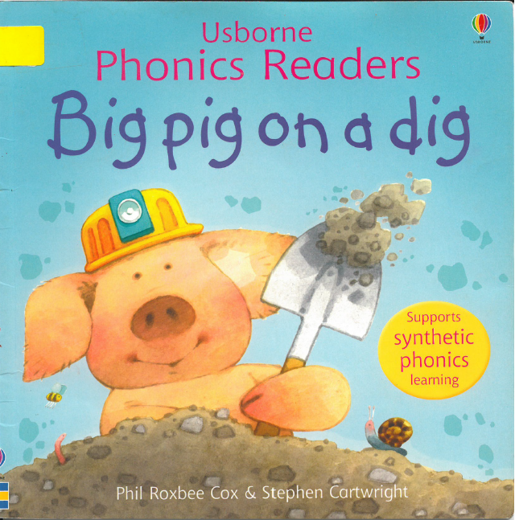
We have read every book to sort them, link them to phonics, attach keywords and a colour.

Slide 28
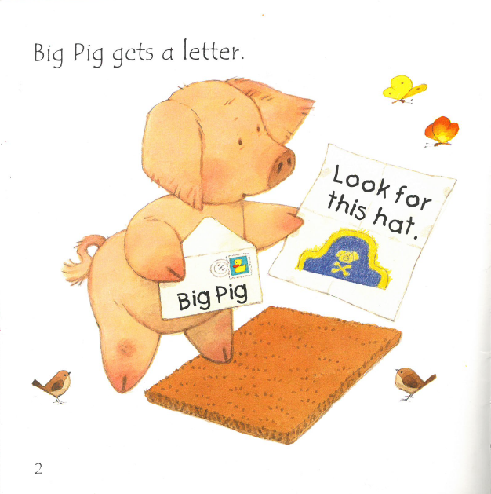

Slide 29
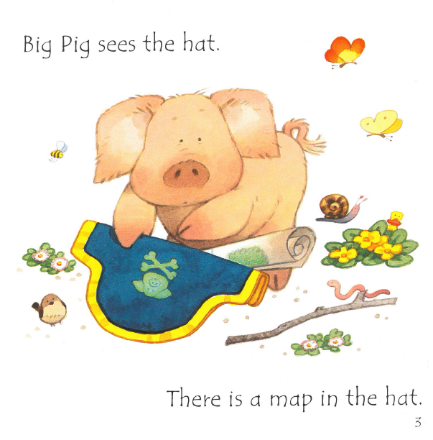

Slide 30
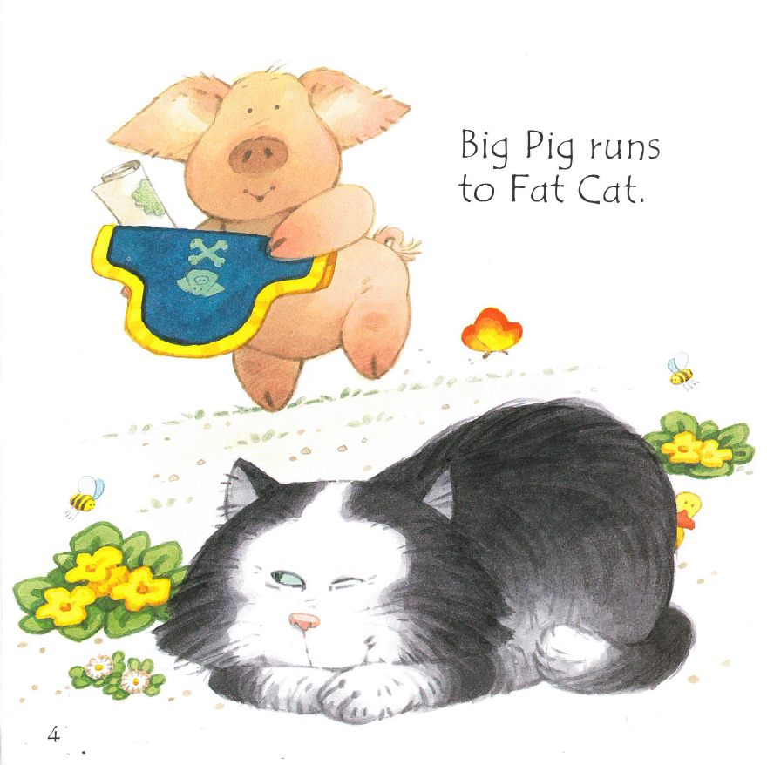

Slide 31
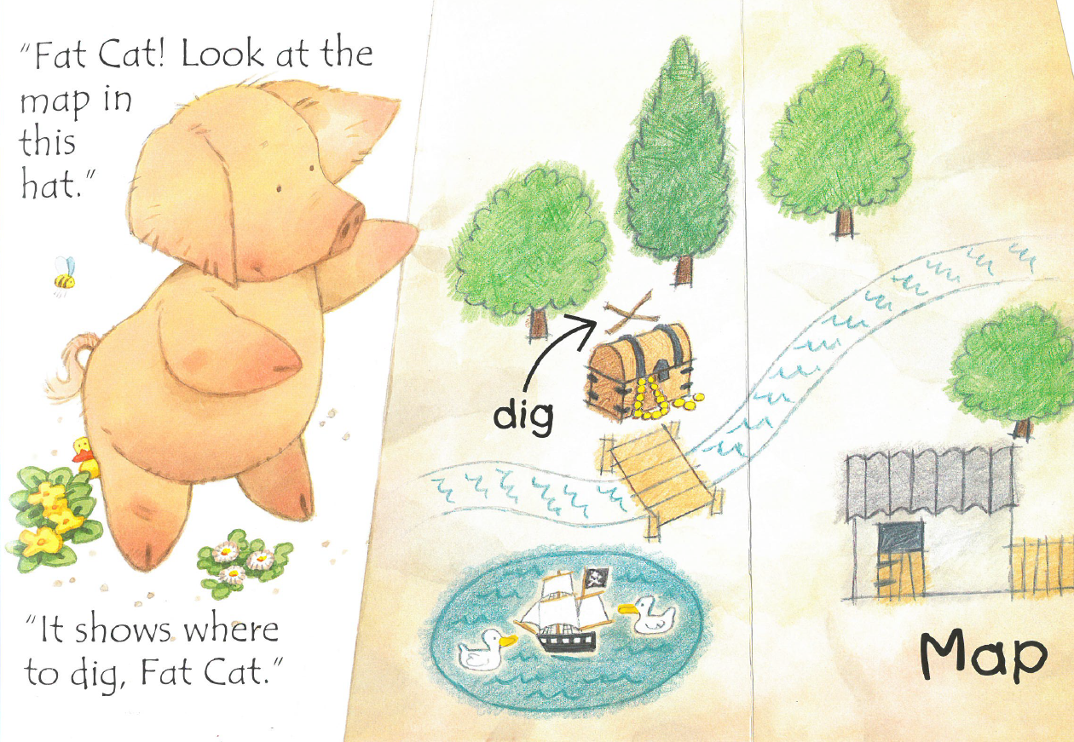

Slide 32
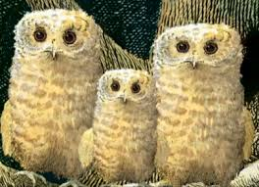
Learning to read
Children learn to read using phonics (their knowledge of our letters are put together to make sounds).
Children learn to read using other strategies.
The emphasis is on phonics.
Books with number are designed to help your child practise their phonic phase.
Colour books are designed to help your child practise other skills.

Slide 33

What to practise at home?
If possible practise reading for a short time every night.
Share a book at bedtime.
Practise their tricky words
Please jot down comments or questions in reading record books as it’s our way of knowing how reading is going at home.
Bring their reading bag each day so we can make sure their books match their phonic phases.
Phonics reading books can be changed within the
same number. Colour banded books can be changed
within the same colour.
Children can’t progress to the next phonics book until
they know all the keywords from the one they have read.

Slide 34
Thoughts or Questions
If you would like us to deliver workshops on any other areas of school….or more on reading, please just jot it on a post it note.
Also, let us know what time suits you best.
Thank you very much for your time.

